Slide 1
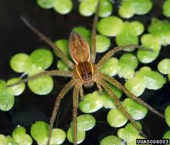
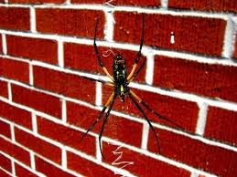
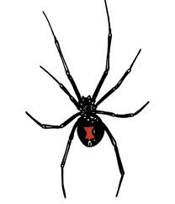
All about spiders
By lauren grey

Slide 2
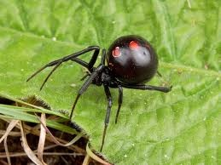
LEARN ABOUT SPIDERS
Most people are afrad
Off spiders.
BY LAUREN GREY
BY LAUREN GREY

Slide 3
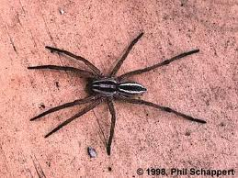
spiders
Some spiders are
Pouwsanes.

Slide 4
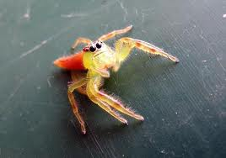
Spider are scarey
I like spiders.

