Slide 1
All about spiders
BY amel khader

Slide 2
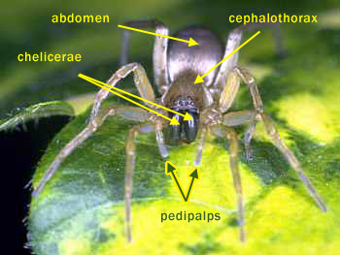
Sum spiders are brown .

Slide 3
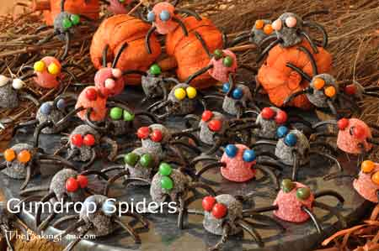
Spiders have 8 legs.

Slide 4
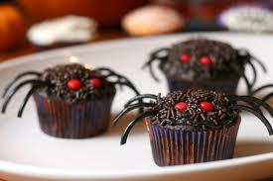
What do spiders do.

