Slide 1
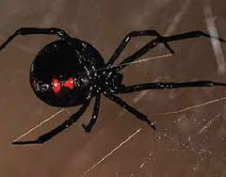
All about spiders
by Suhaib

Slide 2
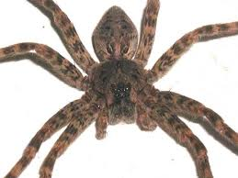
Woif spiders
Woif spiders have 4 eyes in a row.

Slide 3
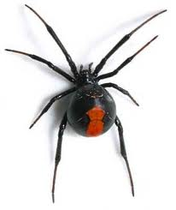
Black widow a black window poison is ten timses more powerful then the rattlesnakes bite.

Slide 4
giantwoodrspider
Spiders are arachnids, not insects.

Slide 5
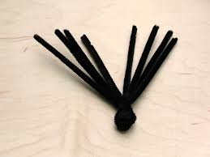
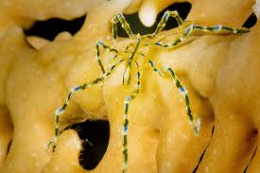
Sea spiders
Sea spider are loge and thin
The sea spider is light green
To yellow white wite a dark
Stirpeon the front of it,s bode.

Slide 6
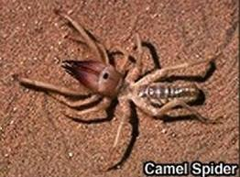
Camel spider
Spiders bloge to the arachnid family.

Slide 7
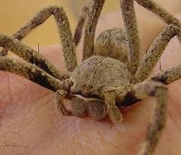
Rain spider spiders cannot chew or swallow.

Slide 8
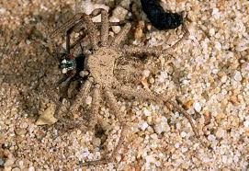
Sand spider
The largst spider in the world is the giant bird-eating
spider.

