Slide 1
All about butterflies
By: Alanna, jenesis, Franceska & Kayla

Slide 2
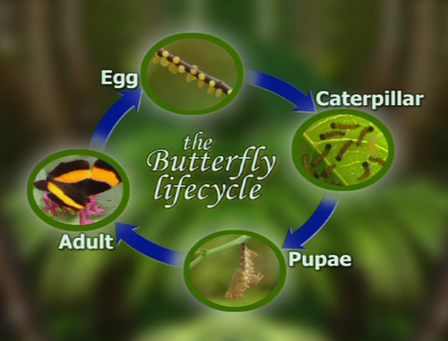
A life cycle of a butterfly

Slide 3
Facts about butterflies!

Slide 4
A fact is that a butterflies is that they have big eyes to see the color and the shape of flowers.
Butterflies may also have large spots on their wings that look like eyes!
One day the pupa splits and a butterfly crawls out.
The blue morpho butterfly likes to sip juice from fruit rotting on the rain forest floor.

