Slide 1
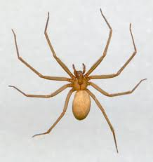
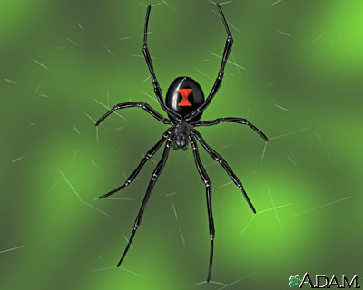
All about spider !
By: Caitlin

Slide 2
What are spider ?

Slide 3
Spider have 8 lags .

Slide 4
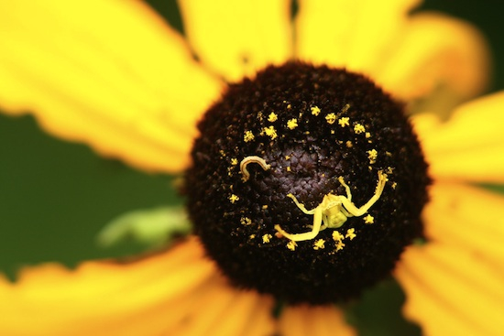
Spider are different colors .

