Slide 1
All about spiders
By Payton

Slide 2
Spiders are cool

Slide 3
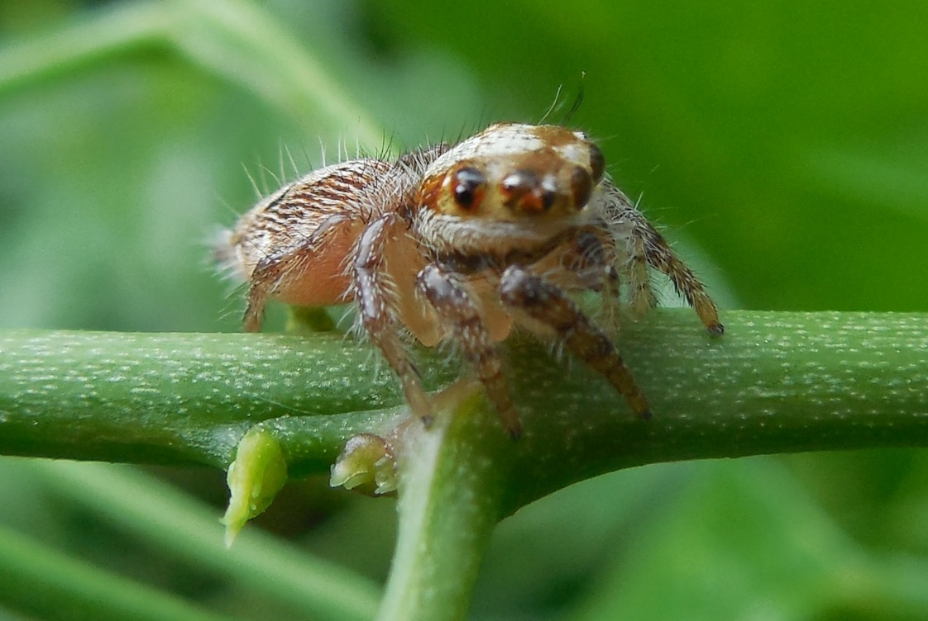
Spiders have 8 legs.

Slide 4
Spiders eat bugs and have 48 nees.

Slide 5
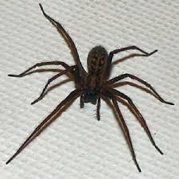
Spiders have a lot of babys.

Slide 6
Spiders can see at the drak

Slide 7
Spiders are osom.

