Slide 1
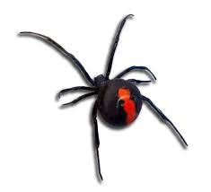
All about spiders
By katarina

Slide 2
Spiders are cool cretors

Slide 3
Spiders don’t have a sceloton

Slide 4
Some spiders have less than 8 eyes

Slide 5
Spiders have many hairs on there legs

Slide 6
All spiders have 8 legs

Slide 7
All spiders cant chew

Slide 8
Spiders have many predodors

Slide 9
Some spiders can spin webs
The end

