Slide 1
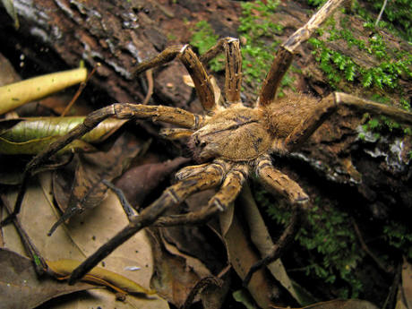
All about spiders
by dara omosaiye

Slide 2
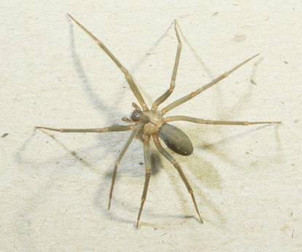
I hate spiders.
By dara

Slide 3
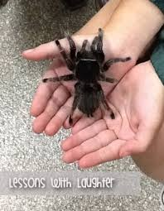
All spiders prdeis silck.

Slide 4
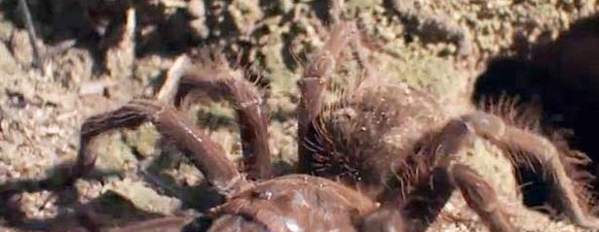
The second part of the body is a abdomen.

Slide 5
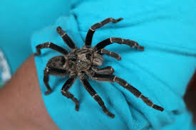
Spiders do not have skeletons.

Slide 6
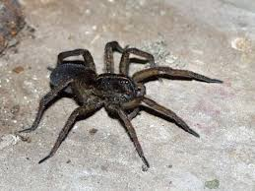
Spiders have babys.

Slide 7
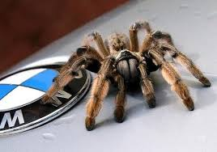
I do not like spiders.

