Slide 1
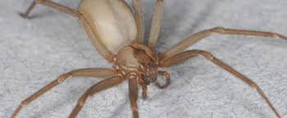
All about spiders
By shivani

Slide 2
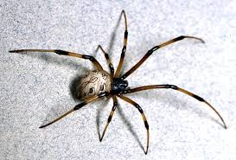
Most spiders have eight eyes

Slide 3
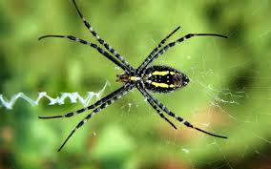
Men are smarter then mom spiders

Slide 4
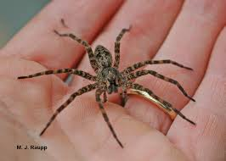
Spiders have 48 knees

Slide 5
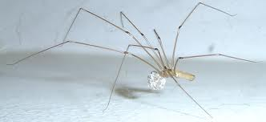
The spiders body has an oil on it to keep the spider from sticking to the web

Slide 6
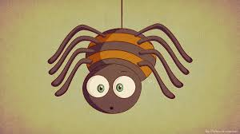
Spiders are the scarest animal ever

Slide 7
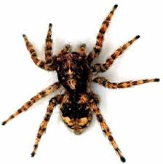
Spiders have two body segments

Slide 8
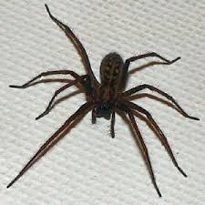
Mom spiders will not grow up

Slide 9
Spiders also have these tiny legish things called pedipals

Slide 10
can be any color

Slide 11
Spiders are really creepy

