Slide 1
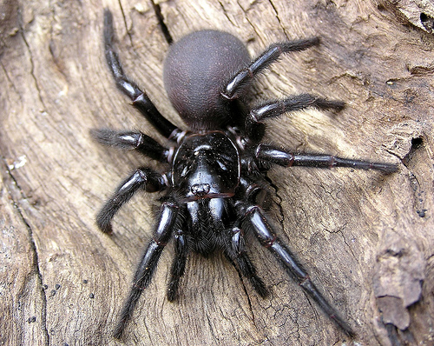
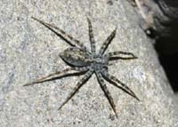
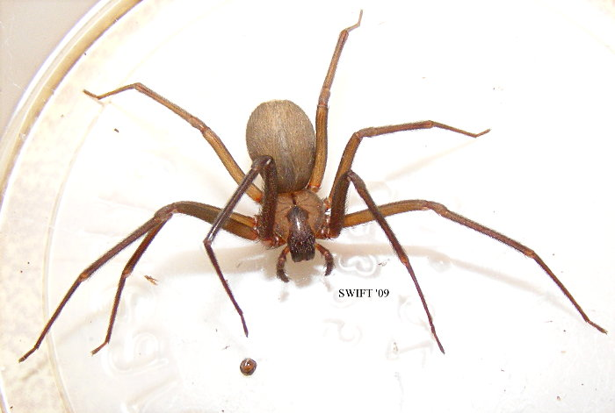
All about spooky spiders
by. Emma rose

Slide 2
Some people are scared of spiders.
Spider have 8 legs.

Slide 3
Some spiders are helpfle and some are not.

Slide 4
I DO Not Like spiders.

Slide 5
A lot of people are scaerd of
Spiders.
Sume spiders do not make webs

Slide 6
Sum spiders billd ther web wiith
Sillk.

