Slide 1
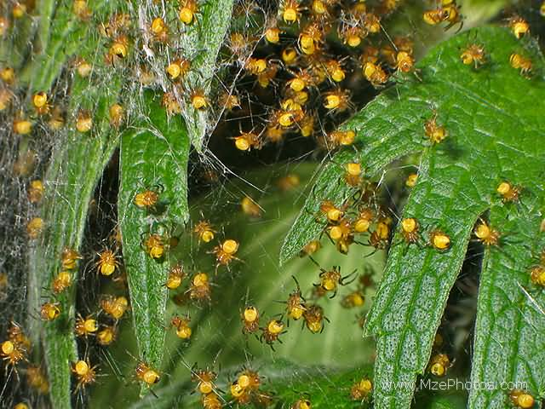
All about spiders
By Muskaan

Slide 2
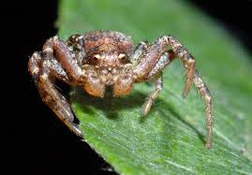
Spiders have eight legs.

Slide 3
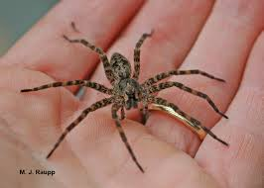
I like spiders they are cool and awsomesome.

Slide 4
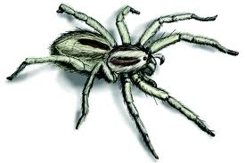
This is a spider I think that the white is a bone but it is not.

Slide 5
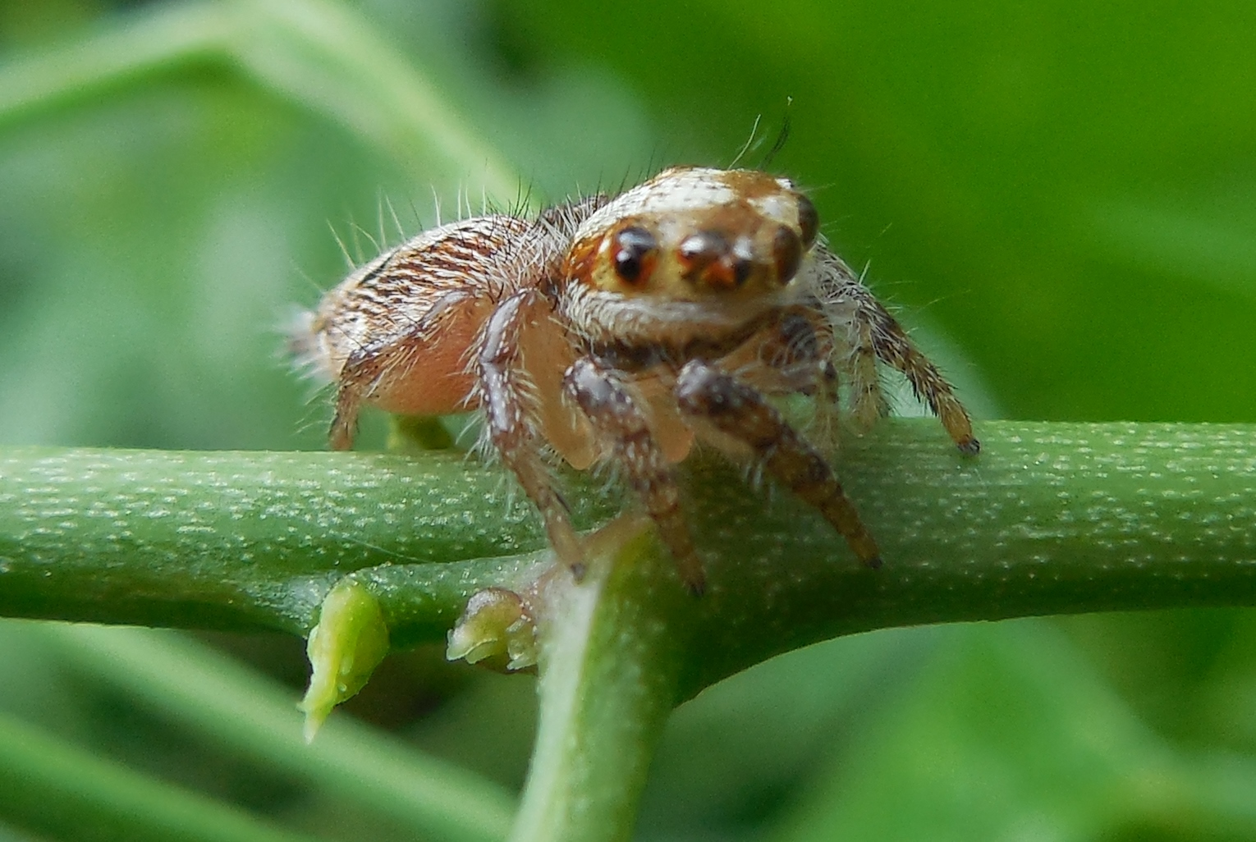
My naber likes erey thig.

Slide 6
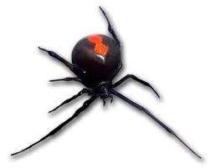
This blackvidospider has six legs.

Slide 7
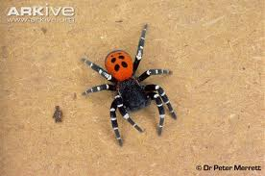
This iooks like a ladebugspider.

