Slide 1
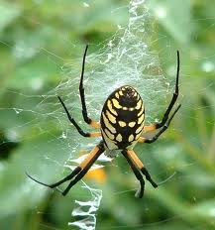
All about spiders.
By: Ashton

Slide 2
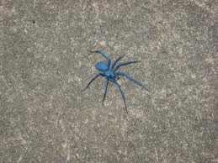
Sum spidrs are blue.

