Slide 1
Spiders can bit.

Slide 2
Spiders can diy.

Slide 3
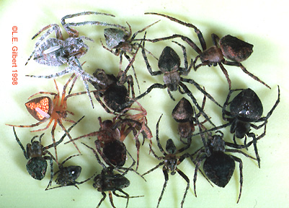
Spiders fit.

Slide 4
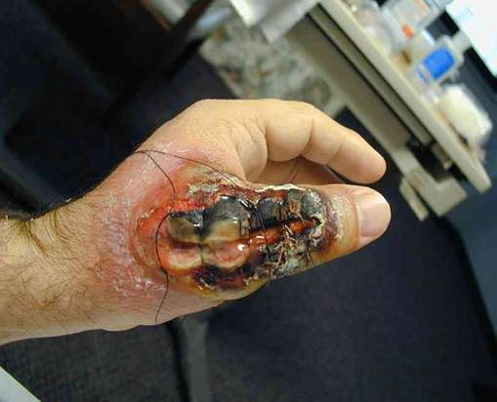
Spiders can bit.

Slide 5
Spiders sdand.

Slide 6
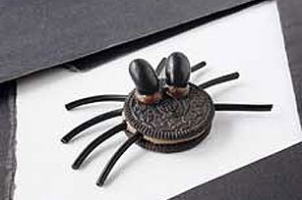
Spiders can be cocis.

Slide 7
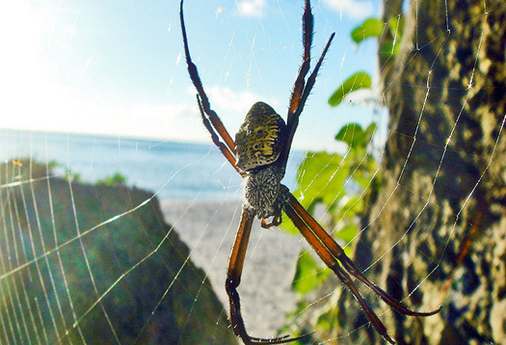
Spuiders can mac wabs

Slide 8
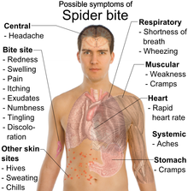
Spiders can bid hord.

Slide 9
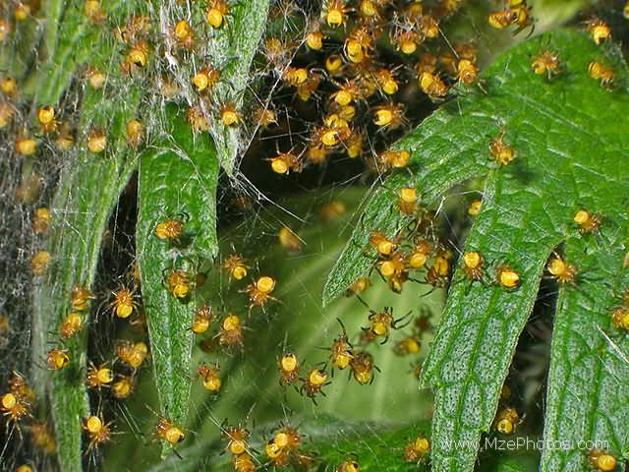
A lot ov spiders can bed.

Slide 10
Spiders can be beg.

Slide 11
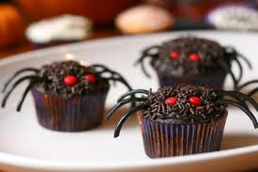

Slide 12
Spiders atace.

Slide 13
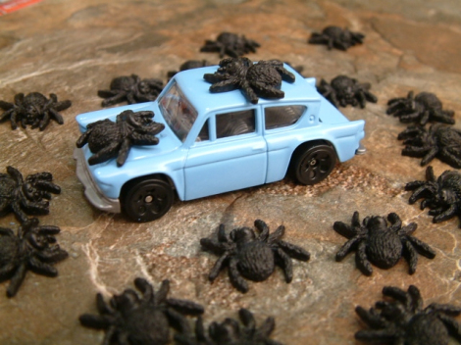
Spiers eat.

Slide 14
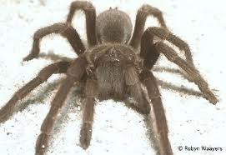
Spider can woc.

