Slide 1
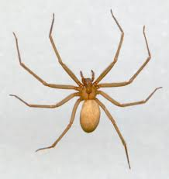
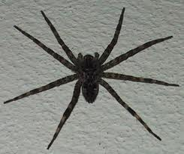
Cerepe Spatrs
Spiders have 8 Legs Insects hav 6 Legs
By:Ethan
s

Slide 2
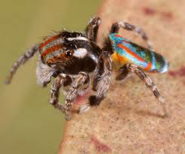
Culr Sbitres
Spiders make webs

Slide 3
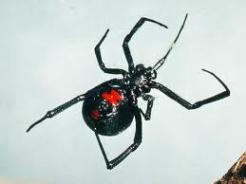
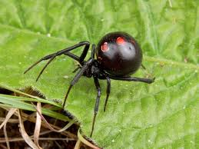
Poosin sartrs
Poosin
Spiders Bite

