Slide 1
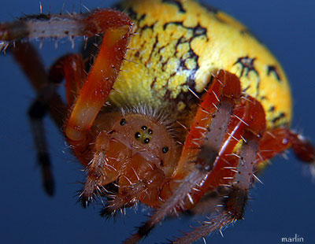
Creepy spiders
By: saatvik yamala

Slide 2
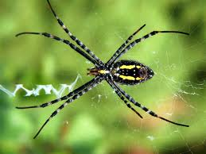
Sum spidrs are small.

Slide 3
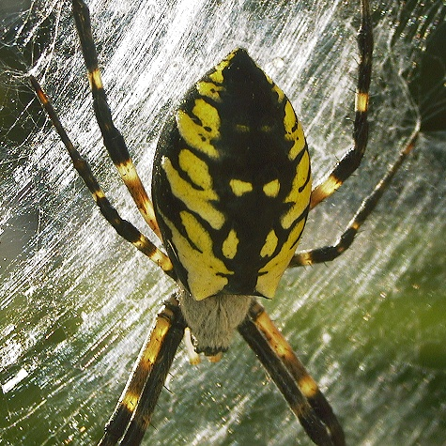
Sum spidrs are pozanis.

Slide 4
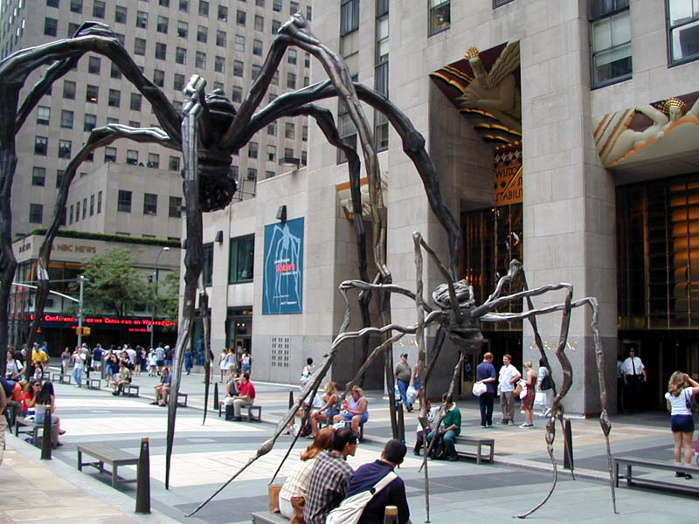
Sum spidrs are as big as a
Dinr pat.

Slide 5
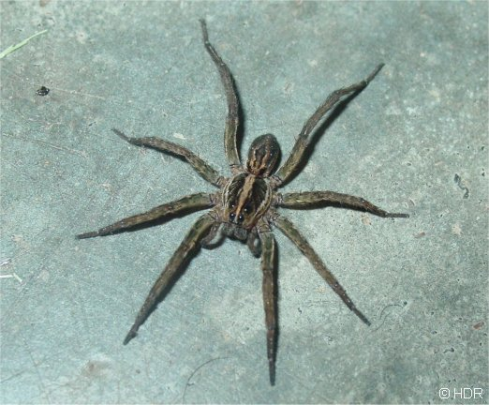
Sum spidrs have 4 eyes.

Slide 6
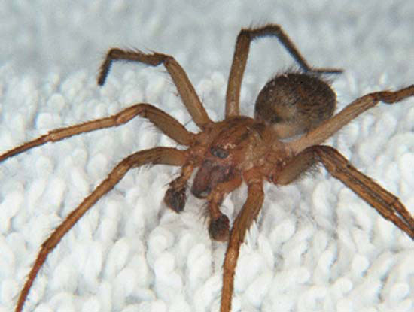
All spidrs have 2 ports of
Thear body.

