Slide 1
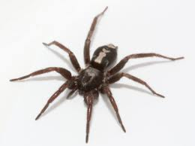
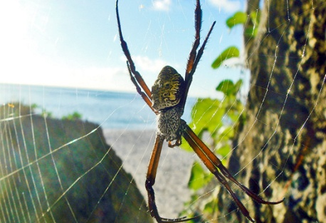
Creepy spider !
By: Joanna Lee

Slide 2
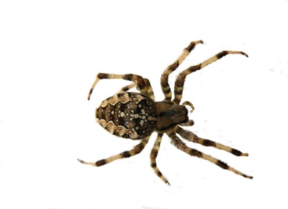
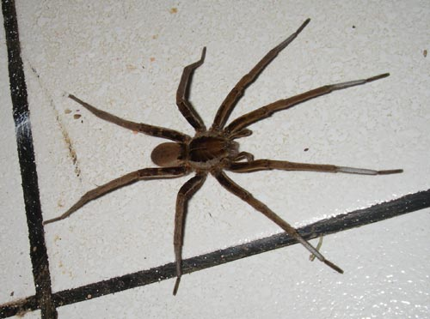
What are spiders ?
Spiders belong to the Arachnid family.

Slide 3
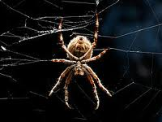
A Spiders body.
A spider has no backbone. Most spiders have six or eight eyes. Spiders can not chew. A spiders skeleton is outside of it`s body.

Slide 4
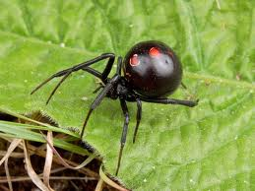
Poison Spiders
Most spiders poison will not harm people because it is quite weak.

