Slide 1
Relate Addition and Subtraction
Unit 1 Lesson 14

Slide 2
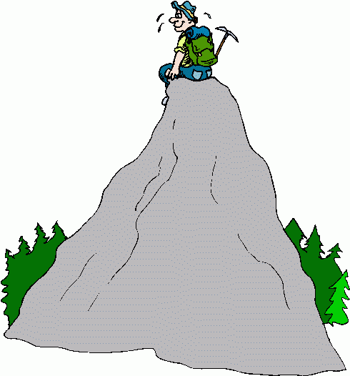
Math Mountains
6 + 4 = 10
partner partner total
Total
10 - 4 = 6
total partner partner
10
Partners
6
4
Partner
Partner
Notes:
Recommendations
You can make any necessary changes to the ppt to meet the specific needs of your students
Preview in presentation mode prior to using in your teaching– there is a lot animation! Animation goes along with either the introduction or review of math mountains in TE p. 96 Math Mountains
Teacher Edition: p. 96
Objective(s): 1.04a, 5.02
Miscellaneous Notes:
The image of the mountain appears after the formation of the math mountain in order to give those students a who don’t have the image of a mountain to make the connection or relationship between the two.
key vocabulary identified in this lesson: totals and partners are captured on this slide

Slide 3
Equal
Equation
Exactly the same amount or value
The process of
Notes:
Recommendations
You can make any necessary changes to the ppt to meet the specific needs of your students
Preview in presentation mode prior to using in your teaching– there is a lot animation! Animation goes along with introducing or reviewing “equation”
Teacher Edition: p. 96-97
Objective(s): 1.04
Miscellaneous Notes:
The key vocabulary that is being focused on is equation. However, the slide with animation builds a scaffold from equal to equation.
before showing the written definition see if students can come up with a class definition. Students can write the definition in their math journals
An equation says that two expressions are equal by the equal sign (=)

Slide 4
8
8
5
3
5
3
Addition equation
Jake had 5 books. Marvin gave him 3 more books.
How many does Jake have now?
Mystery addition equation
Jake had 8 books. He gave 5 of them away.
How many does Jake have now?
Unknown partner
Jake had 5 books. Marvin gave him some more books.
Now Jake has 8 books. How many books did Marvin give Jake?
Subtraction equation
Notes:
Recommendations
You can make any necessary changes to the ppt to meet the specific needs of your students
Preview in presentation mode prior to using in your teaching– there is a lot animation! Animation goes along with “Relate Math Mountains to Equations” on TE p.96
Teacher Edition: p. 96
Objective(s): 1.04, 1.04a, 5.02
Miscellaneous Notes:
Math Mountains represented on p. 96 are replicated on this slide. As you are discussing each type of equation: addition, mystery addition, subtraction and unknown partner with the students represent them on the slide with your SMART tools.
Next click for the first of three story problems to appear. Discuss and work on it. Then click for that one to disappear and the next one to appear. Continue with the third story problem.
MATH TALK: Click for the green circle to appear around the third math mountain that students have to write a story problem for

