Slide 1
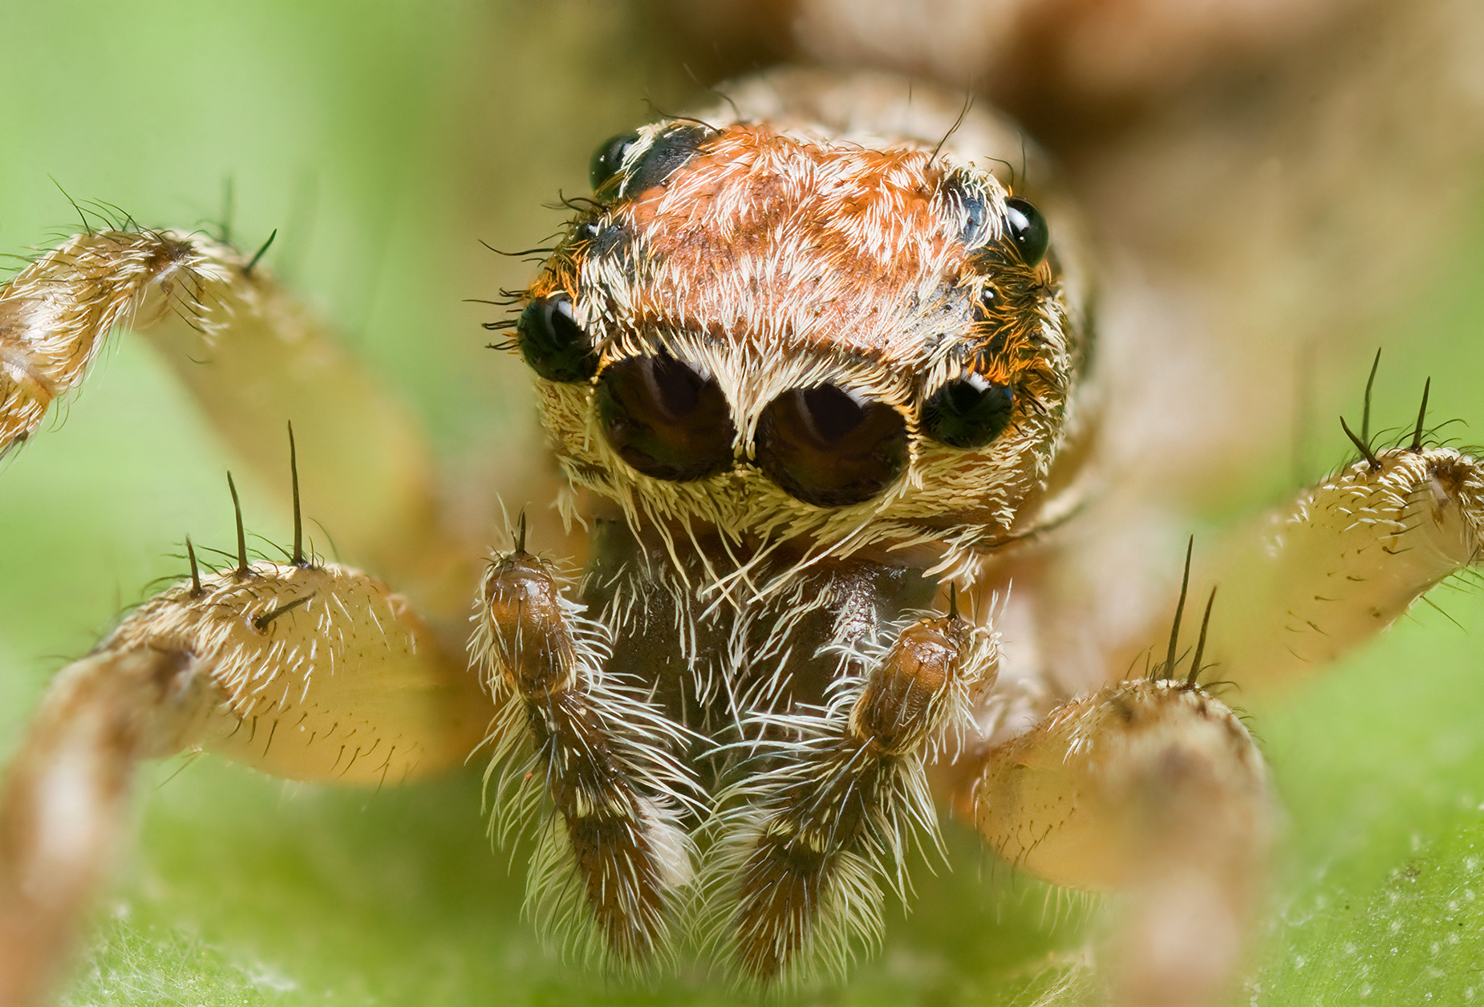
Pictures of spiders
By braxton

Slide 2
Spiders are so neet.

Slide 3
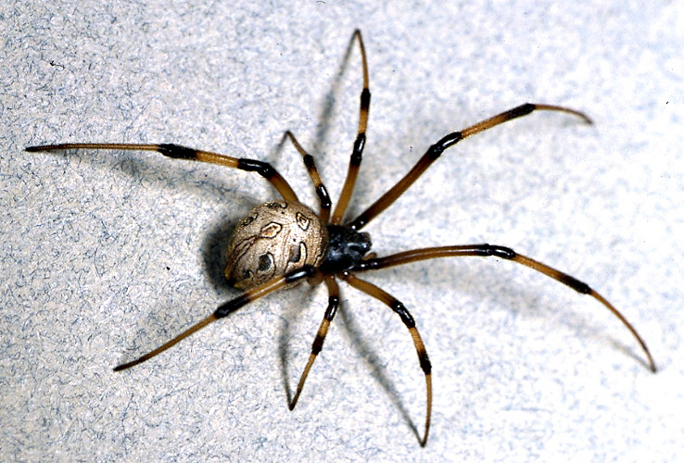
Spiders have two segments.

Slide 4
Blackwidows are the most poisous In north.

Slide 5
Black widows will lay up to 400 eggs steraing time.

Slide 6
daddy long legs have some poison in them but they can not bite you.

Slide 7
Spiders are the best.

