Slide 1
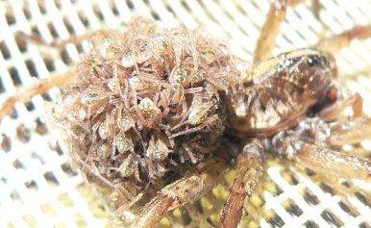
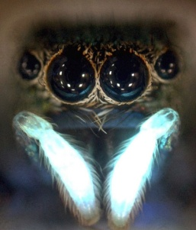
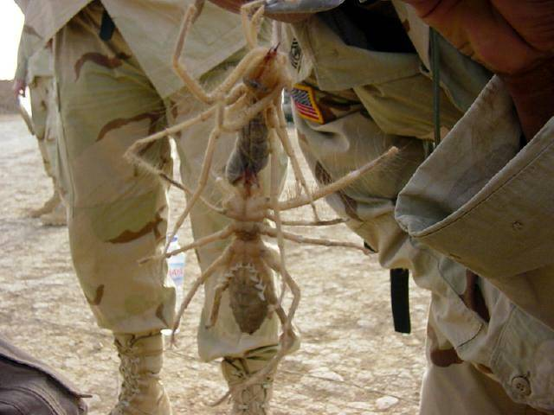
Spiders
By: Raghad

Slide 2
Spiders has 4 eyes.

Slide 3
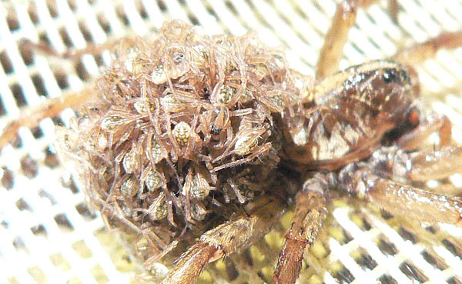
Some spiders like to eat insects.

Slide 4
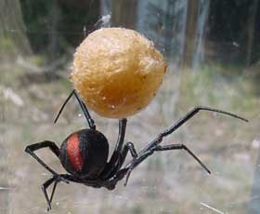
Spiders spins a web.

Slide 5
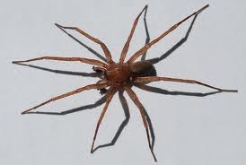
SPIDERS ARE BROWN AND BLACK.

Slide 6
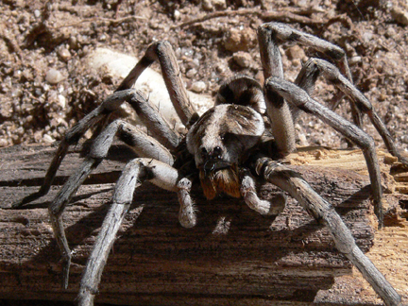
Spiders has 8 legs.

