Slide 1
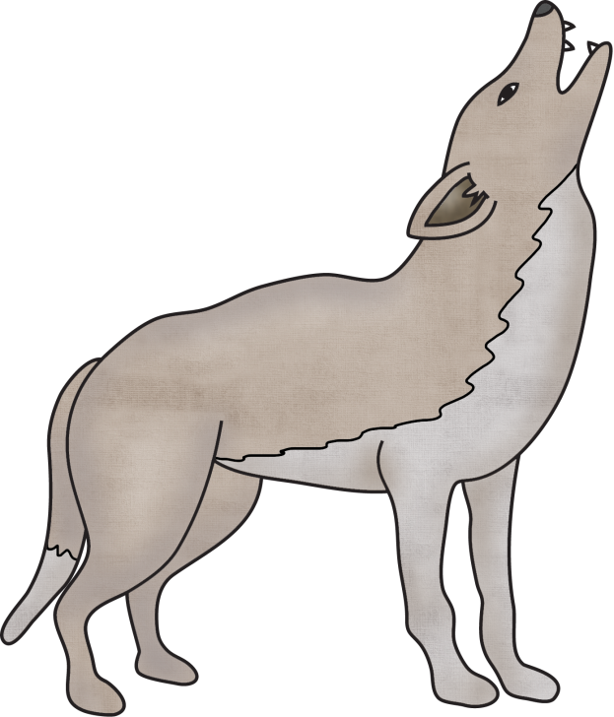
Title:
Table of Contents:
__________________...............Pg. 1
__________________...............Pg. 2
__________________...............Pg. 3
__________________...............Pg. 4
__________________...............Pg. 5
__________________...............Pg. 6
__________________...............Pg. 7
__________________...............Pg. 8
__________________...............Pg. 9
__________________.............Pg. 10
Researched By:
_________________

Slide 2
Know | Want to know ? | Learn

Slide 3
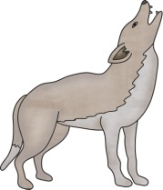
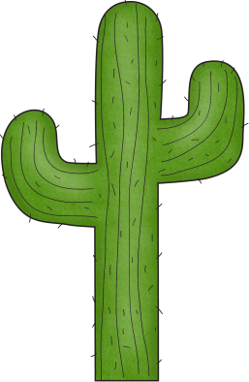
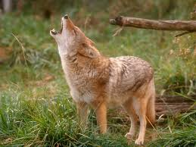
The Coyote
The Coyote
Coyotes are found mostly in North America in prairies, deserts, and forests.
Coyotes can grow to 3 to 7 feet long with a 16 inch tail. Coyotes can weigh up to 50 pounds. Coyotes can live for about 14 years.
Coyotes can adapt or easily change its behavior to survive in a new place. Coyotes can run 40 miles per hour. Coyotes are excellent hunters. They have terrific vision, a keen sense of smell, and good hearing. They live in family groups, and sometimes the pack cooperates to hunt down a large animal like a deer. At other times, coyotes hunt alone or in pairs.
You might have a pack of coyotes for neighbors, even if you live in a city! These wild dogs are very secretive, though. You may never see some, but you might hear them. At night, a coyote howls to say “I’m over here, where are you?” Coyotes yelp while playing, bark to say “stay away,” and make a huffing sound to call their pups.
Coyotes eat a wide variety of food including mice, lizards, insects, rabbits, fish, frogs, snakes, grasses, or nuts.
Since they are smart and eat many different foods, coyotes can always find something to eat. In some places, coyotes have learned that human’s garbage cans are an easy source of food. They are also attracted to backyards where pet food is left outside. Coyotes are predators—to them, a cat or dog is prey. In order to not get attacked by predators, coyotes often walk on their toes to make as little noise as possible.
Both males and females take care of the young. In spring, a litter of 3 to 12 pups is born in a den.
Coyotes are excellent swimmers. They have been able to colonize islands and escape from predators by swimming.

Slide 4
The Coyote
The Coyote
Coyotes are found mostly in North America in prairies, deserts, and forests.
Coyotes can grow to 3 to 7 feet long with a 16 inch tail. Coyotes can weigh up to 50 pounds. Coyotes can live for about 14 years.
Coyotes can run 40 miles per hour. Coyotes are excellent hunters. They can see, smell, and hear well. They live in family groups, called a pack, and they sometimes work together to hunt down a large animal like a deer. At other times, coyotes hunt alone or in pairs.
You might have a pack of coyotes for neighbors, even if you live in a city! These wild dogs are very sneaky, though. You may never see some, but you might hear them. Coyotes often walk on their toes to make no noise. At night, a coyote howls to say “I’m over here, where are you?” Coyotes yelp while playing, bark to say “stay away,” and make a huffing sound to call their pups.
Coyotes eat mice, lizards, insects, rabbits, fish, frogs, snakes, grasses, or nuts.
In some places, coyotes have learned that human’s garbage cans can be food. They also go to homes where pet food is left outside. Coyotes are predators—to them, a cat or dog is prey.
Both males and females take care of the young. In spring, a litter of 3 to 12 pups is born in a den.
Coyotes are excellent swimmers and use this skill to escape from predators.

Slide 5
The Coyote
The Coyote
Coyotes live in North America in prairies, deserts, and forests.
Coyotes are 3 to 7 feet long.
They have a 16 inch tail.
Coyotes weigh 50 pounds.
Coyotes can live for 14 years.
Coyotes can run 40 miles per hour.
They can see, smell, and hear well.
Their group is called a pack.
Coyotes often walk on their toes to make no noise.
Coyotes yelp, bark, and howl.
Coyotes eat mice, lizards, insects, rabbits, fish, frogs, snakes, grasses, or nuts.
They can eat a dog or cat.
Their babies are called pups.
Coyotes are good swimmers.

Slide 6
Diagram of the Coyote:

Slide 7
Coyotes
have
are
Can
_________________
_________________
_________________
_________________
_________________
_________________
_________________
_________________
_________________
_________________
_________________
_________________
_________________
_________________
_________________
_________________
_________________
_________________
_________________
_________________
_________________

Slide 8
Coyotes

Slide 9
Life Cycle of the Coyote:

Slide 10
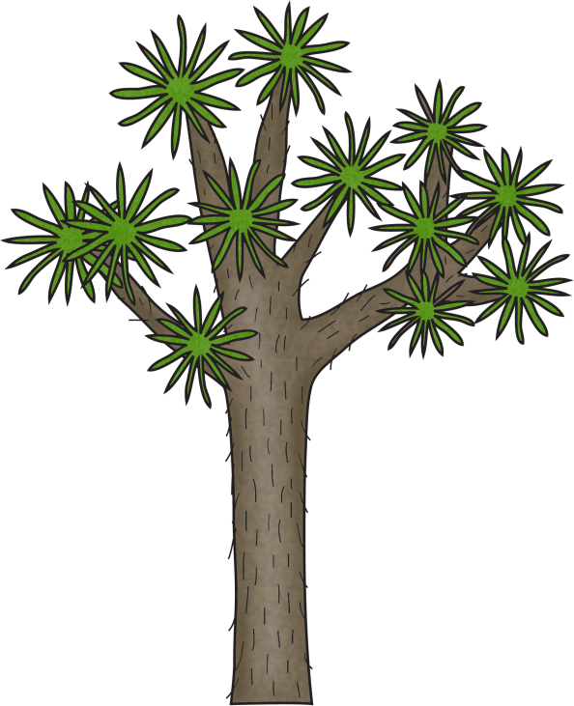
Coyotes:
Habitat:
Life Span:
Interesting Fact:
Diet:

Slide 11
Coyotes
3 things I learned:
2 interesting facts :
1 question :

Slide 12
Topic:
Fact 1:
Fact 2:
Fact 3:
Closing:

Slide 14
Habitat
Diet
Life Span

Slide 15
Adaptations
Size
Babies

Slide 16
Coyotes
Live__________________________________.
Have _________________________________.
Are __________________________________.
Can __________________________________.
Eat __________________________________.
Always _______________________________.
Never ________________________________.

Slide 17
Graph:
Photograph:
Question: ___________________________
___________________________
Yes No
14
13
12
11
10
9
8
7
Caption:
6
5
4
3
2
1

Slide 18
Coyote
____________
Both

Slide 19
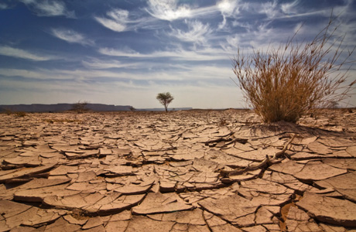
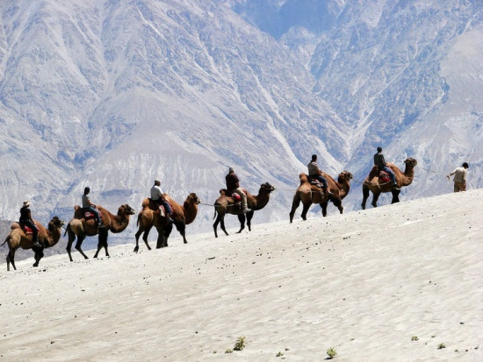
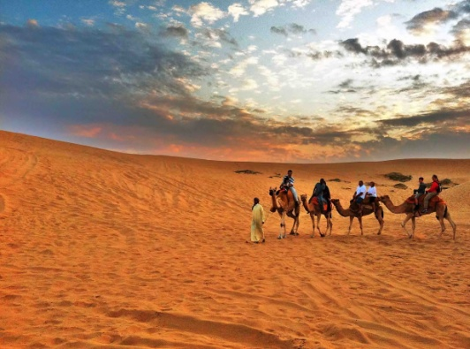
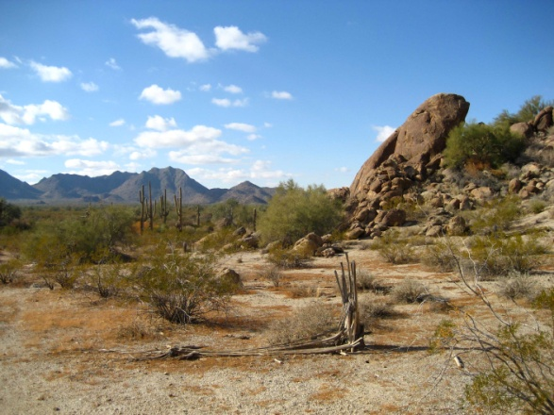
The Desert
HABITAT: The desert is important because it covers about a fifth of the earth's surface! There are both hot and cold deserts. Antarctica is the largest cold desert in the world, while the Sahara in Africa is the largest of the hot deserts. Another type of desert is the coastal desert, for example, the Atacama Desert in Chile of South America.
PLANTS: Deserts plants have many adaptations to survive in such a dry environment. They are good at storing and finding water. Some plants have seeds that can stay dormant in the sand for a long time, until there is enough rain for them to grow. In hot deserts, you'll often find Cacti. Cacti are great at storing water. With their waxy coating, water can't escape and their spines protect them from being desert dinner. Their roots are shallow, and widely spread so that any rain can be absorbed immediately! Some other plants you might find in the hot desert are creosote bush, sagebrush, and ocotillo. Coastal deserts house a variety of plants. These plants must adapt to minimal rainfall by having extensive root systems that come up to the surface to absorb any possible rainfall, and go far down to absorb any water saturated in the ground. These plants also have very thick leaves that can absorb and store water whenever it is available.
PEOPLE AND THIS BIOME: Often people visit to see the beautiful sand colors and rock formations. Many people enjoy visiting the desert because it is a quiet place to get away from the business and noise of cities and spend time in the open land. The desert offers many types of recreation, for example, rock climbing, hiking and dirt biking. Mining, grazing, road building, and utility projects take place in the desert.
WEATHER: Weather is not the same in all deserts. The seasons in hot and dry deserts are usually very hot during the summer and warm during the rest of the year. During winter these deserts get little rainfall. Rain is often light, or in short concentrated bursts. Most of the time evaporation rates are faster than rainfall rates. Sometimes the rain evaporates before even hitting the ground. This is the reason for the dry characteristic of this type of desert. Coastal deserts are in moderately cool to warm areas. Coastal deserts usually have cool winters followed by fairly long, warm summers.

Slide 20
The Desert
HABITAT: There are both hot and cold deserts. Antarctica is the largest cold desert in the world, while the Sahara in Africa is the largest of the hot deserts. Another type of desert is the coastal desert, that is near the ocean.
PLANTS: Deserts plants are good at storing and finding water. Some plants have seeds that can stay dormant in the sand for a long time, until there is enough rain for them to grow. In hot deserts, you'll often find Cacti. Cacti are great at storing water. With their waxy coating, water can't escape and their spines protect them from being desert dinner. Their roots are shallow, and widely spread so they can drink up the rain. Coastal deserts have plants that must survive on little rain by having long roots that come up to the surface and go far down in the ground to get as much water as it can. These plants also have very thick leaves that can absorb and store water.
PEOPLE AND THIS BIOME: People like to come to the desert to see the different colors of sand and rocks. The desert offers many types of recreation, for example, rock climbing, hiking and dirt biking. Mining, grazing, road building, and utility projects take place in the desert.
WEATHER: Weather is not the same in all deserts. The seasons in hot and dry deserts are usually very hot during the summer and warm during the rest of the year. During winter these deserts get little rainfall. Rain dries up quick sometimes before even hitting the ground. Coastal deserts have cool winters and long, warm summers.

Slide 21
The Desert

Slide 22
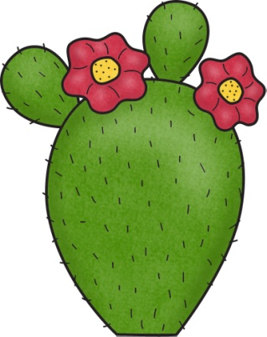
Desert

Slide 23
Diagram of the Desert Habitat:
Landform Labels:
Canyon, valley, plain, mountain, hill,
Caption:

Slide 24
The Desert Habitat
has
is
Can
_________________
_________________
_________________
_________________
_________________
_________________
_________________
_________________
_________________
_________________
_________________
_________________
_________________
_________________
_________________
_________________
_________________
_________________
_________________
_________________
_________________

Slide 25
Desert Habitat
________ Habitat
Both:

Slide 26
If I Went to the Desert,
I would pack:
Because…
__________________________________________
__________________________________________
__________________________________________
__________________________________________
__________________________________________
__________________________________________
__________________________________________
__________________________________________

Slide 27
I wonder….
?
?
?
?

Slide 28
Diary of an Desert Animal
Dear Diary,
______________________________________________________________________
______________________________________________________________________
______________________________________________________________________
______________________________________________________________________
______________________________________________________________________
______________________________________________________________________
______________________________________________________________________
______________________________________________________________________
Sincerely, _________________

Slide 29
My Coyote Adventure Story!
______________________________________________________________________
______________________________________________________________________
______________________________________________________________________
______________________________________________________________________
______________________________________________________________________
______________________________________________________________________
______________________________________________________________________
______________________________________________________________________
______________________________________________________________________
______________________________________________________________________

Slide 30
Glossary:
Glossary:
_______________
_______________
_______________
_______________
___________________________
___________________________
_______________
_______________
_______________
_______________
___________________________
___________________________
_______________
_______________
_______________
_______________
___________________________
___________________________

Slide 31
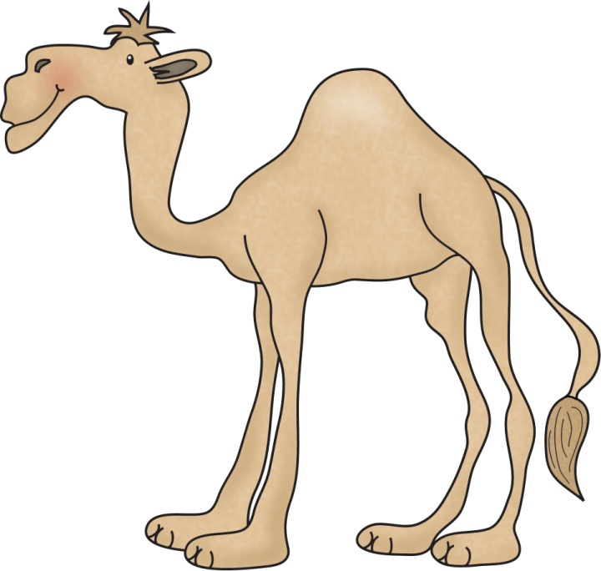
Title:
Table of Contents:
__________________...............Pg. 1
__________________...............Pg. 2
__________________...............Pg. 3
__________________...............Pg. 4
__________________...............Pg. 5
__________________...............Pg. 6
__________________...............Pg. 7
__________________...............Pg. 8
__________________...............Pg. 9
__________________.............Pg. 10
Researched By:
_________________

Slide 32
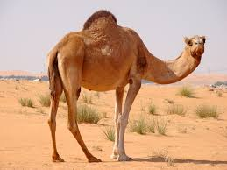
The Camel
The Camel
There are different types of camels. The one-humped camel is called the dromedary camel. The two-humped camel is called the Bactrian camel. They live in different parts of the world.
The camel is about 5 to 7 feet tall and can be 7 to 11 feet long. They usually weigh 660 to 1,520 pounds. Camels can live to be 80 years old.
Camels have humps on their bodies. The hump stores fatty tissue. The tissue acts as a source of energy. They can go up to 6 months without food. When a camel uses the fat stored in its humps for energy, the humps start to get smaller and deflate. The humps grow again when the camel rehydrates. They can rehydrate faster than any other mammal, able to drink about 30 gallons (113 liters) of water in just 13 minutes.
Camels have adapted to the hot, dry desert climate. Their thick coat reflects sunlight which helps keep it from overheating. Long legs help to keep their bodies farther away from the hot ground. When camels walk they move both legs on one side of their body and then the other.
The bottom of a camels hooves are large and flat to help from sinking in the sand. Camels are powerful runners.
Camels are known for spitting on people. In fact, the animals are throwing up the contents of their stomach along with spit. This is a defense tactic when the animals feel threatened.
The large beasts make a variety of moans, groans and deep, throaty bellows. One of the camel's noises was even used to voice the character Chewbacca in the Star Wars movies.
Camels are herbivores and eat desert plants. Camels have very thick lips allowing them to eat even very salty, bitter or thorny plants. If hungry, camels can even eat leather shoes.
Many people use camels for transportation. They can carry over 200 pounds for 20 miles in the desert heat.

Slide 33
The Camel
The Camel
There are different types of camels. The one-humped camel is called the dromedary camel. The two-humped camel is called the Bactrian camel. They live in different parts of the world.
The camel is about 5 to 7 feet tall and can be 7 to 11 feet long. They usually weigh 660 to 1,520 pounds. Camels can live to be 80 years old.
Camels have humps on their bodies. The hump stores fat that gives them energy. They can go up to 6 months without food. When a camel uses the fat, the humps start to get smaller. The humps grow again when the camel gets more water. They can drink about 30 gallons of water in just 13 minutes.
Their thick coat reflects sunlight which helps keep it from getting hot. Long legs help to keep their bodies farther away from the hot ground. When camels walk they move both legs on one side of their body and then the other.
The bottom of a camels hooves are large and flat to help from sinking in the sand. Camels are strong runners.
Camels are known for spitting on people or other animals when they are scared.
They make a variety of moans and groans.
Camels are herbivores and eat desert plants. Camels have very thick lips allowing them to eat even very salty, bitter or thorny plants. If hungry, camels can even eat leather shoes.
Many people use camels for transportation. They can carry over 200 pounds for 20 miles in the desert heat.

Slide 34
The Camel
The Camel
Some camels have 1 hump and some have 2 humps.
The camel is 5 to 7 feet tall and can be 7 to 11 feet long.
They weigh 660 to 1,520 pounds.
Camels can live to be 80 years old.
The hump stores fat that gives them energy.
They can go up to 6 months without food.
Their humps can get big or get small.
They have long legs and a lot of hair.
They have big flat hooves.
Camels spit when they are scared.
They make a lot of sounds.
Camels eat desert plants.
Camels have thick lips.
People ride on camels.

Slide 35
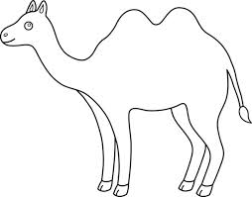
Diagram of the Coyote:

Slide 36
Camels
have
are
Can
_________________
_________________
_________________
_________________
_________________
_________________
_________________
_________________
_________________
_________________
_________________
_________________
_________________
_________________
_________________
_________________
_________________
_________________
_________________
_________________
_________________

Slide 37
Camels

Slide 38
Life Cycle of the Camel:

Slide 39
Camels:
Habitat:
Life Span:
Interesting Fact:
Diet:

Slide 40
Camels
3 things I learned:
2 interesting facts :
1 question :

Slide 41
Camels
Live__________________________________.
Have _________________________________.
Are __________________________________.
Can __________________________________.
Eat __________________________________.
Always _______________________________.
Never ________________________________.

Slide 42
Camel
____________
Both

Slide 43
My Camel Adventure Story!
______________________________________________________________________
______________________________________________________________________
______________________________________________________________________
______________________________________________________________________
______________________________________________________________________
______________________________________________________________________
______________________________________________________________________
______________________________________________________________________
______________________________________________________________________
______________________________________________________________________

Slide 44
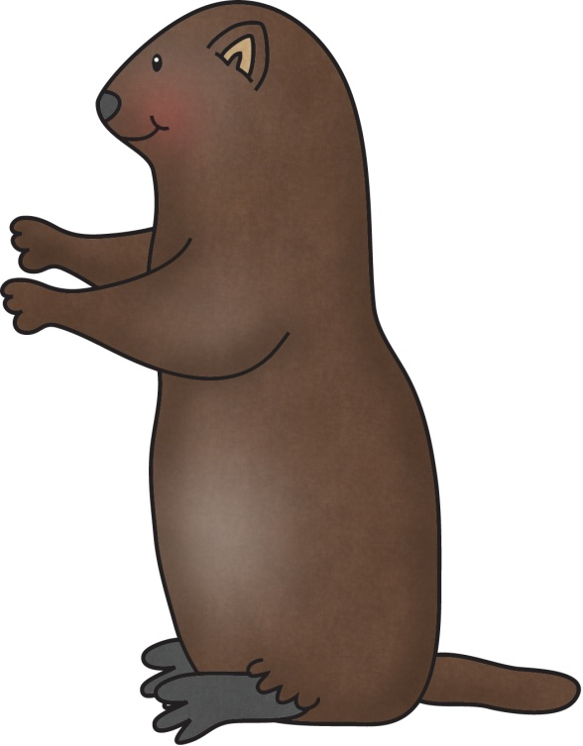
Title:
Table of Contents:
__________________...............Pg. 1
__________________...............Pg. 2
__________________...............Pg. 3
__________________...............Pg. 4
__________________...............Pg. 5
__________________...............Pg. 6
__________________...............Pg. 7
__________________...............Pg. 8
__________________...............Pg. 9
__________________.............Pg. 10
Researched By:
_________________

Slide 45
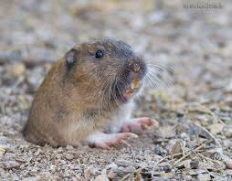
The Gopher
The Gopher
The pocket gopher is a type of gopher that lives in the desert. These animals are rarely seen because they live underground in tunnels. Gophers are known for building complex underground tunnel systems. They use their front legs and long teeth to push dirt out of their tunnels and onto the grass above. Gophers like to be alone and only one gopher will be found in a tunnel system.
The pocket gopher can grow to be 5-10 inches tall and weigh 6 to 8 ounces. It has very small ears and eyes, a short tail, and large forelimbs with long claws. The gopher can be pale gray or white to almost black.
Gophers have very long teeth that constantly grow. They are trimmed by gnawing (chewing).
The gopher is a true hoarding mammal as the gopher stores the food that the gopher finds in its cheek pouches before taking the food back to the gopher burrow, where the gophers are known to collect astonishing amounts of food. Gophers eat roots, grasses, green plants, and prickly pears.
The gopher however, has a number of natural predators mainly because of the size and abundance of the gopher in certain areas. The natural predators of the gopher include large birds, badgers, humans, and coyotes.

Slide 46
The Gopher
The Gopher
The pocket gopher is a type of gopher that lives in the desert. These animals are rarely seen because they live underground in tunnels. Gophers are known for building underground tunnel systems. They use their front legs and long teeth to push dirt out of their tunnels and onto the grass above. Gophers like to be alone and only one gopher will be found in a tunnel system.
The pocket gopher can grow to be 5-10 inches tall and weigh 6 to 8 ounces. It has very small ears and eyes, a short tail, and large legs with long claws. The gopher can be pale gray or white to almost black.
Gophers have very long teeth that always grow. They are trimmed by gnawing (chewing).
The gopher stores the food in its cheek pouches before taking the food back to their burrow. Gophers eat roots, grasses, green plants, and prickly pears.
The natural predators of the gopher include large birds, badgers, humans, and coyotes.

Slide 47
The Gopher
The Gopher
The pocket gopher lives in the desert.
They live in a tunnel.
They use their front legs and long teeth to push dirt out of their tunnels.
Gophers like to be alone.
The pocket gopher is 5 to 10 inches tall.
It weighs 6 to 8 ounces.
It has very small ears and eyes.
It has a short tail and big legs with long claws.
The gopher can be pale gray or white to almost black.
Gophers teeth always grow.
The gopher puts food in its cheek
Gophers eat roots, grasses, green plants, and prickly pears.
Big birds, badgers, humans, and coyotes

Slide 48
Diagram of the Gopher:

Slide 49
Gophers
have
are
Can
_________________
_________________
_________________
_________________
_________________
_________________
_________________
_________________
_________________
_________________
_________________
_________________
_________________
_________________
_________________
_________________
_________________
_________________
_________________
_________________
_________________

Slide 50
Gophers

Slide 51
Life Cycle of the Gopher:

Slide 52
Gophers:
Habitat:
Life Span:
Interesting Fact:
Diet:

Slide 53
Gophers
3 things I learned:
2 interesting facts :
1 question :

Slide 54
Gophers
Live__________________________________.
Have _________________________________.
Are __________________________________.
Can __________________________________.
Eat __________________________________.
Always _______________________________.
Never ________________________________.

Slide 55
Gopher
____________
Both

Slide 56
My Gopher Adventure Story!
______________________________________________________________________
______________________________________________________________________
______________________________________________________________________
______________________________________________________________________
______________________________________________________________________
______________________________________________________________________
______________________________________________________________________
______________________________________________________________________
______________________________________________________________________
______________________________________________________________________

Slide 57
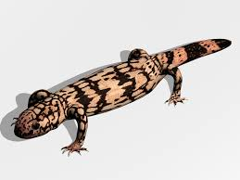
Title:
Table of Contents:
__________________...............Pg. 1
__________________...............Pg. 2
__________________...............Pg. 3
__________________...............Pg. 4
__________________...............Pg. 5
__________________...............Pg. 6
__________________...............Pg. 7
__________________...............Pg. 8
__________________...............Pg. 9
__________________.............Pg. 10
Researched By:
_________________

Slide 58
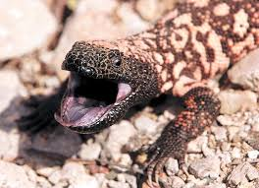
The Gila Monster
The Gila Monster
The Gila Monster is a poisonous lizard. The Gila Monster is the largest lizard native to the United States. They live in dry regions like deserts. Some deserts they live in include the Mojave, Sonoran, and Chihuahuan deserts of the southwestern U.S. and northwestern Mexico.
The Gila Monster measures up to 2 feet long and weighs over 5 pounds. The Gila Monster can live to be 20-30 years old.
They have black bodies that are covered in bead-like scales with bright spots, blotches, or bands of pink, orange, or yellow. They have bulky bodies, a slow-moving stride, a thick forked tongue, and snorting hisses.
They feed primarily on eggs from bird nests and some newborn mammals. They spend about 95 percent of their time underground and emerge only to hunt for food.
They don’t need to eat very often because they can store fat in their large tails. They can go months and even a year between meals!
Gila monsters are more likely to use their venom on a predator. They clamp their jaws and the venom in their bottom jaw flows through their grooved teeth. The Gila’s bite is very painful.
They are usually seen during March through June and not in the colder winter months.

Slide 59
The Gila Monster
The Gila Monster
The Gila Monster is a poisonous lizard. The Gila Monster is the largest lizard in the United States. They live in dry deserts. Some deserts they live in include the Mojave, Sonoran, and Chihuahuan deserts of the southwestern U.S. and northwestern Mexico.
The Gila Monster can be up to 2 feet long and weighs over 5 pounds. The Gila Monster can live to be 20-30 years old.
They have black bodies that are covered in bead-like scales with bright spots of pink, orange, or yellow. They have wide bodies, a slow walk, a thick forked tongue, and snorting hisses.
They feed on eggs from bird nests and some newborn mammals. They spend about 95 percent of their time underground and come out only to hunt for food. They don’t need to eat very often because they can store fat in their large tails. They can go months and even a year between meals!
Gila monsters are more likely to use their venom on a predator. They clamp their jaws and the venom in their bottom jaw comes out of their grooved teeth. The Gila’s bite is very painful.
They are seen in the warmer months.

Slide 60
The Gila Monster
The Gila Monster
They live in the Mojave, Sonoran, and Chihuahuan deserts.
The Gila Monster is 2 feet long and weighs over 5 pounds.
The Gila Monster can live to be 20-30 years old.
They have black bodies with spots of pink, orange, or yellow.
They have bumpy skin.
They have a wide body.
They walk slow.
They have a thick forked tongue.
They make snorting hisses.
They eat eggs and newborn mammals.
They live under the dirt. They come out for food.
They can go 1 year without food. They store fat in their tail.
They have poison in their bite. It hurts!
They are seen when it is warm.

Slide 61
Diagram of the Gila Monster:

Slide 62
Gila Monsters
have
are
Can
_________________
_________________
_________________
_________________
_________________
_________________
_________________
_________________
_________________
_________________
_________________
_________________
_________________
_________________
_________________
_________________
_________________
_________________
_________________
_________________
_________________

Slide 63
Gila
Monsters

Slide 64
Life Cycle of the Gila Monster:

Slide 65
Gila Monsters:
Habitat:
Life Span:
Interesting Fact:
Diet:

Slide 66
Gila Monsters
3 things I learned:
2 interesting facts :
1 question :

Slide 67
Gila Monsters
Live__________________________________.
Have _________________________________.
Are __________________________________.
Can __________________________________.
Eat __________________________________.
Always _______________________________.
Never ________________________________.

Slide 68
Gila Monster
____________
Both

Slide 69
My Gila Monster Adventure Story!
______________________________________________________________________
______________________________________________________________________
______________________________________________________________________
______________________________________________________________________
______________________________________________________________________
______________________________________________________________________
______________________________________________________________________
______________________________________________________________________
______________________________________________________________________
______________________________________________________________________

Slide 70
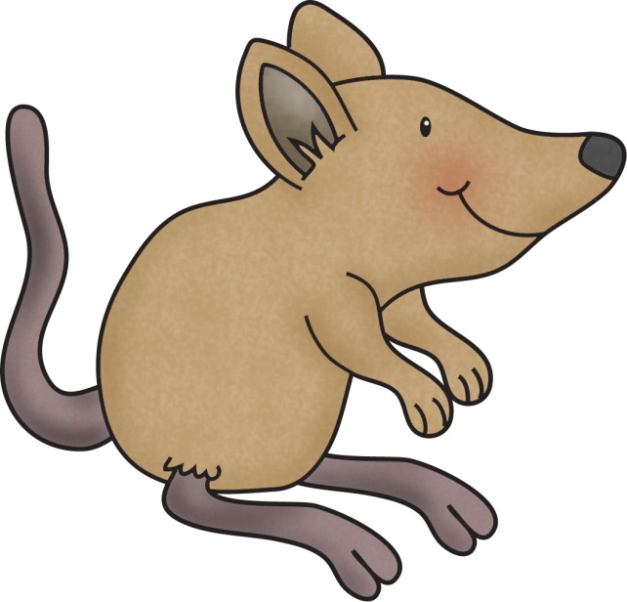
Title:
Table of Contents:
__________________...............Pg. 1
__________________...............Pg. 2
__________________...............Pg. 3
__________________...............Pg. 4
__________________...............Pg. 5
__________________...............Pg. 6
__________________...............Pg. 7
__________________...............Pg. 8
__________________...............Pg. 9
__________________.............Pg. 10
Researched By:
_________________

Slide 71
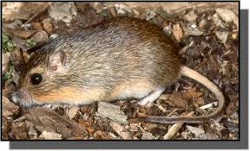
The Desert Mouse
The Desert Mouse
The desert pocket mouse lives in desert regions. Common desert pocket mouse habitats include dry stream beds, desert washes or arroyos.
The desert pocket mouse is about 7 inches long. More than half of that length is its tail. It can weigh about half an ounce or less. The desert pocket mouse usually lives about a year.
The desert pocket mouse is a granivore (eats seeds). The desert pocket mouse eats seeds and sometimes small insects. The mouse has cheek pouches to store seed in and it also builds burrows to store seeds. Interestingly, there's no evidence a desert pocket mouse drinks water. It seems to extract as much water as it needs from the seeds it eats. This helps it to live in an arid desert climate. The mouse has sharp front teeth to help it dig in the dirt for seeds.
The desert pocket mouse is nocturnal. He hunts for seeds in the dark but has to be careful of predators like the owl.
The desert pocket mouse has buff to brownish, coarse fur, and a white underside. The tufted tail is long, and has a crest of fur forming a ridge along its length.
A baby of a desert pocket mouse is called a 'pinkie, kitten or pup'. The females are called 'doe' and males 'buck'. A desert pocket mouse group is called a 'nest.
These animals are solitary (live alone) and defend small territories, often fighting when they encounter each other.

Slide 72
The Desert Mouse
The Desert Mouse
The desert pocket mouse lives in desert regions. Common desert pocket mouse habitats include dry stream beds, desert washes or arroyos.
The desert pocket mouse is about 7 inches long with its tail. It can weigh about half an ounce or less. The desert pocket mouse usually lives about 1 year.
The desert pocket mouse is a granivore (eats seeds) and insects. The mouse has cheek pouches to store seed in and it also builds burrows to store seeds. The seeds give the mouse water. This helps it to live in a dry desert. The mouse has sharp front teeth to help it dig in the dirt for seeds.
The desert pocket mouse is nocturnal. He hunts for seeds in the dark but has to be careful of predators like the owl.
The desert pocket mouse has light to brownish, coarse fur, and a white belly. The tail is long, and has fur forming a ridge along it.
A baby of a desert pocket mouse is called a 'pinkie, kitten or pup'. The females are called 'doe' and males 'buck'. A desert pocket mouse group is called a 'nest.
These animals live alone and fight when they see each other.

Slide 73
The Desert Mouse
The Desert Mouse
The desert pocket mouse lives in the desert.
It is about 7 inches long with its tail.
It can weigh half an ounce or less.
The desert pocket mouse lives 1 year.
The desert pocket mouse eats seeds and insects.
The mouse has cheek pouches to store seed in.
The seeds give the mouse water.
It has sharp front teeth.
It is awake at night.
The desert pocket mouse has brown fur and a white belly. The tail is long.
A baby of a desert pocket mouse is called a pup.
The females are called 'doe' and males 'buck'.
A group is called a 'nest.
These animals live alone and fight when they see each other.

Slide 74
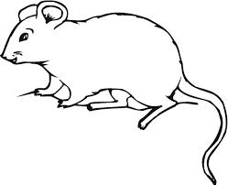
Diagram of the Desert Mouse:

Slide 75
Desert Mice
have
are
Can
_________________
_________________
_________________
_________________
_________________
_________________
_________________
_________________
_________________
_________________
_________________
_________________
_________________
_________________
_________________
_________________
_________________
_________________
_________________
_________________
_________________

Slide 76
Desert Mice

Slide 77
Life Cycle of the Desert Mouse:

Slide 78
Desert Mice:
Habitat:
Life Span:
Interesting Fact:
Diet:

Slide 79
Desert Mice
3 things I learned:
2 interesting facts :
1 question :

Slide 80
Desert Mice
Live__________________________________.
Have _________________________________.
Are __________________________________.
Can __________________________________.
Eat __________________________________.
Always _______________________________.
Never ________________________________.

Slide 81
Desert Mouse
____________
Both

Slide 82
My Desert Mouse Adventure Story!
______________________________________________________________________
______________________________________________________________________
______________________________________________________________________
______________________________________________________________________
______________________________________________________________________
______________________________________________________________________
______________________________________________________________________
______________________________________________________________________
______________________________________________________________________
______________________________________________________________________

Slide 83
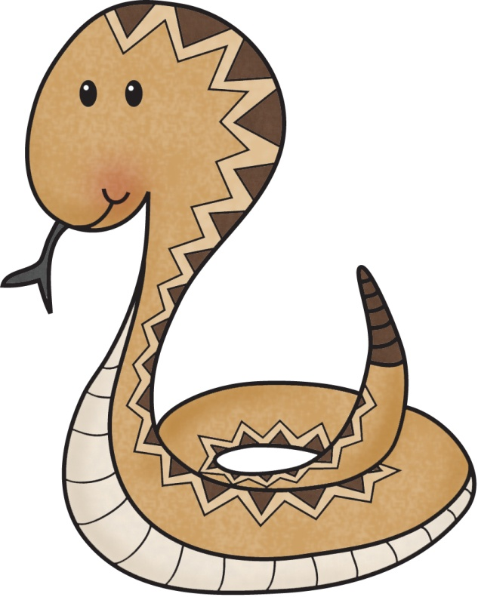
Title:
Table of Contents:
__________________...............Pg. 1
__________________...............Pg. 2
__________________...............Pg. 3
__________________...............Pg. 4
__________________...............Pg. 5
__________________...............Pg. 6
__________________...............Pg. 7
__________________...............Pg. 8
__________________...............Pg. 9
__________________.............Pg. 10
Researched By:
_________________

Slide 84
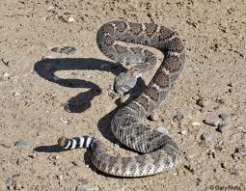
The Rattlesnake
The Rattlesnake
Rattlesnakes are animals that live in the desert.
The rattlesnake is a snake that has a rattle. It is found at the tip of the rattlesnake’s tail. The snake uses the rattle to warn potential aggressors to back off or to distract prey.
Rattlesnakes are brown, gray, or tan with diamond-shaped patches or bands that serve as camouflage.
Rattlesnakes can be between 1 foot and 8 feet long.
The rattlesnake sheds its skin, or molts. Parts on the end of the rattle wear out and break off. New parts grow when the rattlesnake sheds. Most rattlesnakes have 8 to 10 parts. The more parts the rattle has, the louder it is.
The rattlesnake’s famous strike pose is head and neck up, body coiled, and rattle vibrating. The rattlesnake can attack from any position, even while slithering along the ground.
The rattlesnake stores its poisonous venom in glands below and behind their eyes. When the rattlesnake bites prey, the muscles around the glands squeeze tightly, pushing venom through the hollow fangs and into its victim. After the snake bites, the fangs fold back, where they’ll stay until needed again.
Rattlesnakes don’t have ears and can’t hear most sounds. They detect movement by sensing vibrations in the ground.
Rattlesnakes eat small animals including rodents and ground birds.

Slide 85
The Rattlesnake
The Rattlesnake
Rattlesnakes are animals that live in the desert.
The rattlesnake is a snake that has a rattle. It is found at the tip of the rattlesnake’s tail. The snake uses the rattle to scare other animals or to trick their prey.
Rattlesnakes are brown, gray, or tan with diamond-shaped patches or bands that help them camouflage.
Rattlesnakes can be between 1 foot and 8 feet long.
The rattlesnake sheds its skin, or molts. Parts on the end of the rattle wear out and break off. New parts grow when the rattlesnake sheds. Most rattlesnakes have 8 to 10 parts. The more parts the rattle has, the louder it is.
Their strike pose is head and neck up, body curled, and rattle vibrating. The rattlesnake can attack from any position, even while slithering along the ground.
The rattlesnake stores its poisonous venom in glands below and behind their eyes. When the rattlesnake bites prey, the muscles around the glands squeeze tightly, pushing venom through the hollow fangs and into its victim. After the snake bites, the fangs fold back, where they’ll stay until needed again.
Rattlesnakes don’t have ears and can’t hear most sounds. They can feel vibrations in the ground.
Rattlesnakes eat small animals like rodents and ground birds.

Slide 86
The Rattlesnake
The Rattlesnake
Rattlesnakes live in the desert.
It has a rattle to scare or trick animals.
Rattlesnakes are brown, gray, or tan with diamond-shaped patches.
Rattlesnakes is 1 foot to 8 feet long.
The rattlesnake sheds its skin.
The more parts the rattle has, the louder it is.
Their strike pose is head and neck up, body curled, and rattle shaking.
They have fangs.
They have poison that comes out of their fangs.
Rattlesnakes don’t have ears and can’t hear most sounds.
They can feel things in the ground.
Rattlesnakes eat rodents and ground birds.

Slide 87
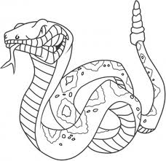
Diagram of the Rattlesnake:

Slide 88
Rattlesnakes
have
are
Can
_________________
_________________
_________________
_________________
_________________
_________________
_________________
_________________
_________________
_________________
_________________
_________________
_________________
_________________
_________________
_________________
_________________
_________________
_________________
_________________
_________________

Slide 89
Rattlesnakes

Slide 90
Life Cycle of the Rattlesnake:

Slide 91
Rattlesnakes:
Habitat:
Life Span:
Interesting Fact:
Diet:

Slide 92
Rattlesnakes
3 things I learned:
2 interesting facts :
1 question :

Slide 93
Rattlesnakes
Live__________________________________.
Have _________________________________.
Are __________________________________.
Can __________________________________.
Eat __________________________________.
Always _______________________________.
Never ________________________________.

Slide 94
Rattlesnake
____________
Both

Slide 95
My Rattlesnake Adventure Story!
______________________________________________________________________
______________________________________________________________________
______________________________________________________________________
______________________________________________________________________
______________________________________________________________________
______________________________________________________________________
______________________________________________________________________
______________________________________________________________________
______________________________________________________________________
______________________________________________________________________

Slide 96
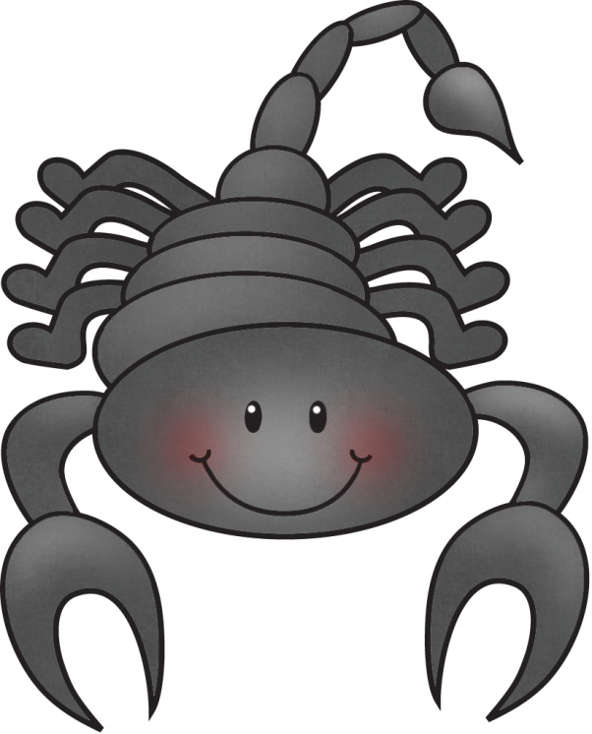
Title:
Table of Contents:
__________________...............Pg. 1
__________________...............Pg. 2
__________________...............Pg. 3
__________________...............Pg. 4
__________________...............Pg. 5
__________________...............Pg. 6
__________________...............Pg. 7
__________________...............Pg. 8
__________________...............Pg. 9
__________________.............Pg. 10
Researched By:
_________________

Slide 97
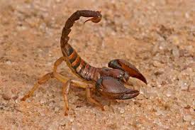
The Scorpion
The Scorpion
The Arizona Desert hairy scorpion is the largest scorpion in North America, reaching the length of 14 inches. It gets its name from the brown hair that covers its body, which help it to detect vibration in the soil, so it can find its prey. Since it is so large, it is easy for this scorpion to feed on other scorpions in the desert, and it preys on other animals, including lizards and snakes. The also eat large insects, spiders, and vertebrates. It has lobster-like pincers, and it is usually yellow with a dark top.
The Arizona Desert hairy scorpion is predominantly found in the Sonora and Mohave Deserts, and are a warm-desert species.
They are especially adapted to hot, dry conditions. They are usually found in and around washes or low-elevation valleys, where they dig elaborate burrows. They emerge from these burrows at night to hunt and forage for prey and mates, meaning they are nocturnal. They can also be found under rocks containing moisture.
The scorpion is very aggressive, and it is venomous. Even though it is the largest of the scorpions in America, its venom is not very potent. Its sting is said to be about as painful as a honeybee’s sting, but if one is allergic to the sting, the results could be deadly
The scorpion gives birth to live young who ride on their mother’s back for about a week before going off on their own. Their poison is held in their long tail that is tipped with a poison gland and stinger. The pincers at the front of their body are large and they have four additional legs.
Predators of the scorpion are birds, bats, small mammals, large spiders, centipedes, and lizards. They use their aggression, good sense of hearing, and their body hairs to detect vibration to ward off predators. Their eyesight is very poor, though, so this is not something they rely on.

Slide 98
The Scorpion
The Scorpion
The Arizona Desert hairy scorpion is the largest scorpion in North America. It can be 14 inches long. It gets its name from the brown hair that covers its body, which help it to feel vibration in the soil, so it can find its prey. Their eyesight is very poor, though, so this is not something they rely on. Since it is so large, it can eat other scorpions and it preys on other animals, including lizards and snakes. The also eat large insects and spiders. It has lobster-like pincers, and it is yellow with a dark top.
The Arizona Desert hairy scorpion lives in the Sonora and Mohave Deserts.
They are adapted to hot, dry habitats. They are usually found in and around washes or valleys, where they dig
burrows. They come out from these burrows at night to hunt and look for prey and mates, meaning they are nocturnal. They can also be found under wet rocks.
The scorpion likes to fight and it is venomous. Its venom is not powerful. Its sting is said to be about as painful as a honeybee’s sting.
The scorpion gives birth to live young who ride on their mother’s back for about a week before going off on their own. Their poison is held in their long tail that is tipped with a poison gland and stinger. The pincers at the front of their body are large and they have four more legs.
Predators of the scorpion are birds, bats, small mammals, large spiders, centipedes, and lizards.

Slide 99
The Scorpion
The Scorpion
The scorpion lives in North America, in the Sonora and Mohave Deserts.
It can be 14 inches long.
Its hairs help it feel.
They cannot see well.
It eats lizards, insects, spiders, and snakes.
It is yellow with a dark top.
They like to be near a wet place so they can dig.
They are awake at night.
It has a stinger on the end of its tail.
They like to fight.
The babies like to ride on the mom’s back.
Birds, bats, small mammals, large spiders, centipedes, and lizards eat the scorpion.

Slide 100
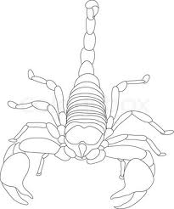
Diagram of the Scorpion:

Slide 101
Scorpions
have
are
Can
_________________
_________________
_________________
_________________
_________________
_________________
_________________
_________________
_________________
_________________
_________________
_________________
_________________
_________________
_________________
_________________
_________________
_________________
_________________
_________________
_________________

Slide 102
Scorpions

Slide 103
Life Cycle of the Scorpion:

Slide 104
Scorpions:
Habitat:
Life Span:
Interesting Fact:
Diet:

Slide 105
Scorpions
3 things I learned:
2 interesting facts :
1 question :

Slide 106
Scorpions
Live__________________________________.
Have _________________________________.
Are __________________________________.
Can __________________________________.
Eat __________________________________.
Always _______________________________.
Never ________________________________.

Slide 107
Scorpion
____________
Both

Slide 108
My Scorpion Adventure Story!
______________________________________________________________________
______________________________________________________________________
______________________________________________________________________
______________________________________________________________________
______________________________________________________________________
______________________________________________________________________
______________________________________________________________________
______________________________________________________________________
______________________________________________________________________
______________________________________________________________________

Slide 109
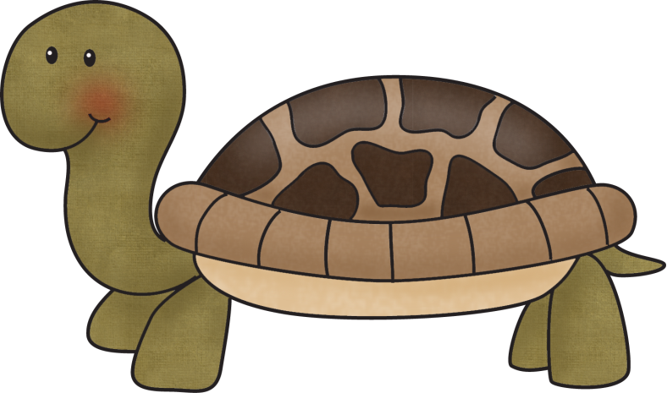
Title:
Table of Contents:
__________________...............Pg. 1
__________________...............Pg. 2
__________________...............Pg. 3
__________________...............Pg. 4
__________________...............Pg. 5
__________________...............Pg. 6
__________________...............Pg. 7
__________________...............Pg. 8
__________________...............Pg. 9
__________________.............Pg. 10
Researched By:
_________________

Slide 110
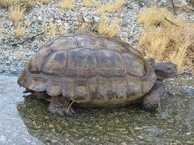
The Tortoise
The Tortoise
The Desert Tortoise is a large herbivore that grows to be 9 – 14 inches long. It is able to stay cool in the desert by living inside deep burrows that is digs in tightly compacted desert gravel. They like to live in rocky canyon bottoms, sandy washes, and other places that can collect water.
They like to eat grasses, fleshy cactus pads, and cactus blossoms. They have sharp, serrated (jagged) jaws that look a lot like a bread knife. This jaw helps the Desert Tortoise to shred the foods it likes to eat, which are very tough.
The Desert Tortoise has a shell that is tan to dark brown with yellowish plates underneath and their bodies are reddish-brown. These colors do not help camouflage the tortoise, but that is okay, because they rely on their tough shells to keep them safe! If they are ever in any danger, they pull their legs and head inside their shell, making it nearly impossible for their predators to eat them. The predators of the Desert Tortoise are ravens, Gila Monsters, kit foxes, badgers, road runners, coyotes, and fire ants. They prey on eggs and young tortoises, but rarely the adults.
The tortoise can live in temperatures that are up to 140 degrees Fahrenheit, because they are able to burrow into deep holes that they dig. Their burrows are usually 3-6 feet deep! They spend 95% of their time underground because of the heat.
They forage for food in the spring, but they can go an entire year without access to water, because they have sacs under their shells that store the water. In the winter, the Desert Tortoise can hibernate, which limits their need for water during these months, and during the driest, hottest times of the year, it can store water to drink as needed, and is able to adapt to the severe weather change.
The Desert Tortoise’ females can lay 4-6 eggs at a time, and do not begin laying eggs until they are 15-20 years old. These eggs are the size and shape of ping pong balls. The survival of these eggs is very low; only 2-3 eggs out of 100 will hatch. Tortoises can live very long lives. Many reach the age of 30, and some will even reach the age of 80 before dying.

Slide 111
The Tortoise
The Tortoise
The tortoise lives in the desert. It is able to stay cool in the desert by living inside deep burrows under the desert gravel. They like to live in rocky canyon bottoms, sandy washes, and other places that can collect water.
They like to eat grasses, fleshy cactus pads, and cactus blossoms. They have sharp, jaws that look a lot like a bread knife. This jaw helps them to shred the foods they like to eat, which are very tough.
The Desert Tortoise has a shell that is tan to dark brown with yellowish plates underneath and their bodies are reddish-brown. They rely on their tough shells to keep them safe! If they are ever in any danger, they pull their legs and head inside their shell, making it hard for their predators to eat them. The predators of the Desert Tortoise are ravens, Gila Monsters, kit foxes, badgers, road runners, coyotes, and fire ants. These animals prey on eggs and young tortoises, but rarely the adults.
The tortoise can live in deserts that are up to 140 degrees Fahrenheit, because they are able to burrow into deep holes that they dig. Their burrows are usually 3-6 feet deep! They spend 95% of their time underground because of the heat.
They look for food in the spring, but they can go an entire year without access to water, because they have sacs under their shells that store the water. In the winter, the Desert Tortoise can hibernate, which means they do not need to drink during this time. The tortoise is able to adapt to the severe weather change.
The Desert Tortoise’ females can lay 4-6 eggs at a time, and do not begin laying eggs until they are 15-20 years old. These eggs are the size and shape of ping pong balls. Only 2-3 eggs out of 100 will hatch. Tortoises can live very long lives. Many reach the age of 30, and some will even reach the age of 80 before dying. The Desert Tortoise grows to be 9 – 14 inches long.

Slide 112
The Tortoise
The Tortoise
The tortoise lives in the desert.
They live in burrows under the sand.
They like to live near water.
They like to eat grasses, fleshy cactus pads, and cactus blossoms.
They have sharp jaws.
The Desert Tortoise has a shell that is tan to dark brown with yellowish plates.
Their bodies are reddish-brown.
Their hard shells keep them safe.
If they are scared they will tuck their legs and head in their shell.
Ravens, Gila Monsters, kit foxes, badgers, road runners, coyotes, and fire ants like to eat baby Tortoises.
They spend almost all their time under the ground.
They have sacs under their shells that store the water.
They can go a year without water.
Only 2-3 eggs out of 100 eggs will hatch.
They can live to be 30 to 80 years old.
The Desert Tortoise grows to be 9 – 14 inches long.

Slide 113
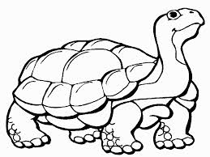
Diagram of the Tortoise:

Slide 114
Tortoise
have
are
Can
_________________
_________________
_________________
_________________
_________________
_________________
_________________
_________________
_________________
_________________
_________________
_________________
_________________
_________________
_________________
_________________
_________________
_________________
_________________
_________________
_________________

Slide 115
Tortoises

Slide 116
Life Cycle of the Tortoise:

Slide 117
Tortoises:
Habitat:
Life Span:
Interesting Fact:
Diet:

Slide 118
Tortoises
3 things I learned:
2 interesting facts :
1 question :

Slide 119
Tortoises
Live__________________________________.
Have _________________________________.
Are __________________________________.
Can __________________________________.
Eat __________________________________.
Always _______________________________.
Never ________________________________.

Slide 120
Tortoise
____________
Both

Slide 121
My Tortoise Adventure Story!
______________________________________________________________________
______________________________________________________________________
______________________________________________________________________
______________________________________________________________________
______________________________________________________________________
______________________________________________________________________
______________________________________________________________________
______________________________________________________________________
______________________________________________________________________
______________________________________________________________________

Slide 122
Title:
Table of Contents:
__________________...............Pg. 1
__________________...............Pg. 2
__________________...............Pg. 3
__________________...............Pg. 4
__________________...............Pg. 5
__________________...............Pg. 6
__________________...............Pg. 7
__________________...............Pg. 8
__________________...............Pg. 9
__________________.............Pg. 10
Researched By:
_________________

Slide 123
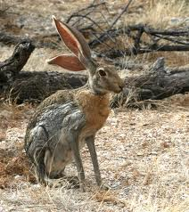
The Jackrabbit
The Jackrabbit
The Antelope Jackrabbit is named after the fast, long-legged antelopes of Africa. They can run as fast as 50 miles per hour, and they can jump as high as 5 feet and as far as 22 feet. They can be up to two feet in length, and their nearly one foot long ears help them to hear even the faintest of sounds. When it is hot in the desert, the Jackrabbit’s ears stand straight up and emit heat. When it is cool, the ears are wrapped around the body and can help keep the Jackrabbit warm. The ears also become tall when the jackrabbit feels alarmed.
Most of the Antelope Jackrabbit’s nutrition comes from grasses, herbs, soft cacti, twigs, and bark. They do not drink much water, but get the moisture they need from the plants they eat.
The Antelope jackrabbit can normally be found in northern Mexico and Arizona, and its natural habitat is grasslands or deserts where grass grows under shrubs.
The jackrabbit is nocturnal, so it spends most of the daylight hours under shrub, resting. They are active at night, which is when they find food.
The Antelope Jackrabbit, which is actually a hare, not a rabbit, has eyes placed so that it has nearly 360 degrees of visibility, which helps them avoid being preyed upon. Even better than their eyesight is their hearing, and they are able to quickly detect where danger is coming from.
The Antelope jackrabbit is greyish-brown above, with its lower sides being mostly white. They have a brown face, throat, and ears. Their tail is mostly white. When they are sleeping during the day, the jackrabbit blends in with its surroundings and avoids being found by its predators, which include coyotes, rattlesnakes, bobcats, and cougars.

Slide 124
The Jackrabbit
The Jackrabbit
The Antelope Jackrabbit can run as fast as 50 miles per hour, and they can jump as high as 5 feet and as far as 22 feet. They can be up to two feet in length, and their nearly one foot long ears help them to hear. When it is hot in the desert, the Jackrabbit’s ears stand straight up and heat leaves their ears so they can stay cool. When it is cool, the ears are wrapped around the body and can help keep the Jackrabbit warm. The ears also become tall when the jackrabbit feels alarmed.
The Antelope Jackrabbit’s eats grasses, herbs, soft cacti, twigs, and bark. They do not drink much water, but get the water they need from the plants they eat.
The Antelope jackrabbit can be found in northern Mexico and Arizona, and they love grasslands or deserts where grass grows under shrubs.
The jackrabbit is nocturnal, so it spends most of the day under shrub, resting. They are active at night, which is when they find food.
The Antelope Jackrabbit, which is actually a hare, not a rabbit, has eyes so it can see all the way around him, which helps them see predators. They have even better hearing, and they are able to quickly detect where danger is coming from.
The Antelope jackrabbit is greyish-brown above, with its lower sides being mostly white. They have a brown face, throat, and ears. Their tail is mostly white. When they are sleeping during the day, the jackrabbit blends in with its surroundings (camouflage) and avoids being found by its predators, which include coyotes, rattlesnakes, bobcats, and cougars.

Slide 125
The Jackrabbit
The Jackrabbit
The Antelope Jackrabbit is 2 feet long.
Their ears are 1 foot long.
When it is hot their ears stand up.
When it is cool, the ears wrap around to keep them warm.
If it is scared, the ears will stand up too.
The Antelope Jackrabbit’s eats grasses, herbs, soft cacti, twigs, and bark. They get water from the plants they eat.
The Antelope jackrabbit can be found in northern Mexico and Arizona.
They like to lay under shrubs (bushes)
The jackrabbit gets food at night and sleeps in the day.
Their eyes can see all the way around them.
They have super hearing.
The Antelope jackrabbit is greyish-brown with a white belly. This blends in to the desert.
They have a brown face, throat, and ears. Their tail is mostly white.
Coyotes, rattlesnakes, bobcats, and cougars like to eat them.

Slide 126
Diagram of the Jackrabbit:

Slide 127
Jackrabbits
have
are
Can
_________________
_________________
_________________
_________________
_________________
_________________
_________________
_________________
_________________
_________________
_________________
_________________
_________________
_________________
_________________
_________________
_________________
_________________
_________________
_________________
_________________

Slide 128
Jackrabbits

Slide 129
Life Cycle of the Jackrabbit:

Slide 130
Jackrabbits:
Habitat:
Life Span:
Interesting Fact:
Diet:

Slide 131
Jackrabbits
3 things I learned:
2 interesting facts :
1 question :

Slide 132
Jackrabbits
Live__________________________________.
Have _________________________________.
Are __________________________________.
Can __________________________________.
Eat __________________________________.
Always _______________________________.
Never ________________________________.

Slide 133
Jackrabbit
____________
Both

Slide 134
My Jackrabbit Adventure Story!
______________________________________________________________________
______________________________________________________________________
______________________________________________________________________
______________________________________________________________________
______________________________________________________________________
______________________________________________________________________
______________________________________________________________________
______________________________________________________________________
______________________________________________________________________
______________________________________________________________________

Slide 135
Title:
Table of Contents:
__________________...............Pg. 1
__________________...............Pg. 2
__________________...............Pg. 3
__________________...............Pg. 4
__________________...............Pg. 5
__________________...............Pg. 6
__________________...............Pg. 7
__________________...............Pg. 8
__________________...............Pg. 9
__________________.............Pg. 10
Researched By:
_________________

Slide 136
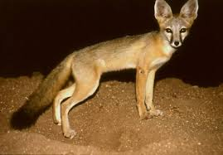
The Kit Fox
The Kit Fox
The Kit Fox is the smallest fox that lives in the desert. It only weighs 3 to 5 pounds and is only 20 to 30 inches long from the tip of his tail to the tip of his snout.
It likes to eat rodents, small birds, scorpions, insects, and spiders.
It is light tan-grey above with tan on sides and below. It has a black tip on its tail. Its ears are very large, which help it to regulate its body temperature. It lives in southwestern United States, favoring the arid climate.
The Kit Fox has adapted to living in the desert by living in the arid environment, such as desert scrub and grasslands. They can also be found in urban areas. They use their ears to regulate their temperature by lowering it when necessary. The ears of the Kit Fox are also used for exceptional hearing. Its tan-grey coat helps it to blend in with its surroundings (camouflage) but it is nocturnal, so it spends a majority of its time in the dark.
The Kit Fox is primarily carnivorous, and hunts a large variety of prey, including kangaroo rats, cottontail rabbits, black-tailed jackrabbits, meadow voles, hares, prairie dogs, insects, lizards, snakes, fish, and ground-dwelling birds. It goes out to hunt shortly after sunset. Even though the Kit Fox is primarily carnivorous, if it cannot find prey to eat, it has been known to eat tomatoes, cactus fruit, and other fruit. Kit Fox families will hunt together, and can hunt in the same areas as other Kit Foxes, but they do not normally hunt together. The Kit Fox is small, but it has even been known to snack on poisonous scorpions.
To live in, the Kit Fox will either dig its own dens or move into and enlarge small burrows left behind by ground squirrels and kangaroo rats. They use larger family dens during the months of December to February when they are expecting a litter. Litters are born throughout March and April, averaging four pups per litter. They become independent at five to six months. Both parents take a part in raising their young. Kits usually live 5 to 6 years.

Slide 137
The Kit Fox
The Kit Fox
The Kit Fox is the smallest fox that lives in the desert. It only weighs 3 to 5 pounds and is only 20 to 30 inches long from the tip of his tail to the tip of his snout.
It likes to eat rodents, small birds, scorpions, insects, and spiders.
It is light tan-grey above with tan on sides and below. It has a black tip on its tail. Its ears are very large.
It lives in southwestern United States, favoring the dry climate. The Kit Fox lives in desert scrub and grasslands. They can also be found in urban areas.
They use their ears to stay warm. The ears of the Kit Fox are also used for hearing. Its tan-grey coat helps it to blend in with the desert (camouflage) but it is nocturnal, so it spends its time in the dark.
The Kit Fox is primarily carnivorous, and hunts a large variety of prey, including kangaroo rats, cottontail rabbits, black-tailed jackrabbits, meadow voles, hares, prairie dogs, insects, lizards, snakes, fish, and ground-dwelling birds. It goes out to hunt shortly after sunset. Kit Fox families will hunt together. The Kit Fox is small, but it has even been known to snack on poisonous scorpions.
To live in, the Kit Fox will either dig its own dens or move into small burrows left behind by ground squirrels and kangaroo rats. They use larger family dens when they are expecting a litter. Litters have four pups per litter. Both parents take a part in raising their young. Kits usually live 5 to 6 years.

Slide 138
The Kit Fox
The Kit Fox
The Kit Fox is the smallest fox that lives in the desert.
It only weighs 3 to 5 pounds and is only 20 to 30 inches long.
It likes to eat rodents, small birds, scorpions, insects, and spiders.
It is light tan-grey.
It has a black tip on its tail.
Its ears are very large.
It lives in southwestern United States.
Kits usually live 5 to 6 years.
The Kit Fox lives in desert scrub and grasslands.
They use their ears to stay warm.
It spends its time in the dark.
The Kit Fox eats kangaroo rats, cottontail rabbits, black-tailed jackrabbits, meadow voles, hares, prairie dogs, insects, lizards, snakes, fish, and ground-dwelling birds.
They live in dens.
They have 4 pups at a time.

Slide 139
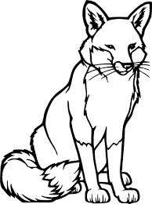
Diagram of the Kit Fox:

Slide 140
Kit Foxes
have
are
Can
_________________
_________________
_________________
_________________
_________________
_________________
_________________
_________________
_________________
_________________
_________________
_________________
_________________
_________________
_________________
_________________
_________________
_________________
_________________
_________________
_________________

Slide 141
Kit Foxes

Slide 142
Life Cycle of the Kit Fox:

Slide 143
Kit Foxes:
Habitat:
Life Span:
Interesting Fact:
Diet:

Slide 144
Kit Foxes
3 things I learned:
2 interesting facts :
1 question :

Slide 145
Kit Foxes
Live__________________________________.
Have _________________________________.
Are __________________________________.
Can __________________________________.
Eat __________________________________.
Always _______________________________.
Never ________________________________.

Slide 146
Kit Fox
____________
Both

Slide 147
My Kit Fox Adventure Story!
______________________________________________________________________
______________________________________________________________________
______________________________________________________________________
______________________________________________________________________
______________________________________________________________________
______________________________________________________________________
______________________________________________________________________
______________________________________________________________________
______________________________________________________________________
______________________________________________________________________

Slide 148
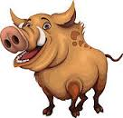
Title:
Table of Contents:
__________________...............Pg. 1
__________________...............Pg. 2
__________________...............Pg. 3
__________________...............Pg. 4
__________________...............Pg. 5
__________________...............Pg. 6
__________________...............Pg. 7
__________________...............Pg. 8
__________________...............Pg. 9
__________________.............Pg. 10
Researched By:
_________________

Slide 149
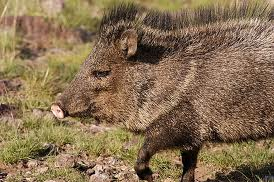
The Javelina
The Javelina
The Javelina, or Peccary, is a pig-like animal, but is not actually a pig. Typically, it grows to be nearly two feet tall, and weighs anywhere from 35 – 55 pounds when it reaches adulthood.
Like pigs, the Javelina has a snout and hoofed feet. It has very sharp tusks that it uses to charge and to dig for food. The tusks are what give the Javelina their name, because it is the Spanish word for “javelin.” This animal came from South America, but there is a large amount found in Arizona, specifically the desert area.
The Javelina is grey or black, with a distinctive white color that runs from shoulder to shoulder. It is not colored in a way that camouflages it, but this animal lives in herds. They rely on each other to defend territory, protect against predators, regulate temperature, and interact socially. When the desert is cold, the Javelina stand very close to other members in their herd to maintain body heat, but they are usually active at night, but during the day, they will roll around in water or mud to cool off. They also like to live in areas of the desert that have water.
Javelina are found in many different habitats, so the food they eat varies. They like to eat roots, fruit, cacti, and seeds. Prickly pear cactus is a favorite of the Javelina.
Its predators are coyotes and mountain lions. Javelina will charge at their predators, and live in herds to help keep them safe. Sometimes, when it looks like they are charging, they are actually running away from something.
Their eyesight is very poor, but they have a very keen sense of smell, which they use to their advantage when searching from food.
They breed year-round, and baby Javelina are born a reddish-brown color.

Slide 150
The Javelina
The Javelina
The Javelina is a pig-like animal, but is not actually a pig. It grows to be nearly two feet tall, and weighs anywhere from 35 – 55 pounds.
This animal came from South America, but there is a large amount found in Arizona, specifically the desert area. They also like to live in areas of the desert that have water.
The Javelina is grey or black, with a white color that runs from shoulder to shoulder. They live in herds (groups). They rely on each other to defend territory, protect against predators, stay warm, and talk to each other. When the desert is cold, the Javelina stand very close to eachother. They are active at night, but during the day, they will roll around in water or mud to cool off.
Like pigs, the Javelina has a snout and hoofed feet. It has very sharp tusks (javelin) that it uses to charge and to dig for food.
Javelina like to eat roots, fruit, cacti, and seeds. Prickly pear cactus is a favorite of the Javelina.
Its predators are coyotes and mountain lions. Javelina will charge at their predators, and live in herds to help keep them safe. Sometimes, when it looks like they are charging, they are really running away from something.
They cannot see very well, but they can smell! This helps them search for food!
Baby Javelinas are born a reddish-brown color.

Slide 151
The Javelina
The Javelina
The Javelina looks like a pig but its not.
It is 2 feet tall and weighs 35 – 55 pounds.
They live in South America and Arizona. They live near water.
The Javelina is grey or black, with a white color on its shoulder.
They live in herds (groups).
They stay in groups to keep warm.
They will roll around in water or mud to cool off.
It has a snout and hoofed feet.
It has very sharp tusks. It uses them to dig for food.
Javelina like to eat roots, fruit, cacti, prickly pear, and seeds.
Coyotes and mountain lions eat them.
They cannot see very well, but they can smell!
Baby Javelinas are born a reddish-brown color.

Slide 152
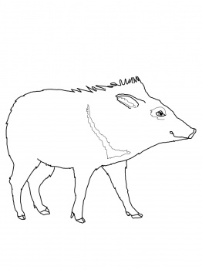
Diagram of the Javelina:

Slide 153
Javelinas
have
are
Can
_________________
_________________
_________________
_________________
_________________
_________________
_________________
_________________
_________________
_________________
_________________
_________________
_________________
_________________
_________________
_________________
_________________
_________________
_________________
_________________
_________________

Slide 154
Javelinas

Slide 155
Life Cycle of the Javelina:

Slide 156
Javelinas:
Habitat:
Life Span:
Interesting Fact:
Diet:

Slide 157
Javelina
3 things I learned:
2 interesting facts :
1 question :

Slide 158
Javelina
Live__________________________________.
Have _________________________________.
Are __________________________________.
Can __________________________________.
Eat __________________________________.
Always _______________________________.
Never ________________________________.

Slide 159
Javelina
____________
Both

Slide 160
My Javelina Adventure Story!
______________________________________________________________________
______________________________________________________________________
______________________________________________________________________
______________________________________________________________________
______________________________________________________________________
______________________________________________________________________
______________________________________________________________________
______________________________________________________________________
______________________________________________________________________
______________________________________________________________________

Slide 161
Title:
Table of Contents:
__________________...............Pg. 1
__________________...............Pg. 2
__________________...............Pg. 3
__________________...............Pg. 4
__________________...............Pg. 5
__________________...............Pg. 6
__________________...............Pg. 7
__________________...............Pg. 8
__________________...............Pg. 9
__________________.............Pg. 10
Researched By:
_________________

Slide 162
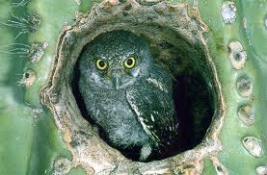
The Elf Owl
The Elf Owl
This owl is very small, standing only 6 inches tall at full height, making it one of the smallest owls in the desert. It mainly lives in the Sonoran Desert in Arizona, and likes to live in riparian habitats, which means it lives in the parts of the desert with water nearby.
They find many things to eat in the desert, mostly feasting on moths, crickets, centipedes, and beetles. Its talons and beak are very sharp, so it can even eat scorpions! Because it is so small, it cannot eat animals that are much larger.
The Elf Owl is colored to match its environment. It has light brown and white feathers, which helps it to blend into its surrounding area. This means it camouflages itself. They have thin, white eyebrows, and the only body part giving them away is their pair of bright yellow eyes. If it is found, the Elf Owl will play dead until all danger has passed. They would rather not fight with other animals, but choose to fly away instead if they feel they are in danger.
The Elf Owl lives in natural tree cavities or holes in cacti, oak trees, and sycamores that have been abandoned by woodpeckers. The nests are 15 – 35 feet off the ground, so many predators of the elf owl find it difficult to find the owls nests that are in the saguaro cacti. The predators of the Elf Owl include other owls, snakes, coyotes, bobcats, and ringtails. In these nests, the female Elf Owls lay 2 to 4 small, white eggs that are about the size of jelly beans!
The Elf Owls have some characteristics that are similar to other owls, like their excellent night vision, but they have also had to adapt to live in the desert. Even though they cannot see in complete darkness, they can see in very low light, and they are able to catch prey, even in complete darkness, because they have incredible hearing. They also sneak up on their prey by using something called “silent flight,” which means they do not make any noise as the approach their prey. Even the sound of their wings beating is muffled by their softened feathers on the leading edges of their wings.

Slide 163
The Elf Owl
The Elf Owl
This owl is very small, standing only 6 inches tall. It mainly lives in the Sonoran Desert in Arizona, and likes to live in riparian habitats, which means it lives in the parts of the desert with water nearby.
They find many things to eat in the desert like moths, crickets, centipedes, and beetles. Its talons and beak are very sharp, so it can even eat scorpions! Because it is so small, it cannot eat animals that are much larger.
The Elf Owl has light brown and white feathers, which helps it to blend into the desert. This means it camouflages itself. They have thin, white eyebrows, and bright yellow eyes. If it is found, the Elf Owl will play dead until all danger has passed. They would rather not fight with other animals, but choose to fly away instead if they feel they are in danger.
The Elf Owl lives in natural tree cavities or holes in cacti, oak trees, and sycamores that have been left by woodpeckers. The nests are 15 – 35 feet off the ground, so many predators cannot reach the saguaro cacti. The predators of the Elf Owl include other owls, snakes, coyotes, bobcats, and ringtails. In these nests, the female Elf Owls lay 2 to 4 small, white eggs that are about the size of jelly beans!
The Elf Owls are similar to other owls, like their excellent night vision, but they have also had to adapt to live in the desert. Even though they cannot see in complete darkness, they can see in very low light, and they are able to catch prey, even in the dark, because they can hear very well. They also sneak up on their prey by using something called “silent flight,” which means they do not make any noise as come near their prey. Even the sound of their wings is silent because of their soft feathers.

Slide 164
The Elf Owl
The Elf Owl
This owl is 6 inches tall.
It lives in the Sonoran Desert in Arizona, and likes to be close to water.
They eat moths, crickets, centipedes, scorpions, and beetles.
It has a sharp beak and claws.
The Elf Owl has light brown and white feathers. which helps it to blend into the desert.
They have thin, white eyebrows, and yellow eyes.
They like to play dead.
They do not fight, they fly away.
The nests where they live are 15 – 35 feet off the ground.
The nest is in the saguaro cacti.
Elf Owls lay 2 to 4 small, white eggs.
They can see and hear very well.
They are silent when they fly.

Slide 165
Diagram of the Elf Owl:

Slide 166
Elf Owls
have
are
Can
_________________
_________________
_________________
_________________
_________________
_________________
_________________
_________________
_________________
_________________
_________________
_________________
_________________
_________________
_________________
_________________
_________________
_________________
_________________
_________________
_________________

Slide 167
Elf Owls

Slide 168
Life Cycle of the Elf Owl:

Slide 169
Elf Owls:
Habitat:
Life Span:
Interesting Fact:
Diet:

Slide 170
Elf Owls
3 things I learned:
2 interesting facts :
1 question :

Slide 171
Elf Owls
Live__________________________________.
Have _________________________________.
Are __________________________________.
Can __________________________________.
Eat __________________________________.
Always _______________________________.
Never ________________________________.

Slide 172
Elf Owl
____________
Both

Slide 173
My Elf Owl Adventure Story!
______________________________________________________________________
______________________________________________________________________
______________________________________________________________________
______________________________________________________________________
______________________________________________________________________
______________________________________________________________________
______________________________________________________________________
______________________________________________________________________
______________________________________________________________________
______________________________________________________________________

