Slide 1
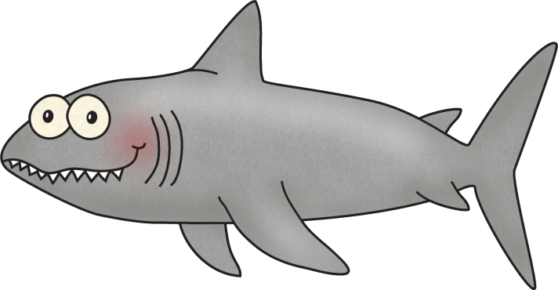
Title:
Table of Contents:
__________________...............Pg. 1
__________________...............Pg. 2
__________________...............Pg. 3
__________________...............Pg. 4
__________________...............Pg. 5
__________________...............Pg. 6
__________________...............Pg. 7
__________________...............Pg. 8
__________________...............Pg. 9
__________________.............Pg. 10
Researched By:
_________________

Slide 2
Know | Want to know ? | Learn

Slide 3
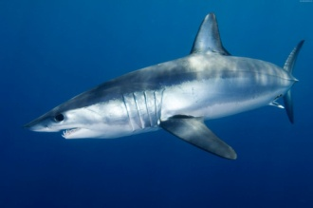
The Shark
The Shark
The shark swims away from its mother as soon as it is born. It does not stay with its mother after birth like most other animals. Sharks are very smart creatures and can learn new things quickly. Sharks live in all of the oceans of the world. Some like to live in cold waters and other like to live in the warmer parts.
Most sharks are already about 5 feet long when they are born! The largest shark is the whale shark. It can grow to be 12 feet long. Some sharks can be much smaller – about 7 inches long. Most sharks are about the same size as a full grown human.
One of the reasons that sharks are such successful predators is that they have such super senses. Two-thirds of a shark's brain is dedicated to its keenest sense -- smell.
Some sharks have eyes similar to a cat. A mirror-like layer in their eyes allows them to see better in the water. This allows the shark to hunt in clear seas or murky water.
They are able to feel vibrations in the water using a line of canals that go from its head to its tail. Called a "lateral line", these canals are filled with water and contain sensory cells with hairs growing out of them. These hairs move when the water vibrates and alerts the shark to potential prey. Sharks also have a sensory organ called the "ampullae of Lorenzini" which they use to "feel" the electrical field coming from its prey.
Most sharks are carnivorous, which means they eat meat. They like to eat fish and other mammals (sea lions, dolphins, and seals). Some sharks even eat turtles and seagulls. They sometimes even eat other sharks that are smaller than them.
Sharks have no bones, only cartilage. Sharks have many teeth. As their teeth fall out, they get new ones. If you look carefully you can find sharks’ teeth in the sand at the beach.

Slide 4
The Shark
The Shark
Sharks are very smart creatures and can learn new things quickly. Sharks live in all of the oceans of the world. Some like to live in cold waters and other like to live in the warmer parts.
Most sharks are already about 5 feet long when they are born! The largest shark is the whale shark. It can grow to be 12 feet long. Some sharks can be much smaller – about 7 inches long. Most sharks are about the same size as a full grown human.
The shark swims away from its mother as soon as it is born. It does not stay with its mother after birth like most other animals.
Sharks are such successful predators because of their super senses. The strongest sense is smell.
Some sharks have eyes similar to a cat. A mirror-like layer in their eyes allows them to see better in the water.
They are able to feel vibrations in the water using a line of canals that go from its head to its tail. The canals have tiny hairs that move when the water vibrates and alerts the shark to prey. Sharks can also feel the electrical field coming from its prey.
Most sharks are carnivorous, which means they eat meat. They like to eat fish and other mammals (sea lions, dolphins, and seals). Some sharks even eat turtles and seagulls. They sometimes even eat other sharks that are smaller than them.
Sharks have no bones, only cartilage. Sharks have many teeth. As their teeth fall out, they get new ones. If you look carefully you can find sharks’ teeth in the sand at the beach.

Slide 5
The Shark
The Shark
Sharks live in all of the oceans of the world. Some like to live in cold waters and other like to live in the warmer parts.
Sharks can be 7 inches to 12 feet long. Most are 5 feet long.
Sharks are very smart!
When a shark is born, it leaves its mother.
They can smell their food from far away.
Sharks can see very well. They have eyes like a cat.
Sharks have tiny hairs that help them feel when their prey is coming.
Sharks like to eat fish, sea lions, dolphins, and seals.
Some sharks even eat turtles, smaller sharks, and seagulls.
Sharks have no bones, only cartilage.
Sharks have many teeth. As their teeth fall out, they get new ones.

Slide 6
Diagram of the Shark:

Slide 7
Sharks
Can
have
are
_________________
_________________
_________________
_________________
_________________
_________________
_________________
_________________
_________________
_________________
_________________
_________________
_________________
_________________
_________________
_________________
_________________
_________________
_________________
_________________
_________________

Slide 8
Sharks

Slide 9
Life Cycle of the Shark:

Slide 10
Sharks:
Habitat:
Life Span:
Interesting Fact:
Diet:

Slide 11
Sharks
3 things I learned:
2 interesting facts :
1 question :

Slide 12
Topic:
Fact 1:
Fact 2:
Fact 3:
Closing:

Slide 14
Habitat
Diet
Life Span

Slide 15
Adaptations
Size
Babies

Slide 16
Sharks
Live__________________________________.
Have _________________________________.
Are __________________________________.
Can __________________________________.
Eat __________________________________.
Always _______________________________.
Never ________________________________.

Slide 17
Graph:
Photograph:
Question: ___________________________
___________________________
Yes No
14
13
12
11
10
9
8
7
Caption:
6
5
4
3
2
1

Slide 18
Shark
____________
Both:

Slide 19
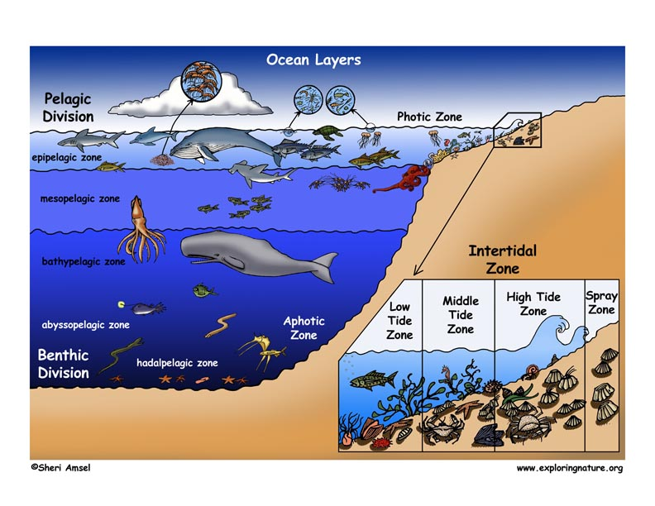
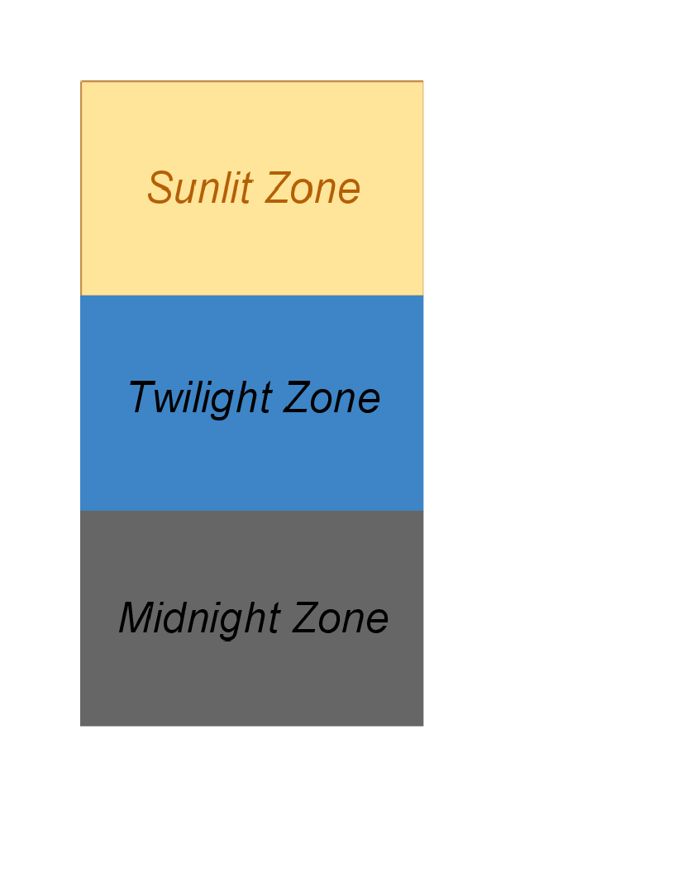
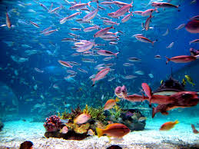
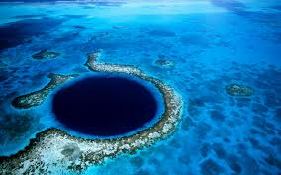
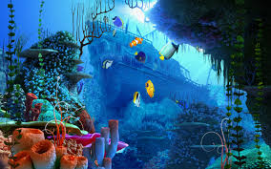
The Ocean
HABITAT: The ocean covers about 70% of the earth. It includes five main oceans: the Pacific, Atlantic, Indian, Arctic, and Southern, as well as many smaller Gulfs and Bays. There is about one cup of salt per gallon of water in the ocean. The ocean has three vertical zones. The top layer is called the euphotic zone and it is the area of the ocean where light can penetrate. The next layer is the disphotic zone. This area is too deep for lots of light to reach. Instead, the light here looks like our twilight on land. The deepest part of the ocean is called the aphotic zone, or deep sea. The water here is awfully cold, completely dark, and low in nutritional content.
PLANTS: Kelp is an important algae plant because it provides shelter and food for a lot of sea creatures. Kelp is also used by humans for many products, including toothpaste and ice cream. Another important marine plant is phytoplankton. These are tiny plants that serve as food for many of the ocean creatures from the smallest of fish to large whales. Some scientists estimate that phytoplankton provide the earth with almost half of its oxygen!
PEOPLE AND THIS BIOME: People everywhere heavily use the ocean for food, medicines, oil, other resources, and recreation. Some people poison and dynamite coral reefs, catch unwanted fish, drag nets on the sea floor, and overfish popular species and it causes damage to the ocean and the animals. Oil spills and putting cleaners down the drain can cause damage too.
WEATHER: The ocean provides rain for crops through evaporation, wind to help circulate air, and affects coastal temperatures. The ocean is a big influence on whether the weather may be sunny or cloudy or if the temperature is warm or cold. The average temperature of all oceans is about 39°F (4°C). Heat from the sun warms only the surface of the water. Deep down, oceans everywhere are cold and dark.

Slide 20
The Ocean
HABITAT: The ocean covers about 70% of the earth. It has five main oceans: the Pacific, Atlantic, Indian, Arctic, and Southern oceans. The ocean has three zones. The top layer is called the sunlight zone, the middle is called the twilight zone (kind of getting dark), and the bottom is called the midnight zone, or deep sea, (really dark).
PLANTS: Kelp is an important algae plant because it provides shelter and food for fish. Kelp is also used by humans as toothpaste and ice cream. Another plant is phytoplankton. These are tiny plants that are food to all the fish and animals. It helps the earth with almost half of its oxygen! Without it, it would be hard breathe.
PEOPLE AND THIS BIOME: People use the ocean for food, medicines, oil, and to play. Some things like fishing to much, oil spills, and putting cleaners down the drain can cause damage to the ocean.
WEATHER: The temperature of all oceans is about 39°F (4°C). Heat from the sun warms only the surface of the water. Deep down, oceans everywhere are cold and dark.

Slide 21
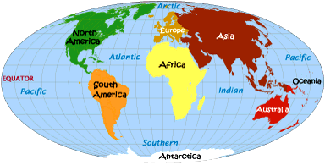
The Ocean

Slide 22
Ocean

Slide 23
Diagram of the Arctic Habitat:
Landform Labels:
ocean, island, peninsula
Caption:

Slide 24
The Ocean Habitat
Can
has
is
_________________
_________________
_________________
_________________
_________________
_________________
_________________
_________________
_________________
_________________
_________________
_________________
_________________
_________________
_________________
_________________
_________________
_________________
_________________
_________________
_________________

Slide 25
Ocean Habitat
________ Habitat
Both:

Slide 26
If I Went to the Ocean,
I would pack:
Because…
__________________________________________
__________________________________________
__________________________________________
__________________________________________
__________________________________________
__________________________________________
__________________________________________
__________________________________________

Slide 27
I wonder….
?
?
?
?

Slide 28
Diary of an Ocean Animal:
Dear Diary,
______________________________________________________________________
______________________________________________________________________
______________________________________________________________________
______________________________________________________________________
______________________________________________________________________
______________________________________________________________________
______________________________________________________________________
______________________________________________________________________
Sincerely, _________________

Slide 29
My Shark Adventure Story!
______________________________________________________________________
______________________________________________________________________
______________________________________________________________________
______________________________________________________________________
______________________________________________________________________
______________________________________________________________________
______________________________________________________________________
______________________________________________________________________
______________________________________________________________________
______________________________________________________________________

Slide 30
Glossary:
Glossary:
_______________
_______________
_______________
_______________
___________________________
___________________________
_______________
_______________
_______________
_______________
___________________________
___________________________
_______________
_______________
_______________
_______________
___________________________
___________________________

Slide 31
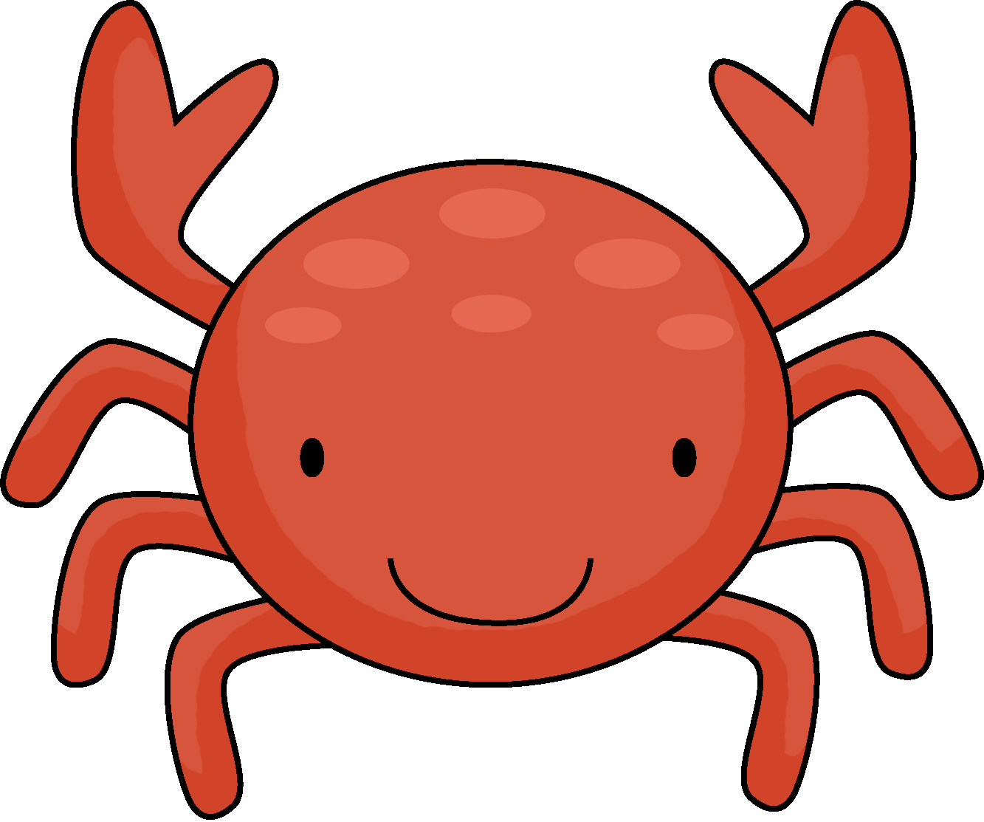
Title:
Table of Contents:
__________________...............Pg. 1
__________________...............Pg. 2
__________________...............Pg. 3
__________________...............Pg. 4
__________________...............Pg. 5
__________________...............Pg. 6
__________________...............Pg. 7
__________________...............Pg. 8
__________________...............Pg. 9
__________________.............Pg. 10
Researched By:
_________________

Slide 32
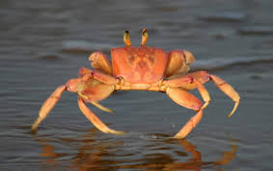
The Crab
The Crab
A crab is an animal that is generally found in all of the world’s oceans. Many crabs do live in fresh water and on land, mainly in tropical regions.
Crabs are invertebrates, which mean an animal without a backbone. They have an exoskeleton. An exoskeleton is an outer shell that both protects them from predators and provides support. They are crustaceans because of their exoskeleton. They have 10 legs and are known to walk sideways. Two of their legs have large, grasping claws called pinchers. They have a flattened body, two feelers (antennae), and two eyes located at the ends of the stalks.
Many crabs are omnivores, which mean they eat plants and meat. Some crabs are just carnivores, meat eaters, while others are just herbivores, plant eaters. Crabs are known to work together to provide food and protection for their family.
Crabs molt, or shed their shells, as they grow. A new shell forms in several days. While the new shell is forming, the crab is known as a soft-shell crab instead of a hard-shell crab. It is defenseless when it is a soft-shell crab.
All crabs lay their eggs in the water.
There are almost 5,000 different types of crabs. The 5,000 different types are made up of about 4,500 different kinds of true crabs and then the other 500 known as hermit crabs. Names of different types of crabs include the Beach Crab, Fiddler Crab, Land Crab, Rock Crab, and Spider Crab.
The biggest crab is the Japanese Spider Crab, which lives on the floor of the Pacific Ocean. It has a 12 foot leg span! The biggest land crab is the Coconut crab, which lives on the islands in the Pacific Ocean and has a leg span of up to 2 ½ feet. The smallest crab is called a Pea Crab. Its leg span only reaches a couple of millimeters.
Crabs have interesting behavior patterns. They can communicate by drumming or waving their pinchers. They can be aggressive towards one another. They may fight over hiding holes.

Slide 33
The Crab
The Crab
A crab is an animal that lives in all the world’s oceans. Many crabs do live in fresh water and on land, mainly in tropical regions.
Crabs are invertebrates, which mean an animal without a backbone. They have an exoskeleton. An exoskeleton is an outer shell that both protects them from predators and provides support. They are crustaceans because of their exoskeleton. They have 10 legs and are known to walk sideways. Two of their legs have large, grasping claws called pincers. They have a flattened body, two feelers (antennae), and two eyes located at the ends of the stalks.
Many crabs are omnivores, which mean they eat plants and meat. Some crabs are just carnivores, meat eaters, while others are just herbivores, plant eaters. Crabs are known to work together to get food and protect their family. Some crabs eat mollusks, worms, or other crustaceans.
Crabs molt, or shed their shells, as they grow. A new shell forms in several days. While the new shell is forming, the crab is known as a soft-shell crab instead of a hard-shell crab. It cannot protect itself when it is a soft-shell crab.
There are almost 5,000 different types of crabs. Names of different types of crabs include the Beach Crab, Fiddler Crab, Land Crab, Rock Crab, and Spider Crab.
The biggest crab is the Japanese Spider Crab, which lives on the floor of the Pacific Ocean. It has a 12 foot leg span! The biggest land crab is the Coconut crab, which lives on the islands in the Pacific Ocean and has a leg span of up to 2 ½ feet. The smallest crab is called a Pea Crab. Its leg span only reaches a couple of millimeters.
Crabs can talk to each other by drumming or waving their pincers. They may even fight over hiding holes. All crabs lay their eggs in the water.

Slide 34
The Crab
The Crab
A crab lives in all the oceans, in freshwater, and on land.
Crabs do not have a backbone.
Crabs have a hard shell to protect them.
They have 10 legs and like to walk sideways.
Two of their legs have large, grasping claws called pincers.
They have a flat body, two feelers (antennae), and two eyes located at the ends of the stalks.
Some crabs eat mollusks, worms, or other crustaceans. Some eat meat, some eat plants, and some eat both.
Crabs molt, or shed their shells, as they grow.
There are almost 5,000 different types of crabs.
Crabs are usually small (a few inches) but can grow up to 2 ½ feet or even 12 feet!
Crabs can talk to each other by drumming or waving their pincers.
They fight over hiding holes.
All crabs lay their eggs in the water.

Slide 35
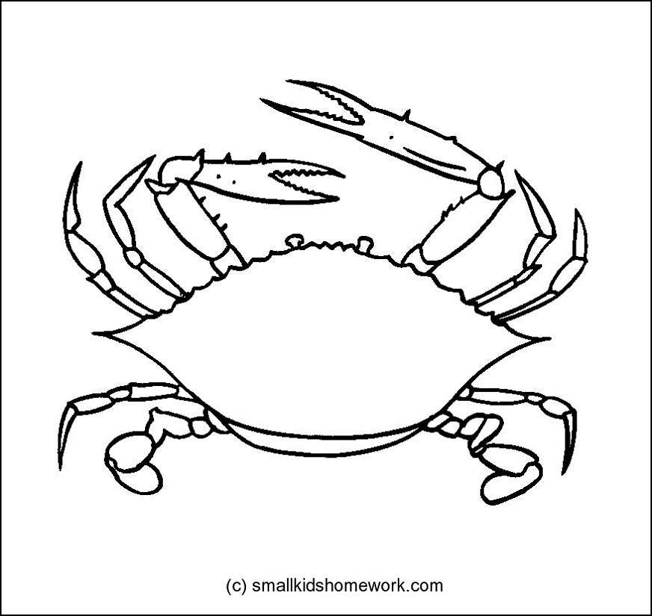
Diagram of the Crab:

Slide 36
Crabs
Can
have
are
_________________
_________________
_________________
_________________
_________________
_________________
_________________
_________________
_________________
_________________
_________________
_________________
_________________
_________________
_________________
_________________
_________________
_________________
_________________
_________________
_________________

Slide 37
Crabs

Slide 38
Life Cycle of the Crab:

Slide 39
Crabs:
Habitat:
Life Span:
Interesting Fact:
Diet:

Slide 40
Crabs
3 things I learned:
2 interesting facts :
1 question :

Slide 41
Crabs
Live__________________________________.
Have _________________________________.
Are __________________________________.
Can __________________________________.
Eat __________________________________.
Always _______________________________.
Never ________________________________.

Slide 42
Crab
____________
Both:

Slide 43
My Crab Adventure Story!
______________________________________________________________________
______________________________________________________________________
______________________________________________________________________
______________________________________________________________________
______________________________________________________________________
______________________________________________________________________
______________________________________________________________________
______________________________________________________________________
______________________________________________________________________
______________________________________________________________________

Slide 44
Title:
Table of Contents:
__________________...............Pg. 1
__________________...............Pg. 2
__________________...............Pg. 3
__________________...............Pg. 4
__________________...............Pg. 5
__________________...............Pg. 6
__________________...............Pg. 7
__________________...............Pg. 8
__________________...............Pg. 9
__________________.............Pg. 10
Researched By:
_________________

Slide 45
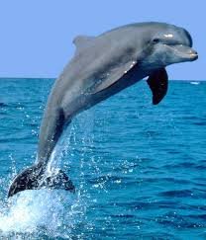
The Dolphin
The Dolphin
There are over 50 different kinds of dolphins. Dolphins are mammals, which means they have hair, are born alive, are warm-blooded, and breathe air. All dolphins have a nose that is shaped like a beak and they all have small, sharp teeth. Dolphins use a blowhole on top of their heads to breathe. Dolphins can hold their breath for several minutes and they can dive down as far as 1,000 feet!
Most dolphins are about 6 feet long. One of the largest dolphins is called a bottle-nosed dolphin and it can be 9 feet long! The smallest dolphin is the Buffeo and it is between 3-4 feet long.
Dolphins mainly eat live fish. Dolphins are predators. Dolphins eat herring, mackerel, and sardines. Some dolphins eat shrimp and squid.
Female dolphins are called cows, males are called bulls and young dolphins are called calves. Dolphins are mammals so they must have hair, right? Well, it is true that they are mammals, but dolphins only have hair when they are first born. This hair is found on the top of the rostrum, which is the dolphin’s snout, and falls out within two weeks. Dolphins do not grow any other hair for the rest of their lives.
Dolphins have excellent eyesight and hearing as well as the ability to use echolocation for finding the exact location of objects. Bottlenose dolphins have excellent vision both above and below the water. When dolphins look at objects under the water, they produce and oily substance that covers their eyes to protect them. Dolphins can also see very well at night, just like cats and dogs. However, they cannot see in color. Dolphins communicate with each other by clicking, whistling and other sounds.
Dolphins often display a playful attitude which makes them popular in human culture. They can be seen jumping out of the water, riding waves, play fighting and occasionally interacting with humans swimming in the water.

Slide 46
The Dolphin
The Dolphin
There are over 50 different kinds of dolphins. Dolphins are mammals, which means they have hair, are born alive, are warm-blooded, and breathe air. All dolphins have a nose that is shaped like a beak and they all have small, sharp teeth. Dolphins use a blowhole on top of their heads to breathe. Dolphins can hold their breath for several minutes and they can dive down as far as 1,000 feet!
Most dolphins are about 6 feet long. One of the largest dolphins is called a bottle-nosed dolphin and it can be 9 feet long! The smallest dolphin is the Buffeo and it is between 3-4 feet long.
Dolphins mainly eat live fish. Dolphins are predators. Dolphins eat herring, mackerel, and sardines. Some dolphins eat shrimp and squid.
Female dolphins are called cows, males are called bulls and young dolphins are called calves. Dolphins only have hair when they are first born. This hair is found on the top of the rostrum, which is the dolphin’s snout, and falls out within two weeks. Dolphins do not grow any other hair for the rest of their lives.
Dolphins have excellent eyesight and hearing as well as the ability to use echolocation for finding the exact location of objects. When dolphins look at objects under the water, they produce and oily substance that covers their eyes to protect them. Dolphins can also see very well at night, just like cats and dogs, but, they cannot see in color. Dolphins talk with each other by clicking, whistling and other sounds.
Dolphins can be seen jumping out of the water, riding waves, play fighting, and sometimes swimming in the water with humans.

Slide 47
The Dolphin
The Dolphin
Dolphins are mammals.
All dolphins have a nose that is shaped like a beak.
All dolphins have small, sharp teeth.
Dolphins use a blowhole on top of their heads to breathe.
They can dive 1000 feet under the water.
Most dolphins are about 6 feet long.
Dolphins mainly eat live fish. They eat herring, mackerel, and sardines. Some dolphins eat shrimp and squid.
Female dolphins are called cows.
Males are called bulls.
Baby dolphins are called calves.
Dolphins only have hair when they are first born. Then the hair falls out.
Dolphins can see and hear well.
Dolphins can see at night, but cannot see in color.
Dolphins talk with each other by clicking, and whistling.
Dolphins like to jump, play fight, swim, and ride waves.

Slide 48
Diagram of the Dolphin:

Slide 49
Dolphins
Can
have
are
_________________
_________________
_________________
_________________
_________________
_________________
_________________
_________________
_________________
_________________
_________________
_________________
_________________
_________________
_________________
_________________
_________________
_________________
_________________
_________________
_________________

Slide 50
Dolphins

Slide 51
Life Cycle of the Dolphin:

Slide 52
Dolphins:
Habitat:
Life Span:
Interesting Fact:
Diet:

Slide 53
Dolphins
3 things I learned:
2 interesting facts :
1 question :

Slide 54
Dolphins
Live__________________________________.
Have _________________________________.
Are __________________________________.
Can __________________________________.
Eat __________________________________.
Always _______________________________.
Never ________________________________.

Slide 55
Dolphin
____________
Both:

Slide 56
My Dolphin Adventure Story!
______________________________________________________________________
______________________________________________________________________
______________________________________________________________________
______________________________________________________________________
______________________________________________________________________
______________________________________________________________________
______________________________________________________________________
______________________________________________________________________
______________________________________________________________________
______________________________________________________________________

Slide 57
Title:
Table of Contents:
__________________...............Pg. 1
__________________...............Pg. 2
__________________...............Pg. 3
__________________...............Pg. 4
__________________...............Pg. 5
__________________...............Pg. 6
__________________...............Pg. 7
__________________...............Pg. 8
__________________...............Pg. 9
__________________.............Pg. 10
Researched By:
_________________

Slide 58
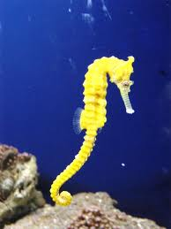
The Seahorse
The Seahorse
A seahorse is a very interesting looking creature! They have eyes, a snout, body, and tail. A seahorse can move its eyes in opposite directions at the same time. So it can look for food with one eye and watch out for predators with the other.
A seahorses’ size can range from about a half an inch (smaller than a thumbnail) to a little over 1 foot (about 14 inches).
A seahorse uses its snout as a straw to suck up tiny animals. A seahorse has no teeth, so it just swallows food whole — as many as 3,000 tiny creatures in a day. Talk about eating like a horse! Seahorses feed on small living animals such as daphnia, Cyclops, larvae of water insects, or mysids.
The daddy seahorse has a pouch on the front of its body. It uses this pouch to keep its eggs inside until they are ready to hatch. He hatches about 100 to 200 babies at a time.
Seahorses are no racehorses: they’re the slowest of all fish. It would take more than a minute for some kinds to swim from your elbow to your fingertips. Since they’re such weak swimmers, seahorses spend most of their time just hanging on to things. That’s where those unusual “monkey tails” come in. The tails work as hands. Seahorses can curl them around coral, plants, or other things and hold on tight.
A seahorse’s body is unusual for a fish. It’s covered with bony plates, kind of like a suit of armor. Stretched over the plates is thin skin that has no scales. Since seahorses are mostly skin and bones, they have few predators. But some crabs, fish, birds, and other creatures don’t mind a crunchy meal. To stay safe from these predators, and to hide from prey, seahorses have a trick: They disappear! Most can change color to blend in with whatever they are clinging to. And some seahorses have spines, bumps, or other growths that help them match their “hitching posts,” as well.

Slide 59
The Seahorse
The Seahorse
A seahorse has eyes, a snout, body, and tail. A seahorse can move its eyes in opposite directions at the same time. So it can look for food with one eye and watch out for predators with the other.
A seahorses’ size can range from about a half an inch (smaller than a thumbnail) to a little over 1 foot (about 14 inches).
A seahorse uses its snout as a straw to suck up tiny animals. A seahorse has no teeth, so it just swallows food whole. Seahorses feed on 3,000 small living animals a day such as daphnia, Cyclops, larvae of water insects, or mysids.
The daddy seahorse has a pouch on the front of its body. It uses this pouch to keep its eggs inside until they are ready to hatch. He hatches about 100 to 200 babies at a time.
Seahorses are very slow and are not good swimmers. Seahorses spend most of their time just hanging on to things. Their tails work as hands. Seahorses can curl them around coral, plants, or other things and hold on tight.
A seahorse’s body is unusual for a fish. It’s covered with bony plates and skin. They have some predators like crabs, fish, and birds. Seahorses can change color to blend in with whatever they are clinging to. And some seahorses have spines, bumps, or other growths that help them match their “hitching posts,” as well.

Slide 60
The Seahorse
The Seahorse
A seahorse has eyes, a snout, body, and tail.
A seahorses is small (1 inch to 14 inches long).
A seahorse uses its snout as a straw to suck up tiny animals.
A seahorse has no teeth.
They eat daphnia, Cyclops, larvae of water insects, or mysids.
The daddy seahorse hatches babies from his pouch.
Seahorses are very slow and are not good swimmers.
Seahorses can curl their tail around coral, plants, or other things and hold on tight.
A seahorse’s body has bony plates and skin.
Crabs, fish, and birds like to eat seahorses.
Seahorses can change colors.
Some seahorses have spines and bumps.

Slide 61
Diagram of the Seahorse:

Slide 62
Seahorses
Can
have
are
_________________
_________________
_________________
_________________
_________________
_________________
_________________
_________________
_________________
_________________
_________________
_________________
_________________
_________________
_________________
_________________
_________________
_________________
_________________
_________________
_________________

Slide 63
Seahorses

Slide 64
Life Cycle of the Seahorse:

Slide 65
Seahorses:
Habitat:
Life Span:
Interesting Fact:
Diet:

Slide 66
Seahorses
3 things I learned:
2 interesting facts :
1 question :

Slide 67
Seahorses
Live__________________________________.
Have _________________________________.
Are __________________________________.
Can __________________________________.
Eat __________________________________.
Always _______________________________.
Never ________________________________.

Slide 68
Seahorse
____________
Both:

Slide 69
My Seahorse Adventure Story!
______________________________________________________________________
______________________________________________________________________
______________________________________________________________________
______________________________________________________________________
______________________________________________________________________
______________________________________________________________________
______________________________________________________________________
______________________________________________________________________
______________________________________________________________________
______________________________________________________________________

Slide 70
Title:
Table of Contents:
__________________...............Pg. 1
__________________...............Pg. 2
__________________...............Pg. 3
__________________...............Pg. 4
__________________...............Pg. 5
__________________...............Pg. 6
__________________...............Pg. 7
__________________...............Pg. 8
__________________...............Pg. 9
__________________.............Pg. 10
Researched By:
_________________

Slide 71
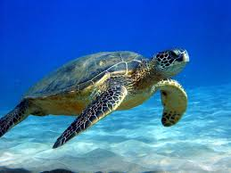
The Sea Turtle
The Sea Turtle
Sea turtles are one of Earth’s most ancient creatures. The seven species that can be found today have been around for 110 million years, since the time of dinosaurs. The sea turtle’s shell is streamlined for swimming through the water. Unlike other turtles, sea turtles cannot retract their legs and heads into their shells.
Most common items eaten include jellyfish, seaweed, crabs, shrimp, sponges, snails, algae, and mollusks.
It is difficult to find population numbers for sea turtles because male and juvenile seat turtles do not return to shore once they hatch and reach the ocean, which makes it hard to keep track of them.
Sea turtles are found in warm and temperate waters throughout the world and migrate hundreds of miles between nesting and feeding grounds. Most sea turtles undergo long migrations, some as far as 1,400 miles, between their feeding grounds and the beaches where they nest.
Sea turtles spend most of their lives in the water, and most of what is known about sea turtle behavior is obtained by observing hatchlings and females that leave the water to lay eggs. Sea turtles, like salmon, will return to the same nesting grounds at which they were born. When females come to the shore they dig out a nest in the ground with their back flippers, bury their clutch of eggs and return to the ocean. After hatching, the young may take as long as a week to dig themselves out of the nest. They emerge at night, move toward the ocean and remain there, solitary.
Sea turtles come in many different sizes, shapes and colors. Their color varies between yellow, greenish and black depending on the species. The upper shell, or carapace, of each sea turtle species ranges in length, color, shape and arrangement of scales. Sea turtles do not have teeth, but their jaws have modified "beaks" suited to their particular diet. They do not have visible ears but have eardrums covered by skin. They hear best at low frequencies, and their sense of smell is excellent. Their vision underwater is good, but they are nearsighted out of water. Their streamlined bodies and large flippers make them remarkably adapted to life at sea. However, sea turtles maintain close ties to land.

Slide 72
The Sea Turtle
The Sea Turtle
Sea turtles have been around for 110 million years, since the time of dinosaurs. The sea turtle’s shell is made for swimming through the water. Unlike other turtles, sea turtles cannot tuck their legs and heads into their shells.
They eat jellyfish, seaweed, crabs, shrimp, sponges, snails, algae, and mollusks.
Male turtles do not return to the shore. Female turtles do return to lay their eggs. Sea turtles, like salmon, will return to the same nesting grounds at which they were born. When females come to the shore they dig out a nest in the ground with their back flippers, bury their clutch of eggs and return to the ocean. After hatching, the young may take as long as a week to dig themselves out of the nest. They emerge at night, move toward the ocean and remain there by themselves.
Sea turtles are found in warm and temperate waters throughout the world and migrate hundreds of miles between nesting and feeding grounds.
Sea turtles come in many different sizes, shapes and colors. Their color varies between yellow, greenish and black depending on the species.
Sea turtles do not have teeth, but their jaws have "beaks" to help them eat. They do not have ears you can see, but have eardrums covered by skin. They hear low sounds best and their sense of smell is excellent. Their vision underwater is good, but they are nearsighted out of water. Their body shape and large flippers help them survive in the ocean.

Slide 73
The Sea Turtle
The Sea Turtle
Sea turtles have a shell and big flippers that helps them swim.
Seaturtles cannot tuck their legs and heads into their shells.
They eat jellyfish, seaweed, crabs, shrimp, sponges, snails, algae, and mollusks.
Female sea turtles bury their eggs in the sand.
The babies hatch at night by themselves.
Sea turtles like warm ocean water. They travel back and forth to find food.
Sea turtles can be yellow, greenish or black.
Sea turtles do not have teeth, but their jaws have "beaks" to help them eat.
They do not have ears you can see, but have eardrums covered by skin.
They hear low sounds best.
They can smell very well.
They can see well under water, but are not good at seeing on land.

Slide 74
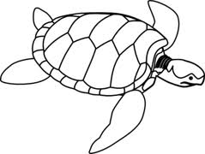
Diagram of the Sea Turtle:

Slide 75
Sea Turtles
Can
have
are
_________________
_________________
_________________
_________________
_________________
_________________
_________________
_________________
_________________
_________________
_________________
_________________
_________________
_________________
_________________
_________________
_________________
_________________
_________________
_________________
_________________

Slide 76
Sea Turtles

Slide 77
Life Cycle of the Sea Turtle:

Slide 78
Sea Turtles:
Habitat:
Life Span:
Interesting Fact:
Diet:

Slide 79
Sea Turtles
3 things I learned:
2 interesting facts :
1 question :

Slide 80
Sea Turtles
Live__________________________________.
Have _________________________________.
Are __________________________________.
Can __________________________________.
Eat __________________________________.
Always _______________________________.
Never ________________________________.

Slide 81
Sea Turtle
____________
Both:

Slide 82
My Sea Turtle Adventure Story!
______________________________________________________________________
______________________________________________________________________
______________________________________________________________________
______________________________________________________________________
______________________________________________________________________
______________________________________________________________________
______________________________________________________________________
______________________________________________________________________
______________________________________________________________________
______________________________________________________________________

Slide 83
Title:
Table of Contents:
__________________...............Pg. 1
__________________...............Pg. 2
__________________...............Pg. 3
__________________...............Pg. 4
__________________...............Pg. 5
__________________...............Pg. 6
__________________...............Pg. 7
__________________...............Pg. 8
__________________...............Pg. 9
__________________.............Pg. 10
Researched By:
_________________

Slide 84
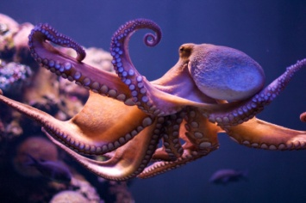
The Octopus
The Octopus
The Octopus does not have bones in its body. Octopi live on the bottom of the ocean in the darkest waters. Sharks, dolphins, and eels like to eat Octopi.
Octopi can be many different sizes. The largest ones can grow to be about 16 feet long, but most are around 4 feet with all of their arms spread out. Female (girl) octopi are smaller than the males (boy).
The Octopus has eight legs with suckers on the bottom of each of them. They use their arms to catch and choke their prey. They eat crabs, clams, snails, small fish, and sometimes even a smaller Octopus.
Octopi have 3 hearts and their blood is blue. They can change color to blend in with their background, squirt ink to escape a predator or even shed an arm to get away from an attack. It will grow back in some time.
Most octopi have an ink sac that can shoot out steams of dark ink like liquid when they are threatened. This serves 3 purposes: 1) When threatened they swallow water and shoot it out, which propels them and shoots ink. This typically distracts the predator and makes the octopus jet away.
2) The substance can interfere with the predators sense of sight or smell. 3) The ink clouds the water, making it difficult for the predator to find the octopus. Their ink may be different colors; black, red or brown.
An octopus has horizontal pupils. Even stranger, when they go upside down their eyes stay in the same position. So they never see anything upside down.
They are very good at problem solving, which makes sense considering how good they are at adapting. They can be taught to unscrew a lid or remove a plug to get a prey from a container!
It’s typical for an octopus to collect shells and other objects that surround them to construct a “home” or “garden” around where they live. Some other types of octopi carry shells for protection.

Slide 85
The Octopus
The Octopus
The Octopus does not have bones in its body. Octopi live on the bottom of the ocean in the darkest waters. Sharks, dolphins, and eels like to eat Octopi.
Octopi can be many different sizes. The largest ones can grow to be about 16 feet long, but most are around 4 feet with all of their arms spread out. Female (girl) octopi are smaller than the males (boy).
The Octopus has eight legs with suckers on the bottom of each of them. They use their arms to catch and choke their prey. They eat crabs, clams, snails, small fish, and sometimes even a smaller Octopus.
Octopi have 3 hearts and their blood is blue. They can change color to blend in with their background, squirt ink to escape a predator or even shed an arm to get away from an attack. It will grow back in some time.
Shooting ink does 3 things: 1) When threatened they swallow water and shoot it out, which pushes them away and shoots ink. This distracts the predator and makes the octopus jet away. 2) The ink can stop with the predators sense of sight or smell. 3) The ink clouds the water, making it hard for the predator to find the octopus. Their ink may be black, red or brown.
An octopus has horizontal pupils. Even stranger, when they go upside down their eyes stay in the same position. So they never see anything upside down.
They are good at adapting. They can be taught to unscrew a lid or remove a plug to get a prey from a container!
Octopi like to collect shells and other objects so they can build a “home” or “garden” around where they live. Some other types of octopi carry shells for protection.

Slide 86
The Octopus
The Octopus
The Octopus does not have bones.
Octopi live on the bottom of the ocean in the dark.
Sharks, dolphins, and eels like to eat Octopi.
Octopi are about 4 feet long.
The Octopus has eight legs with suckers on the bottom of each of them.
They use their arms to catch their prey.
They eat crabs, clams, snails, small fish, and sometimes even a smaller Octopus.
Octopi have 3 hearts and their blood is blue.
They can change color.
They can squirt ink.
Their arm can come off if in harm. It will grow back.
Their ink may be black, red or brown.
Their eyes can turn around so they cannot see upside down.
They can open or pull things with their arms.
They carry shells to protect them.

Slide 87
Diagram of the Octopus:

Slide 88
Octopi
Can
have
are
_________________
_________________
_________________
_________________
_________________
_________________
_________________
_________________
_________________
_________________
_________________
_________________
_________________
_________________
_________________
_________________
_________________
_________________
_________________
_________________
_________________

Slide 89
Octopi

Slide 90
Life Cycle of the Octopus:

Slide 91
Octopi:
Habitat:
Life Span:
Interesting Fact:
Diet:

Slide 92
Octopi
3 things I learned:
2 interesting facts :
1 question :

Slide 93
Octopi
Live__________________________________.
Have _________________________________.
Are __________________________________.
Can __________________________________.
Eat __________________________________.
Always _______________________________.
Never ________________________________.

Slide 94
Octopus
____________
Both:

Slide 95
My Octopus Adventure Story!
______________________________________________________________________
______________________________________________________________________
______________________________________________________________________
______________________________________________________________________
______________________________________________________________________
______________________________________________________________________
______________________________________________________________________
______________________________________________________________________
______________________________________________________________________
______________________________________________________________________

Slide 96
Title:
Table of Contents:
__________________...............Pg. 1
__________________...............Pg. 2
__________________...............Pg. 3
__________________...............Pg. 4
__________________...............Pg. 5
__________________...............Pg. 6
__________________...............Pg. 7
__________________...............Pg. 8
__________________...............Pg. 9
__________________.............Pg. 10
Researched By:
_________________

Slide 97
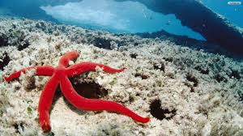
The Starfish
The Starfish
You probably know sea stars as starfish, the name sea stars are commonly known by. But sea stars aren’t really fish. Sea stars, like sea urchins and sand dollars, do not have backbones, which makes them part of a group called invertebrates. Fish have backbones, which makes them vertebrates.
There are more than 1,600 species (types) of sea stars living in all the world’s oceans. Sea stars occupy every type of habitat, including tidal pools, rocky shores, sea grass, kelp beds, and coral reefs. Some sea stars even live in sands as deep as 20,530 feet.
Most sea stars sport spiny skin and five arms, although some can grow as many as 50 arms. The arms are covered with pincher-like organs and suckers that allow the animal to slowly creep along the ocean floor.
Light-sensitive eyespots on the tips of the arms help the sea star find food. Favorites on the menu include mollusks such as clams, oysters, and snails.
The sea star eats by attaching to prey and extending its stomach out through its mouth. Enzymes from the sea star’s stomach digest the prey. The digested material enters the sea star’s stomach. Tiny organisms can be swallowed whole.
Sea stars aren’t social creatures, but they will congregate in large groups during certain times of the year to feed.
Sea stars can grow a new arm if they lose one, although sea stars generally have few predators thanks to their rigid bodies.
Adult sea stars exist in a range of colors, from orange to pink to brown. They can grow from 0.4 inches (1 centimeter) to more than 3 feet (91 centimeters) across!
It’s difficult to tell whether a sea star is male or female just by looking at them.

Slide 98
The Starfish
The Starfish
You probably know sea stars as starfish. But sea stars aren’t really fish. Sea stars, like sea urchins and sand dollars, do not have backbones, which makes them part of a group called invertebrates.
There are more than 1,600 species (types) of sea stars living in all the world’s oceans. Sea stars occupy every type of habitat, including tidal pools, rocky shores, sea grass, kelp beds, and coral reefs.
Most sea stars sport spiny skin and five arms, although some can grow as many as 50 arms. The arms are covered with pincher-like organs and suckers that allow the animal to slowly creep along the ocean floor.
They have light-sensitive eyespots on the tips of the arms help the sea star find food. They eat mollusks such as clams, oysters, and snails.
The sea star eats by attaching to prey and extending its stomach out through its mouth. Tiny living things can be swallowed whole.
Sea stars aren’t social creatures, but they will be in large groups during certain times of the year to feed.
Sea stars can grow a new arm if they lose one, but they do not have many predators because of their rigid bodies.
Adult sea stars can be a range of colors, from orange to pink to brown. They can grow from 0.4 inches to more than 3 feet across!
It’s difficult to tell whether a sea star is male or female just by looking at them.

Slide 99
The Starfish
The Starfish
Starfish are also called sea stars.
They do not have backbones.
There are 1,600 kinds of sea stars.
They live in tidal pools, rocky shores, sea grass, kelp beds, and coral reefs.
They have spiny skin and five arms. Some have 50 arms.
They have suckers on their arms to help them move.
They have eyes on the end of their arm to help them find food.
They eat mollusks such as clams, oysters, and snails.
The stomach and the mouth are in the center of its body.
Sea stars live by themselves.
They get in groups to eat.
Sea stars can grow a new arm if they lose one.
They have very hard bodies.
They can be orange, pink, or brown.
They can grow from 0.4 inches to more than 3 feet across!

Slide 100
Diagram of the Starfish:

Slide 101
Starfish
Can
have
are
_________________
_________________
_________________
_________________
_________________
_________________
_________________
_________________
_________________
_________________
_________________
_________________
_________________
_________________
_________________
_________________
_________________
_________________
_________________
_________________
_________________

Slide 102
Starfish

Slide 103
Life Cycle of the Starfish:

Slide 104
Starfish:
Habitat:
Life Span:
Interesting Fact:
Diet:

Slide 105
Starfish
3 things I learned:
2 interesting facts :
1 question :

Slide 106
Starfish
Live__________________________________.
Have _________________________________.
Are __________________________________.
Can __________________________________.
Eat __________________________________.
Always _______________________________.
Never ________________________________.

Slide 107
Starfish
____________
Both:

Slide 108
My Starfish Adventure Story!
______________________________________________________________________
______________________________________________________________________
______________________________________________________________________
______________________________________________________________________
______________________________________________________________________
______________________________________________________________________
______________________________________________________________________
______________________________________________________________________
______________________________________________________________________
______________________________________________________________________

Slide 109
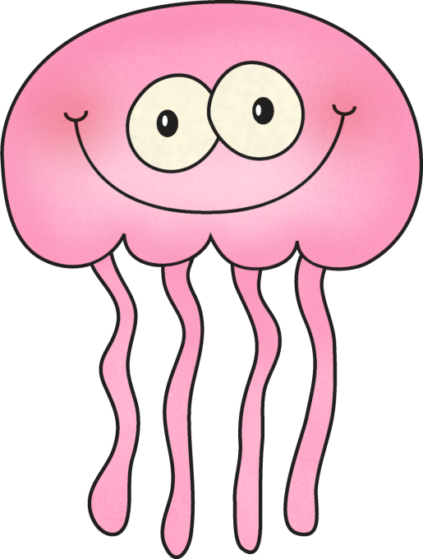
Title:
Table of Contents:
__________________...............Pg. 1
__________________...............Pg. 2
__________________...............Pg. 3
__________________...............Pg. 4
__________________...............Pg. 5
__________________...............Pg. 6
__________________...............Pg. 7
__________________...............Pg. 8
__________________...............Pg. 9
__________________.............Pg. 10
Researched By:
_________________

Slide 110
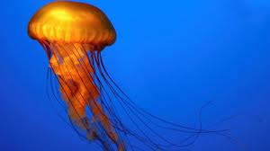
The Jellyfish
The Jellyfish
Jellyfish are “jelly like” creatures that float through the currents of the ocean. They can be pink, yellow, blue, or purple and often seem like they are glowing. They appear to be clear in color as well. They do not have a brain, heart, or bones, but some of them do have eyes. They are bell shaped and have an opening in the center that is their mouth. They have tentacles that hang down below them. They use these to sting their prey. Jellyfish stings can be very painful to humans.
Sea turtles LOVE to eat jellyfish. Many people who live in China like to eat jellyfish – they are very nutritious.
The largest jellyfish ever caught had a center part that was 8 feet in width and had tentacles that hung down over 100 feet! Some jellyfish can be so small that they cannot be seen by the human eye. Most of them are about a foot in length.
Jellyfish like to eat fish, crabs, tiny plants, and will even eat other kinds of jellyfish.
Most jellyfish live less than one year, and some of the smallest may live only a few days. The most familiar stage is the medusa stage, where the jelly usually swims around and has tentacles hanging down. They are formed from thousands of very small larvae called planulae. The larvae then settle on the bottom of the ocean on rocks and oyster shells and form a small polyp that looks just like a tiny sea anemone. Each polyp will bud off many baby jellyfish called ephyrae that grow very quickly into adult medusae.
When huge numbers of plants or animals appear suddenly, scientists call it a 'bloom'. In some areas of the world, millions of jellyfish can swarm together, and these blooms cause problems for fisheries and tourism.

Slide 111
The Jellyfish
The Jellyfish
Jellyfish are “jelly like” creatures that float through the currents of the ocean. They can be pink, yellow, blue, or purple and often seem like they are glowing. They appear to be clear in color as well. They do not have a brain, heart, or bones, but some of them do have eyes. They are bell shaped and have an opening in the center that is their mouth. They have tentacles that hang down below them. They use these to sting their prey. Jellyfish stings can be very painful to humans.
Sea turtles LOVE to eat jellyfish. Many people who live in China like to eat jellyfish – they are very nutritious.
The largest jellyfish ever caught had a center part that was 8 feet in width and had tentacles that hung down over 100 feet! Some jellyfish can be so small that they cannot be seen by the human eye. Most of them are about 1 foot.
Jellyfish like to eat fish, crabs, tiny plants, and will even eat other kinds of jellyfish.
Most jellyfish live less than one year, and some of the smallest may live only a few days. They start as larvae, then form a small polyp. The polyp opens up and many jellyfish swim out. They call this a “bloom” and it can cause problems for fisheries and tourism.

Slide 112
The Jellyfish
The Jellyfish
Jellyfish can be pink, yellow, blue, or purple
They look like they are glowing.
They look clear.
Most jellyfish live less than one year, and some small ones live a few days.
They do not have a brain, heart, or bones, but some of them do have eyes.
They are bell shaped and have a mouth in the middle.
They have tentacles that hang down below them.
They use these to sting their prey.
Jellyfish stings can hurt.
Most of them are about 1 foot.
Jellyfish like to eat fish, crabs, tiny plants, and will even eat other kinds of jellyfish.
Sea turtles LOVE to eat jellyfish.
Many people who live in China like to eat them.

Slide 113
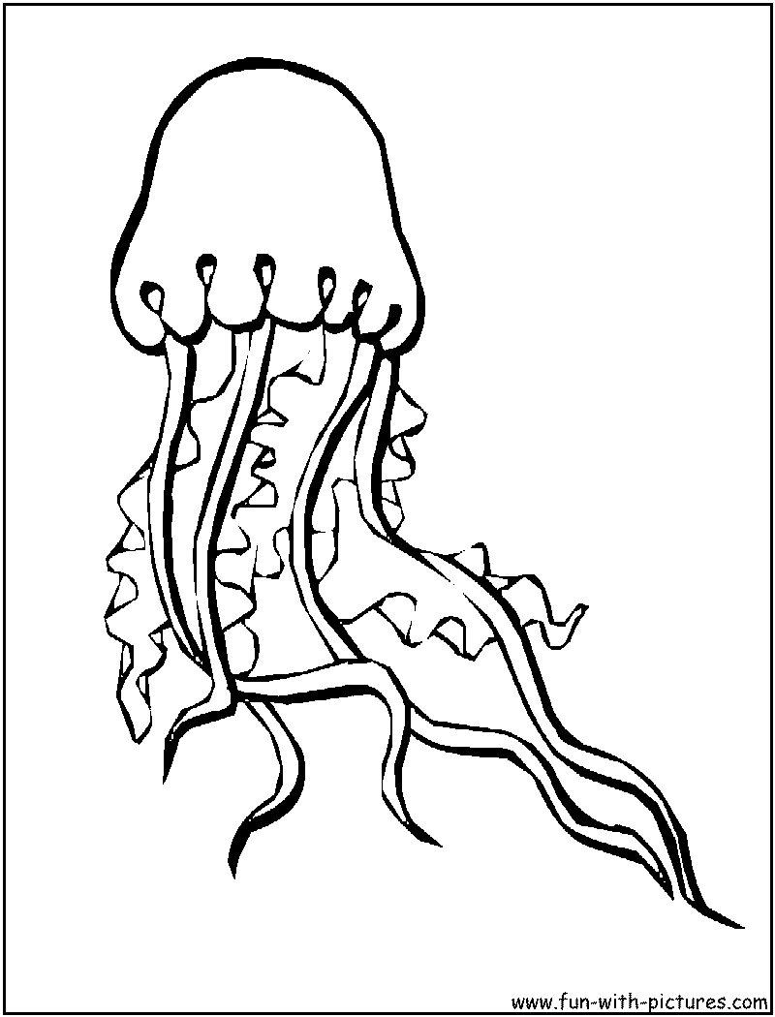
Diagram of the Jellyfish:

Slide 114
Jellyfish
Can
have
are
_________________
_________________
_________________
_________________
_________________
_________________
_________________
_________________
_________________
_________________
_________________
_________________
_________________
_________________
_________________
_________________
_________________
_________________
_________________
_________________
_________________

Slide 115
Jellyfish

Slide 116
Life Cycle of the Jellyfish:

Slide 117
Jellyfish:
Habitat:
Life Span:
Interesting Fact:
Diet:

Slide 118
Jellyfish
3 things I learned:
2 interesting facts :
1 question :

Slide 119
Jellyfish
Live__________________________________.
Have _________________________________.
Are __________________________________.
Can __________________________________.
Eat __________________________________.
Always _______________________________.
Never ________________________________.

Slide 120
Jellyfish
____________
Both:

Slide 121
My Jellyfish Adventure Story!
______________________________________________________________________
______________________________________________________________________
______________________________________________________________________
______________________________________________________________________
______________________________________________________________________
______________________________________________________________________
______________________________________________________________________
______________________________________________________________________
______________________________________________________________________
______________________________________________________________________

Slide 122
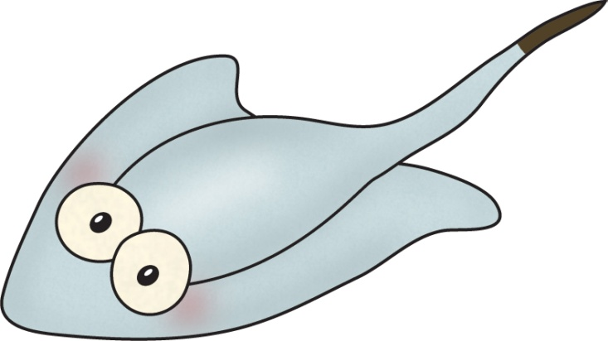
Title:
Table of Contents:
__________________...............Pg. 1
__________________...............Pg. 2
__________________...............Pg. 3
__________________...............Pg. 4
__________________...............Pg. 5
__________________...............Pg. 6
__________________...............Pg. 7
__________________...............Pg. 8
__________________...............Pg. 9
__________________.............Pg. 10
Researched By:
_________________

Slide 123
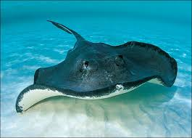
The Stingray
The Stingray
Stingrays are long, flat, and diamond shaped. They have fins that look more like wings that are used to help them move around the ocean. Stingrays like to roam around the bottom of the ocean and sometimes like to bury themselves in the sand for protection from predators. Their colors usually match the mud or sand they hide in. They like to stay in water that is not very deep and warm.
Stingrays can be many different sizes. They can be up to six feet wide. Most are about 2 feet wide. They can live to be 15 to 25 years old.
Stingrays like to eat small fish that live along the bottom of the ocean as well as small plants. They also eat clams, oysters, shrimp, crabs, and mussels. They use their strong jaws to crush the shells of these creatures and get to the meat inside.
Stingrays, with their wide, flat bodies, may not look like fish, but they are. They are related to sharks, and, like their shark cousins, they do not have bones. Instead, their bodies are supported by cartilage—the same material that you feel inside the tip of your nose.
While a stingray's mouth is on the underside of its body, along with its nostrils and gill slits, its eyes are on the top. Scientists don't think they use their eyes for hunting very much though. Instead, they use special sensors called ampullae of Lorenzini, which can detect the tiny electrical charges emitted by their prey.
A stingray’s tail has little points on it that are poisonous if poked into another animal. Stingrays are very soft to the touch.
Generally, female stingrays give birth once a year. They usually have two to six young at a time. While a baby stingray is still inside its mother, it grows to be quite large and developed so that when it's born, it looks like a little adult. From birth, the young stingray is able to fend for itself.

Slide 124
The Stingray
The Stingray
Stingrays are long, flat, and diamond shaped. They have fins that look more like wings that are used to help them move around the ocean. Stingrays like to be on the bottom of the ocean and sometimes like to bury themselves in the sand to hide from predators. Their colors usually match the mud or sand they hide in. They like to stay in water that is not very deep and warm.
Stingrays can be up to six feet wide. Most are about 2 feet wide. They can live to be 15 to 25 years old.
Stingrays like to eat plants, clams, oysters, shrimp, crabs, and mussels. They use their strong jaws to eat.
Stingrays are related to sharks, and, like their shark cousins, they do not have bones. Instead, their bodies have cartilage—the same material that you feel inside the tip of your nose.
While a stingray's mouth is on the bottom of its body, along with its nostrils and gill slits. Its eyes are on the top. They do not use their eyes to hunt. Instead, they use special sensors that detect their prey.
A stingray’s tail has little points on it that are poisonous if poked into another animal. Stingrays are very soft to the touch.
Female stingrays give birth once a year. They usually have two to six young at a time. While a baby stingray is still inside its mother, it grows, and when born it looks like a little adult. The stingray then takes care of itself.

Slide 125
The Stingray
The Stingray
Stingrays are long and flat.
They have fins that look like wings.
Stingrays bury themselves in the sand to hide from predators.
They match the mud or sand they hide in.
They like to stay in water that is not very deep and warm.
Stingrays are about 2 feet wide.
They can live to be 15 to 25 years old.
Stingrays like to eat plants, clams, oysters, shrimp, crabs, and mussels.
Stingrays do not have bones.
Their mouth, nose, and gills are on the bottom of their body.
Their eyes are on top.
A stingray’s tail is pokey and has poison in it.
Stingrays are very soft.
Stingrays have 2 to 6 babies.

Slide 126
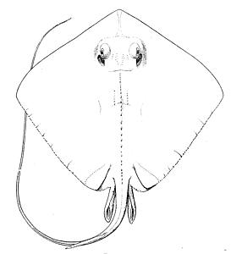
Diagram of the Stingray:

Slide 127
Stingray
Can
have
are
_________________
_________________
_________________
_________________
_________________
_________________
_________________
_________________
_________________
_________________
_________________
_________________
_________________
_________________
_________________
_________________
_________________
_________________
_________________
_________________
_________________

Slide 128
Stingray

Slide 129
Life Cycle of the Stingray:

Slide 130
Stingrays:
Habitat:
Life Span:
Interesting Fact:
Diet:

Slide 131
Stingrays
3 things I learned:
2 interesting facts :
1 question :

Slide 132
Stingrays
Live__________________________________.
Have _________________________________.
Are __________________________________.
Can __________________________________.
Eat __________________________________.
Always _______________________________.
Never ________________________________.

Slide 133
Stingray
____________
Both:

Slide 134
My Stingray Adventure Story!
______________________________________________________________________
______________________________________________________________________
______________________________________________________________________
______________________________________________________________________
______________________________________________________________________
______________________________________________________________________
______________________________________________________________________
______________________________________________________________________
______________________________________________________________________
______________________________________________________________________

Slide 135
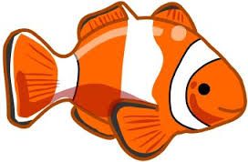
Title:
Table of Contents:
__________________...............Pg. 1
__________________...............Pg. 2
__________________...............Pg. 3
__________________...............Pg. 4
__________________...............Pg. 5
__________________...............Pg. 6
__________________...............Pg. 7
__________________...............Pg. 8
__________________...............Pg. 9
__________________.............Pg. 10
Researched By:
_________________

Slide 136
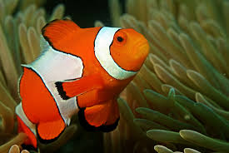
The Clown Fish
The Clown Fish
The colorful clown anemonefish, also called a clownfish, is bright orange with three white stripes—and probably reminds you of the star of the popular movie Finding Nemo.
This four-inch-long (10-centimeter-long) fish shares an amazing partnership with another sea creature: the anemone (pronounced: uh-NEM-uh-NEE). The partnership benefits both participants, and the close relationship led to the fish being named an anemonefish.
Anemones have tentacles that sting, but the clownfish isn't bothered by them. In fact, it lives among the tentacles. How can this fish do that and survive? Because it has a layer of mucus on its skin that makes it immune to the anemone's stings.
Living among the tentacles of the anemone, the clown anemonefish gains protection from predators—which don't dare get near the stinging protector. The anemonefish also gets to eat leftovers from the anemone's meals.
The anemone benefits from having the fish around, too. The useful fish nibbles away parasites that bug the anemone. And sometimes the anemonefish brings food into the tentacles which the anemone can also eat. There are a few predators that harm anemones, and the little anemonefish chases them away.
The scientific name of the clown anemonefish is Amphiprion percula.
The clown anemonefish lives to be six to ten years old. In captivity, they may live up to 18 years.
There are 28 species of anemonefish. They live mostly in shallow waters in the Indian Ocean, the Red Sea, and the western Pacific Ocean.
When clownfish hatch, they are all male. Under certain conditions, a male will change into a female. If it becomes female, it cannot change back.
After the movie Finding Nemo became a hit, the demand for clownfish by people wanting them as pets tripled.
Predators of the clown anemonefish include sharks and stingrays.
In addition to dining on anemone leftovers, the anemonefish eats algae and plankton, tiny plants and animals that float in the sea.

Slide 137
The Clown Fish
The Clown Fish
The colorful clown anemonefish, also called a clownfish, is bright orange with three white stripes—and probably reminds you of the star of the popular movie Finding Nemo.
This four-inch-long fish shares an amazing partnership with another sea creature: the anemone (pronounced: uh-NEM-uh-NEE). Anemones have tentacles that sting, but the clownfish isn't bothered by them. In fact, it lives among the tentacles. The clownfish has a layer of mucus on its skin that makes it immune to the anemone's stings.
The tentacles protect the clownfish from predators—which don't dare get near the stinging tentacles. The anemonefish also gets to eat leftovers from the anemone's meals. The clownfish also eats algae and plankton, tiny plants and animals that float in the sea.
The anemone benefits from having the fish around, too. The useful fish nibbles away parasites that bug the anemone. And sometimes the clownfish brings food into the tentacles which the anemone can also eat. There are a few predators that harm anemones, and the little clownfish chases them away.
The clown anemonefish lives to be six to ten years old. In captivity, they may live up to 18 years.
There are 28 species of anemonefish. They live mostly in shallow waters in the Indian Ocean, the Red Sea, and the western Pacific Ocean.
When clownfish hatch, they are all male. Sometimes a male will change into a female. If it becomes female, it cannot change back.
Predators of the clownfish are sharks and stingrays.

Slide 138
The Clown Fish
The Clown Fish
The clownfish is orange with three white stripes.
It is 4 inches long.
It lives in a plant called anemone. It stings other fish, but not the clownfish.
The clownfish has gooey skin that protects it from the stings.
The clownfish eats algae and plankton, tiny plants and animals that float in the sea.
The clownfish protects the anemone. He eats small things and gives it food.
The clownfish live to be six to ten years old.
There are 28 kinds of clownfish.
They live in the Indian Ocean, the Red Sea, and the western Pacific Ocean.
When clownfish babies are all males. Sometimes the male changes to a female.
Predators of the clownfish are sharks and stingrays.

Slide 139
Diagram of the Clown Fish:

Slide 140
Clown Fish
Can
have
are
_________________
_________________
_________________
_________________
_________________
_________________
_________________
_________________
_________________
_________________
_________________
_________________
_________________
_________________
_________________
_________________
_________________
_________________
_________________
_________________
_________________

Slide 141
Clown
Fish

Slide 142
Life Cycle of the Clown Fish:

Slide 143
Clown Fish:
Habitat:
Life Span:
Interesting Fact:
Diet:

Slide 144
Clown Fish
3 things I learned:
2 interesting facts :
1 question :

Slide 145
Clown Fish
Live__________________________________.
Have _________________________________.
Are __________________________________.
Can __________________________________.
Eat __________________________________.
Always _______________________________.
Never ________________________________.

Slide 146
Clown Fish
____________
Both:

Slide 147
My Clown Fish Adventure Story!
______________________________________________________________________
______________________________________________________________________
______________________________________________________________________
______________________________________________________________________
______________________________________________________________________
______________________________________________________________________
______________________________________________________________________
______________________________________________________________________
______________________________________________________________________
______________________________________________________________________

Slide 148
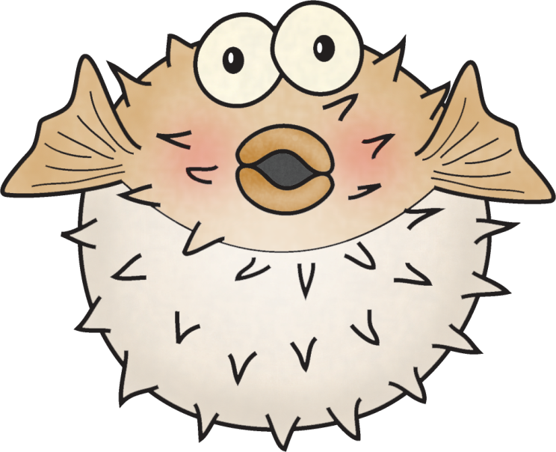
Title:
Table of Contents:
__________________...............Pg. 1
__________________...............Pg. 2
__________________...............Pg. 3
__________________...............Pg. 4
__________________...............Pg. 5
__________________...............Pg. 6
__________________...............Pg. 7
__________________...............Pg. 8
__________________...............Pg. 9
__________________.............Pg. 10
Researched By:
_________________

Slide 149
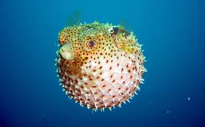
The Pufferfish
The Pufferfish
Pufferfish are able to inflate into a ball shape to evade predators. Also known as blowfish, these clumsy swimmers fill their elastic stomachs with huge amounts of water (and sometimes air) and can blow themselves up to several times their normal size. Pufferfish can be up to three feet (one meter) long. Some species also have spines on their skin to ward off predators. There are more than 120 species of pufferfish worldwide.
Even if a predator gobbles up a puffer before it inflates, it won't enjoy the snack. Most pufferfish contain a toxic substance that makes them foul tasting and potentially deadly to other fish. The toxin is deadly to humans. There is enough poison in one pufferfish to kill 30 adult humans, and there is no known antidote.
Japan, they are called fugu and are a very expensive, delicious treat. Because the fish are so poisonous, they are prepared only by trained, licensed fugu chefs. One false cut by the chef can mean death for the consumer.
Most puffers are found in tropical and subtropical ocean waters, but some species live in brackish (salt and fresh water mixed) and even fresh water. They have long, tapered bodies with bulbous heads. Some have wild markings and colors to show off their toxicity, while others have more muted coloring to blend in with their environment.
They are scaleless fish and usually have rough or spiky skin. All have four teeth that are fused together into a beak-like form. Pufferfish are in the family Tetraodontidae, which means four teeth. The teeth are used to crush their prey.
Pufferfish are carnivores that eat mostly invertebrates and algae. Large puffers will even crack open and eat clams, mussels, and shellfish with their hard beaks.
Some species of pufferfish are considered vulnerable due to pollution, habitat loss, and overfishing, but most populations are considered stable.

Slide 150
The Pufferfish
The Pufferfish
Pufferfish are able to puff into a ball shape to escape from predators. Also known as blowfish, these clumsy swimmers fill their stretchy stomachs with huge amounts of water (and sometimes air) and can blow themselves up to several times their normal size. Pufferfish can be up to three feet long.
Some species also have spines on their skin to ward off predators. There are more than 120 species of pufferfish worldwide.
Most pufferfish contain a poison in their spines. There is enough poison in one pufferfish to kill 30 adult humans, and there is no known cure.
Japan, they are called fugu and are a very expensive, delicious treat. Because the fish are so poisonous, they are prepared only by trained fugu chefs. One false cut by the chef can mean death for the consumer.
Most puffers are found in tropical and subtropical ocean waters, but some species live in brackish (salt and fresh water mixed) and even fresh water. They have long, tapered bodies with round heads. Some have wild markings and colors to show off their poison, while others have more light colors to help them camouflage.
They are scaleless fish and usually have rough or spiky skin. All have four teeth that are fused together into a beak-like form. The teeth are used to crush their prey.
Pufferfish are carnivores that eat mostly invertebrates and algae. Large puffers will even crack open and eat clams, mussels, and shellfish with their hard beaks.

Slide 151
The Pufferfish
The Pufferfish
Pufferfish blow up with air and water.
They can be up to three feet long.
They have pokey spines that have poison in them.
There are more than 120 kinds of pufferfish.
Some people eat pufferfish, but they have to be careful.
Pufferfish live in salt water, fresh water, and both.
Pufferfish can be many colors.
They have 4 teeth that make a beak.
The teeth are used to crush their prey.
Pufferfish eat algae, clams, mussels, and shellfish with their hard beaks.

Slide 152
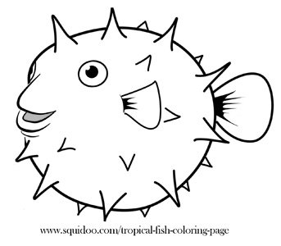
Diagram of the Pufferfish:

Slide 153
Pufferfish
Can
have
are
_________________
_________________
_________________
_________________
_________________
_________________
_________________
_________________
_________________
_________________
_________________
_________________
_________________
_________________
_________________
_________________
_________________
_________________
_________________
_________________
_________________

Slide 154
Pufferfish

Slide 155
Life Cycle of the Pufferfish:

Slide 156
Pufferfish:
Habitat:
Life Span:
Interesting Fact:
Diet:

Slide 157
Pufferfish
3 things I learned:
2 interesting facts :
1 question :

Slide 158
Pufferfish
Live__________________________________.
Have _________________________________.
Are __________________________________.
Can __________________________________.
Eat __________________________________.
Always _______________________________.
Never ________________________________.

Slide 159
Pufferfish
____________
Both:

Slide 160
My Pufferfish Adventure Story!
______________________________________________________________________
______________________________________________________________________
______________________________________________________________________
______________________________________________________________________
______________________________________________________________________
______________________________________________________________________
______________________________________________________________________
______________________________________________________________________
______________________________________________________________________
______________________________________________________________________

Slide 161
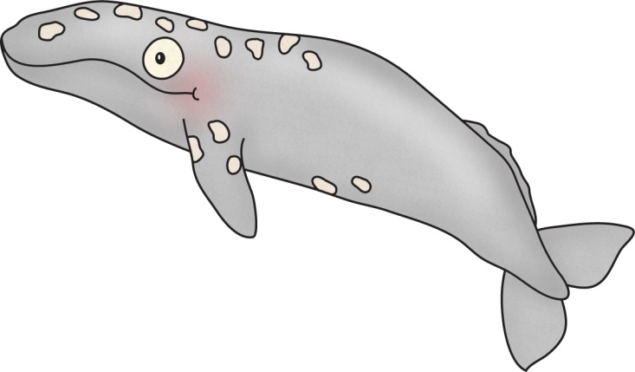
Title:
Table of Contents:
__________________...............Pg. 1
__________________...............Pg. 2
__________________...............Pg. 3
__________________...............Pg. 4
__________________...............Pg. 5
__________________...............Pg. 6
__________________...............Pg. 7
__________________...............Pg. 8
__________________...............Pg. 9
__________________.............Pg. 10
Researched By:
_________________

Slide 162
The Whale
The Whale
All whales have a blowhole (their nose), 2 flippers, and a tail. Whales are a mammal which means they are born alive, are warm blooded, have hair, and breathe air. Some whales travel in groups, others do not.
The largest whale is the blue whale, which can be as long as 90 feet. The smallest kind of whale is 3-4 feet.
Whales eat different things. Some whales eat plankton. Many whales eat fish, squid, crabs, and shrimp. Some whales even eat sharks, seals, sea lions, penguins, and even other whales.
Whales love to sing! They use this as a call to mates, a way to communicate and also just for fun! After a period of time they get bored of the same whale song and begin to sing a different tune.
Whales support many different types of life. Several creatures, such as barnacles and sea lice, attach themselves to the skin of whales and live there.
A baby whale is called a calf. Whales form pods (groups) to look after calves and feed together. These groups are often made up of all female or all male whales.
Many whales are toothless. They use a plate of comb-like fiber called baleen to filter small crustaceans and other creatures from the water.
There are 84 different species of whale. They came in many different shapes and sizes! There are many different species including the blue whale, killer whale, humpback whale, orca and minke. Whales are found all over the world. Sometimes whales can even be found in freshwater rivers.

Slide 163
The Whale
The Whale
All whales have a blowhole (their nose), 2 flippers, and a tail. Whales are a mammal which means they are born alive, are warm blooded, have hair, and breathe air.
The largest whale is the blue whale, which can be as long as 90 feet. The smallest kind of whale is 3-4 feet.
Whales eat plankton, fish, squid, crabs, and shrimp. Some whales even eat sharks, seals, sea lions, penguins, and even other whales.
Whales love to sing! They do this to talk to other whales. Sometimes they will change their song.
Whales help other animals such as barnacles and sea lice. They attach themselves to the skin of whales and live there.
A baby whale is called a calf. Whales form pods (groups) to look after calves and feed together.
Many whales are toothless. They use a plate of comb-like fiber called baleen to filter small crustaceans and other creatures from the water.
There are 84 different species of whale. Some of them are the blue whale, killer whale, humpback whale, orca and minke. Whales are found all over the world. Sometimes whales can even be found in freshwater rivers.

Slide 164
The Whale
The Whale
All whales have a blowhole (their nose), 2 flippers, and a tail.
Whales are a mammal.
They are born alive, have hair, and breathe air.
They can be from 3 feet long to 90 feet long.
Whales eat plankton, fish, squid, crabs, and shrimp.
Some whales even eat sharks, seals, sea lions, penguins, and even other whales.
Whales sing to talk to other whales.
Other animals live on whales like barnacles and sea lice.
A baby whale is called a calf.
Whales get in a group to look after calves and feed together.
Whales do not have teeth.
There are 84 different kinds of whales.
Whales live in all oceans and some freshwater rivers.

Slide 165
Diagram of the Shark:

Slide 166
Whales
Can
have
are
_________________
_________________
_________________
_________________
_________________
_________________
_________________
_________________
_________________
_________________
_________________
_________________
_________________
_________________
_________________
_________________
_________________
_________________
_________________
_________________
_________________

Slide 167
Whales

Slide 168
Life Cycle of the Whale:

Slide 169
Whales:
Habitat:
Life Span:
Interesting Fact:
Diet:

Slide 170
Whales
3 things I learned:
2 interesting facts :
1 question :

Slide 171
Whales
Live__________________________________.
Have _________________________________.
Are __________________________________.
Can __________________________________.
Eat __________________________________.
Always _______________________________.
Never ________________________________.

Slide 172
Whale
____________
Both:

Slide 173
My Whale Adventure Story!
______________________________________________________________________
______________________________________________________________________
______________________________________________________________________
______________________________________________________________________
______________________________________________________________________
______________________________________________________________________
______________________________________________________________________
______________________________________________________________________
______________________________________________________________________
______________________________________________________________________

Slide 174
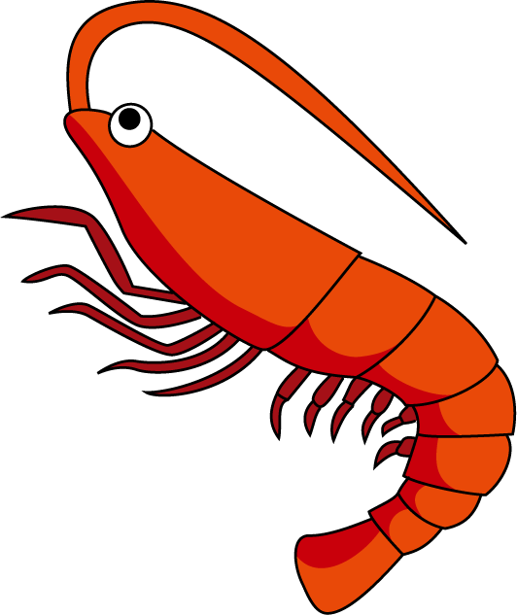
Title:
Table of Contents:
__________________...............Pg. 1
__________________...............Pg. 2
__________________...............Pg. 3
__________________...............Pg. 4
__________________...............Pg. 5
__________________...............Pg. 6
__________________...............Pg. 7
__________________...............Pg. 8
__________________...............Pg. 9
__________________.............Pg. 10
Researched By:
_________________

Slide 175
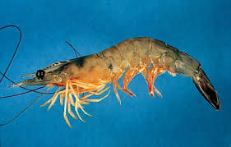
The Shrimp
The Shrimp
Shrimp is an animal found in both freshwater and saltwater throughout the world. Like its relatives the lobsters, crabs, and crayfish, the shrimp is a crustacean. Shrimp are a popular seafood and a valuable commercial item. However, of the more than 1,900 species of shrimp, fewer than 20 are important commercially.
In the United States, the species that are most important commercially are the white shrimp, the brown shrimp, and the pink shrimp. Most of the shrimp marketed in the United States are bred and raised in large tanks under scientifically controlled conditions. However, some shrimp are still fished in the traditional manner; special nets, called otter trawls, are used to catch them. Shrimp are marketed chiefly fresh or frozen, but some are canned or dried. The shells are used to make animal feed.
Shrimp are usually found on muddy or sandy bottoms. Some species burrow in the sand or mud; others burrow into rock and coral crevices. Many of the smaller species live inside sponges. Shrimp live on the river beds and ocean floors around the world, filtering sand and particles in the water. Shrimp are known to stay in schools that contain numerous shrimp individuals, and are able to adapt easily to changes in water conditions. Shrimp eat both plant and animal material.
Shrimp are generally tiny in size, with some species of shrimp being so small that many animals cannot see them. Adult shrimp range in length from less than 1 inch to more than 12 inches, depending on the species. Most of the species caught commercially have an adult length of 3 to 9 inches. Those that are more than 5 inches long are often called jumbo shrimp, or prawns.
The shrimp's body is long and narrow and slightly compressed from side to side. It is covered by a translucent shell called an exoskeleton. Shrimp periodically molt (shed their outer covering). Shrimp may be gray, white, pink, brown, or green, often with various markings. Many species can change color to blend with their surroundings.

Slide 176
The Shrimp
The Shrimp
Shrimp is an animal found in both freshwater and saltwater throughout the world. The shrimp is a crustacean. Shrimp are a popular seafood for people to eat. However, of the more than 1,900 species of shrimp, fewer than 20 are valued by people.
In the United States, the white shrimp, the brown shrimp, and the pink shrimp are eaten. Most of the shrimp sold in the United States are bred and raised in large tanks. However, some shrimp are still fished in the traditional manner; special nets, called otter trawls, are used to catch them. Shrimp shrimp can be eaten fresh, frozen, canned, or dried. The shrimp shells are used to make animal feed.
Shrimp are usually found on muddy or sandy bottoms. Some species burrow in the sand or mud; others burrow into rock and coral crevices. Many of the smaller species live inside sponges.
Shrimp are known to stay in a school of shrimp and are able to adapt easily to changes in water conditions. Shrimp eat both plant and animal material.
Shrimp are generally tiny in size, with some species of shrimp being so small that many animals cannot see them. Adult shrimp range in length from less than 1 inch to more than 12 inches. Most of the shrimp for people to eat have an adult length of 3 to 9 inches. Those that are more than 5 inches long are often called jumbo shrimp, or prawns.
The shrimp's body is long and narrow. It is covered by a translucent shell called an exoskeleton. Shrimp periodically molt (shed their outer covering). Shrimp may be gray, white, pink, brown, or green, often with various markings. Many species can change color to blend with their surroundings.

Slide 177
The Shrimp
The Shrimp
Shrimp live in fresh water and salt water.
The shrimp is a crustacean.
People and other fish love to eat shrimp.
The white shrimp, the brown shrimp, and the pink shrimp are eaten by people.
Shrimp can be grown in tanks by people.
Some shrimp are fished with special nets called otter trawls.
Shrimp can be eaten fresh, frozen, canned, or dried.
The shrimp shells are used to make animal feed.
Shrimp are usually found on muddy or sandy bottoms. Some live in sponges.
Shrimp stay in a big group called a school of shrimp.
Shrimp eat both plant and animal material.
Shrimp can be 1 inch to 12 inches long.
Shrimp longer than 5 inches are called jumbo shrimp, or prawns.
The shrimp's body is long and narrow.
It is covered by a clear shell called an exoskeleton.
Shrimp shed their shell (molt).
Shrimp may be gray, white, pink, brown, or green. Some shrimp can change colors.

Slide 178
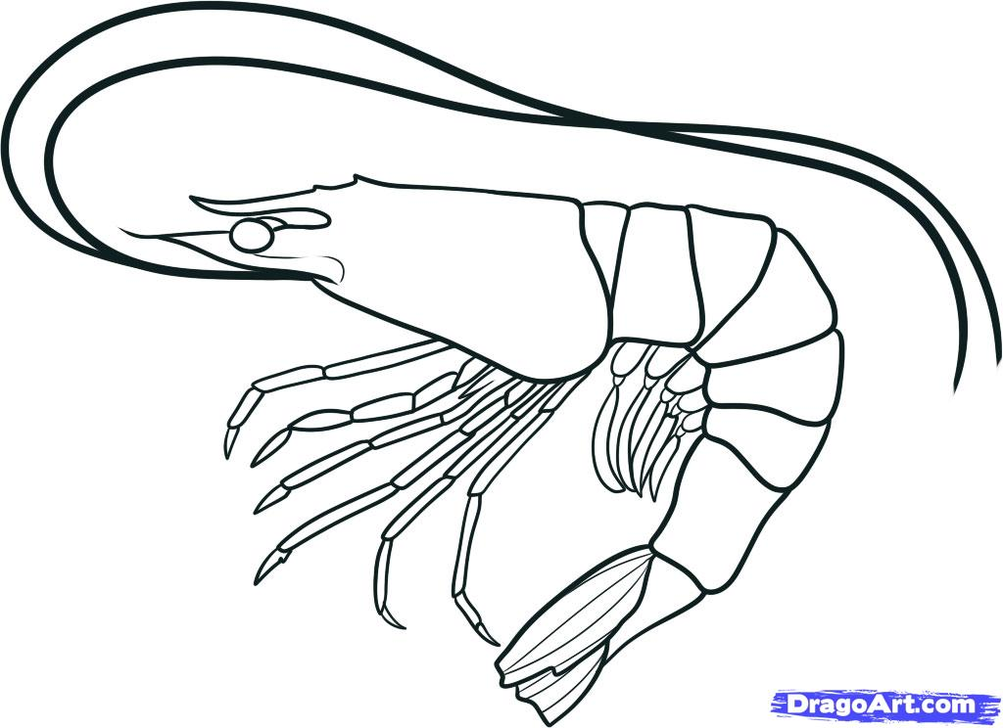
Diagram of the Shrimp:

Slide 179
Shrimp
Can
have
are
_________________
_________________
_________________
_________________
_________________
_________________
_________________
_________________
_________________
_________________
_________________
_________________
_________________
_________________
_________________
_________________
_________________
_________________
_________________
_________________
_________________

Slide 180
Shrimp

Slide 181
Life Cycle of the Shrimp:

Slide 182
Shrimp:
Habitat:
Life Span:
Interesting Fact:
Diet:

Slide 183
Shrimp
3 things I learned:
2 interesting facts :
1 question :

Slide 184
Shrimp
Live__________________________________.
Have _________________________________.
Are __________________________________.
Can __________________________________.
Eat __________________________________.
Always _______________________________.
Never ________________________________.

Slide 185
Shrimp
____________
Both:

Slide 186
My Shrimp Adventure Story!
______________________________________________________________________
______________________________________________________________________
______________________________________________________________________
______________________________________________________________________
______________________________________________________________________
______________________________________________________________________
______________________________________________________________________
______________________________________________________________________
______________________________________________________________________
______________________________________________________________________

Slide 187
Title:
Table of Contents:
__________________...............Pg. 1
__________________...............Pg. 2
__________________...............Pg. 3
__________________...............Pg. 4
__________________...............Pg. 5
__________________...............Pg. 6
__________________...............Pg. 7
__________________...............Pg. 8
__________________...............Pg. 9
__________________.............Pg. 10
Researched By:
_________________

Slide 188
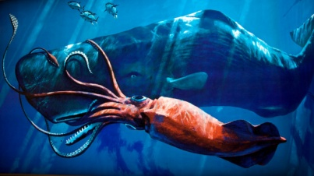
The Giant Squid
The Giant Squid
The giant squid is massive and when full grown can be at least 33 feet long. A giant squid would reach the water if held from the top of an Olympic diving platform! These mysterious eight-armed creatures are rarely seen by humans. Most of what we know about them comes from finding them washed up on beaches. Giant squid can weigh about 440 pounds. The largest of these hard-to-find giants ever found measured 59 feet in length and weighed nearly a ton (900 kilograms).
More recently, in 2004 researchers in Japan took the first images ever of a live giant squid. And in late 2006, scientists with Japan's National Science Museum caught and brought to the surface a live 24-foot female giant squid.
Giant squid, along with their cousin, the colossal squid, have beach ball size eyes with no eyelids! Their eyes are the largest eyes in the animal kingdom and are about 10 inches in diameter. Their big eyes help them see better underwater! They are able to spy objects in dark depths where most other animals would see nothing.
Like other squid species, they are invertebrates and they have eight arms and two longer whip-like tentacles that help them bring food to their beak-like mouths. They are carnivores and their diet likely consists of fish, shrimp, and other squid, and some suggest they might even attack and eat small whales.
Large whales try to eat them, but giant squid leave sucker mark scars on mouths of whales as they try to avoid being swallowed.
They maneuver their massive bodies with fins that seem too small for the rest of their bodies. They use their funnel as a propulsion system, drawing water into the mantle, or main part of the body, and forcing it out the back.
The scientific name for the giant squid is Architeuthis dux. They can change colors to camouflage with their surrounding.

Slide 189
The Giant Squid
The Giant Squid
The giant squid can be at least 33 feet long. It is very hard to find a giant squid. Most of what we know about them comes from finding them washed up on beaches. Giant squid can weigh about 440 pounds. The largest squid ever found measured 59 feet in length and weighed nearly a ton (900 kilograms).
In 2004 researchers in Japan took the first images ever of a live giant squid. And in 2006, scientists with Japan's National Science Museum caught and brought to the surface a live 24-foot female giant squid.
Giant squid, along with their cousin, the colossal squid, have beach ball size eyes with no eyelids! Their eyes are the largest eyes in the animal kingdom and are about 10 inches in diameter. Their big eyes help them see better underwater! They are able to spy objects in dark water where most other animals would see nothing.
Like other squid species, they are invertebrates and they have eight arms and two longer whip-like tentacles that help them bring food to their beak-like mouths. They can change colors to camouflage with their surrounding.
They are carnivores and their diet likely consists of fish, shrimp, and other squid, and sometimes might even attack and eat small whales.
Large whales try to eat them, but giant squid leave sucker mark scars on mouths of whales as they try to avoid being swallowed.
They move their bodies with fins that seem too small for the rest of their bodies. They use their funnel to draw water into the mantle, or main part of the body, and force it out the back.

Slide 190
The Giant Squid
The Giant Squid
The giant squid can be at least 33 feet long.
It is very hard to find a giant squid.
Giant squid can weigh about 440 pounds.
Giant squid can be up to 59 feet long.
Giant squid have beach ball size eyes with no eyelids!
Their eyes are 10 inches.
Their big eyes help them see better underwater!
They are able to spy objects in dark water.
They have eight arms and two long tentacles.
They have a beak-like mouth.
They can change colors.
They eat fish, shrimp, and other squid, and sometimes eat whales.
They leave sucker marks on other fish and animals.
They use fins to move their body. They also use water to push them forward.

Slide 191
Diagram of the Giant Squid:

Slide 192
Giant Squids
Can
have
are
_________________
_________________
_________________
_________________
_________________
_________________
_________________
_________________
_________________
_________________
_________________
_________________
_________________
_________________
_________________
_________________
_________________
_________________
_________________
_________________
_________________

Slide 193
Giant
Squids

Slide 194
Life Cycle of the Giant Squid:

Slide 195
Giant Squids:
Habitat:
Life Span:
Interesting Fact:
Diet:

Slide 196
Giant Squid
3 things I learned:
2 interesting facts :
1 question :

Slide 197
Giant Squid
Live__________________________________.
Have _________________________________.
Are __________________________________.
Can __________________________________.
Eat __________________________________.
Always _______________________________.
Never ________________________________.

Slide 198
Giant Squid
____________
Both:

Slide 199
My Giant Squid Adventure Story!
______________________________________________________________________
______________________________________________________________________
______________________________________________________________________
______________________________________________________________________
______________________________________________________________________
______________________________________________________________________
______________________________________________________________________
______________________________________________________________________
______________________________________________________________________
______________________________________________________________________

