Slide 1
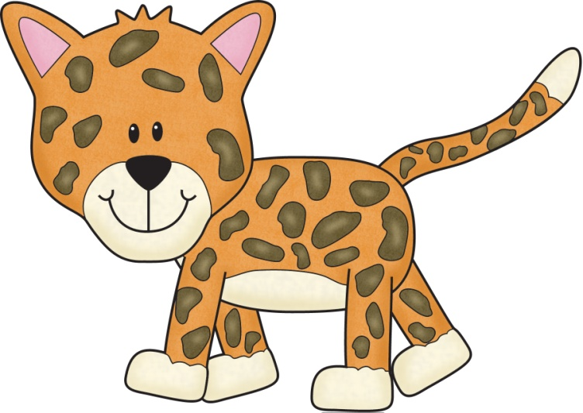
Title:
Table of Contents:
__________________...............Pg. 1
__________________...............Pg. 2
__________________...............Pg. 3
__________________...............Pg. 4
__________________...............Pg. 5
__________________...............Pg. 6
__________________...............Pg. 7
__________________...............Pg. 8
__________________...............Pg. 9
__________________.............Pg. 10
Researched By:
_________________

Slide 2
Know | Want to know ? | Learn

Slide 3
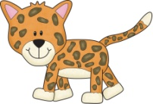
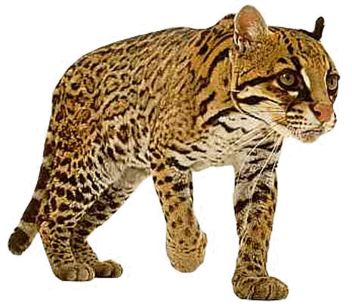
The Ocelot
The Ocelot
The Ocelot is the best known of the South American cats. They live in rainforests, montane forests, thick bush, semi-deserts, coastal marsh, and along river banks. Ocelots are found in Central and South America. During the day Ocelots sleep on a branch, in a hollow tree, or in dense vegetation.
Ocelots eat nocturnal rodents, armadillos, lesser anteaters, deer, squirrel monkeys and land tortoises. During the wet season they will also prey on fish and land crabs. Sometimes Ocelots will dine on birds or reptiles. Without teeth for chewing, Ocelots tear their food to pieces and swallow it whole.
Ocelots range in length from 38 to 60 inches (including tail), yet only weigh 20 to 35 pounds. They stand 16 to 20 inches tall.
They have good night vision and hearing, and have retractable claws. The markings of Ocelots are blotches of darker color surrounded by black outlines. Sometimes these spots run together to form stripes. Ocelot base fur color ranges from yellow/cream to darker yellow/brown and can vary by habitat and is light on the belly and throat. Similar to some other cats, they have black ear backs with a spot in the center, in this case yellow. Ocelots have black rings on their tails. On their cheeks they have 2 stripes; a stripe runs from the top of the eye over the head.
The Ocelot swims well. They are territorial and solitary animals (except for a female with kittens). Ocelot litters (1 to 4 kittens) are born once every two years to a female.
The Ocelot is considered a medium sized cat. They are in the mammal group.

Slide 4
The Ocelot
The Ocelot
The Ocelot is the best known of the South American cats. They live in rainforests in Central and South America. During the day Ocelots sleep on a branch, in a hollow tree, or in a lot of plants close together.
Ocelots eat nocturnal rodents, armadillos, lesser anteaters, deer, squirrel monkeys and land tortoises. They will also eat fish, land crabs, birds, or reptiles. They do not have teeth so they swallow their food whole.
Ocelots are 38 to 60 inches long (including tail), yet only weigh 20 to 35 pounds. They stand 16 to 20 inches tall.
They have good night vision and hearing, and have (retractable) claws that go back into their paw. Their fur is spots of darker color with black outlines. The spots make stripes. The base fur color can be from yellow/cream to darker yellow/brown and can vary by habitat, and is light on the belly and throat.
They have black ear backs with a spot in the center, in this case yellow. Ocelots have black rings on their tails. On their cheeks they have 2 stripes. They also have a stripe that runs from the top of the eye over the head.
The Ocelot swims well. They like to live alone (except for a female with kittens). Ocelot litters (1 to 4 kittens) are born once every two years to a female.
The Ocelot is a medium sized cat. They are in the mammal group.

Slide 5
The Ocelot
The Ocelot
They live in rainforests.
Ocelots are found in Central and South America.
Ocelots sleep on a branch, in a tree, or in plants.
Ocelots eat nocturnal rodents, armadillos, lesser anteaters, deer, squirrel monkeys and land tortoises.
They do not have teeth.
They can see at night.
They have spots and stripes.
The Ocelot swims well.
They live alone.
They have 1 to 4 kittens
Ocelots are 38 to 60 inches long (including tail).
They weigh 20 to 35 pounds.
They stand 16 to 20 inches tall.

Slide 6
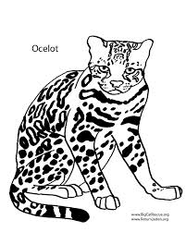
Diagram of the Ocelot:

Slide 7
Ocelots
Can
have
are
_________________
_________________
_________________
_________________
_________________
_________________
_________________
_________________
_________________
_________________
_________________
_________________
_________________
_________________
_________________
_________________
_________________
_________________
_________________
_________________
_________________

Slide 8
Ocelots

Slide 9
Life Cycle of the Ocelot:

Slide 10
Ocelots:
Habitat:
Life Span:
Interesting Fact:
Diet:

Slide 11
Ocelots
3 things I learned:
2 interesting facts :
1 question :

Slide 12
Topic:
Fact 1:
Fact 2:
Fact 3:
Closing:

Slide 14
Habitat
Diet
Life Span

Slide 15
Adaptations
Size
Babies

Slide 16
Ocelots
Live__________________________________.
Have _________________________________.
Are __________________________________.
Can __________________________________.
Eat __________________________________.
Always _______________________________.
Never ________________________________.

Slide 17
Graph:
Photograph:
Question: ___________________________
___________________________
Yes No
14
13
12
11
10
9
8
7
Caption:
6
5
4
3
2
1

Slide 18
Ocelot
____________
Both:

Slide 19
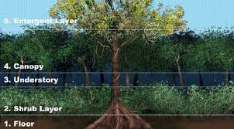
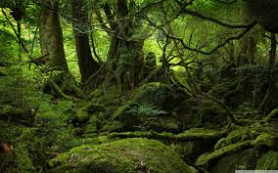
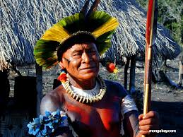
The Rainforest
HABITAT:The tropical rain forest is very humid because of all the rainfall. It gets about 150 cm of rain per year. It gets lots of rain because it is very hot and wet in rain forests. The hotter the air, the more water vapor it can hold.
This climate is found near the equator. It rains more than ninety days a year and the strong sun usually shines between the storms.
PLANTS:The main plants in this biome are trees. This is important because in the rain forest, some rain never gets past the trees and to the smaller plants and ground below. Trees in this climate reach a height of more than 164 feet. They form a canopy. The forest floor is called understory. The canopy also keeps sunlight from reaching the plants in the understory. Between the canopy and understory is a lower canopy made up of smaller trees. These plants do receive some filtered sunlight.
The plants that make up the understory of a rain forest have adapted to the small amount of sunlight that they receive. Ferns and mosses do well, along with epiphytes. These are plants that grow on other plants. They can be found growing on branches of tall trees. There are many different plant species found in the rain forest.
WEATHER:The average temperature of a rain forest is about 77° Fahrenheit. The rain forest is about the same temperature year round. The temperature never drops below 64° Fahrenheit. Rain forests are so hot because they are found near the equator. In a rain forest there is a short dry season. In only a month the rainforest receives 4 inches of rain. A lot of the rain that falls on the rain forest never reaches the ground, instead it stays on the trees because the leaves act as a shield. Rain forest are never found in climates which have temperatures 32° Fahrenheit and below because the plant life will not be able to live in the frost. All the plants will die out if the rain forest is cooler.
PEOPLE AND THIS BIOME: Of the remaining forest people, the Amazon supports the largest native, or indigenous populations, although these people, too, have been impacted by the modern world. While they still depend on the forest for traditional hunting and gathering, most Amerindians, as American indigenous people are called, grow crops (like bananas, manioc, and rice), use western goods (like metal pots, pans, and utensils), and make regular trips to towns and cities to bring foods and wares to market. Still, these forest people can teach us a lot about the rainforest. Their knowledge of medicinal plants used for treating illness is unmatched, and they have a great understanding of the ecology of the Amazon rainforest.

Slide 20
The Rainforest
HABITAT: The tropical rain forest is very humid because of all the rainfall. It gets about 150 cm of rain per year. It gets lots of rain because it is very hot and wet in rain forests.
PLANTS: The main plants are trees. That can be up to 164 feet. There are 4 layers of plants: Emergent, Canopy, Understory, and Forest Floor. The plants on the floor do not get a lot of sun.
WEATHER: The average temperature of a rain forest is about 77° Fahrenheit and it stays the same all year long. Rain forests are so hot because they are found near the equator (middle of Earth). A lot of the rain that falls on the rain forest never reaches the ground, instead it stays on the trees because the leaves act as a shield.
PEOPLE AND THIS BIOME: People of the rainforest depend on the forest for traditional hunting and gathering, but most Amerindians, grow bananas, manioc, and rice, use things like metal pots, pans, and utensils, and make regular trips to towns and cities to bring foods and things they make to market. They also know a lot about using plants for medicine.

Slide 21
The Rainforest

Slide 22
Rainforest

Slide 23
Diagram of the Rainforest Habitat:
Landform Labels:
mountain, canyon, valley, hill, plain, emergent, canopy, understory, forest floor
Caption:

Slide 24
The Rainforest Habitat
Can
has
is
_________________
_________________
_________________
_________________
_________________
_________________
_________________
_________________
_________________
_________________
_________________
_________________
_________________
_________________
_________________
_________________
_________________
_________________
_________________
_________________
_________________

Slide 25
Rainforest Habitat
________ Habitat
Both:

Slide 26
If I Went to the Rainforest,
I would pack:
Because…
__________________________________________
__________________________________________
__________________________________________
__________________________________________
__________________________________________
__________________________________________
__________________________________________
__________________________________________

Slide 27
I wonder….
?
?
?
?

Slide 28
Diary of a Rainforest Animal:
Dear Diary,
______________________________________________________________________
______________________________________________________________________
______________________________________________________________________
______________________________________________________________________
______________________________________________________________________
______________________________________________________________________
______________________________________________________________________
______________________________________________________________________
Sincerely, _________________

Slide 29
My Ocelot Adventure Story!
______________________________________________________________________
______________________________________________________________________
______________________________________________________________________
______________________________________________________________________
______________________________________________________________________
______________________________________________________________________
______________________________________________________________________
______________________________________________________________________
______________________________________________________________________
______________________________________________________________________

Slide 30
Glossary:
Glossary:
_______________
_______________
_______________
_______________
___________________________
___________________________
_______________
_______________
_______________
_______________
___________________________
___________________________
_______________
_______________
_______________
_______________
___________________________
___________________________

Slide 31
Title:
Table of Contents:
__________________...............Pg. 1
__________________...............Pg. 2
__________________...............Pg. 3
__________________...............Pg. 4
__________________...............Pg. 5
__________________...............Pg. 6
__________________...............Pg. 7
__________________...............Pg. 8
__________________...............Pg. 9
__________________.............Pg. 10
Researched By:
_________________

Slide 32
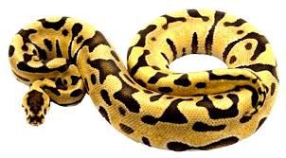
The Anaconda
The Anaconda
Anacondas make their home in the Amazon jungles of South America and are part of the Boa Constrictor family.
Anacondas live near rivers, lakes, and swamps and like to live alone. Water is their main escape method when danger is near. Rather than attacking they will choose to slide into the water when the other animal is not looking.
Anacondas eat amphibious animals, like frogs and toads, as well as fish, caiman, birds, ducks, and turtles. They even eat wild pigs, deer, and jaguars! When Anacondas eat, they squeeze their prey so hard that it dies. Their jaws are so big that they can swallow their prey whole. It takes this food weeks or months to digest. So Anacondas can go weeks and months with no food.
Anacondas are the longest snakes in the world. They can be 20 feet long and weigh up to 300 pounds! To get a picture of how long an Anaconda is, picture 5 10-year-olds lying down head to foot. An Anaconda weighs as much as 11 kids.
Their eyes and nasal openings are on top of their heads, allowing them to lay in wait for prey while remaining nearly completely under water. They wait quietly at the top of the water surface to catch their food.
Anacondas are in the constrictor group, which is a snake. Snakes are reptiles.
Anacondas live for about 10 years. A green Anaconda can stay under water for 10 minutes without coming up to breathe. Anacondas can go months without eating. The female Anaconda is larger than the male.

Slide 33
The Anaconda
The Anaconda
Anacondas make their home in the Amazon jungles of South America and are part of the Boa Constrictor family.
Anacondas live near rivers, lakes, and swamps and like to live alone. Rather than attacking they will choose to slide into the water when the other animal is not looking.
Anacondas eat amphibious animals, like frogs and toads, as well as fish, caiman, birds, ducks, and turtles. They even eat wild pigs, deer, and jaguars! When Anacondas eat, they squeeze their prey so hard that it dies. Their jaws are so big that they can swallow their prey whole. Anacondas can go weeks and months with no food.
Anacondas are the longest snakes in the world. They can be 20 feet long and weigh up to 300 pounds! An Anaconda weighs as much as 11 kids.
Their eyes and nasal openings are on top of their heads so they can lay under the water waiting for their food.
Anacondas are in the constrictor group, which is a snake. Snakes are reptiles.
Anacondas live for about 10 years. A green Anaconda can stay under water for 10 minutes without coming up to breathe. The female Anaconda is larger than the male.

Slide 34
The Anaconda
The Anaconda
Anacondas live in the Amazon jungles of South America
Anacondas live near rivers, lakes, and swamps .
They like to live alone.
They like to hide under the water and can stay under for 10 minutes.
Anacondas eat frogs and toads, as well as fish, caiman, birds, ducks, and turtles.
They can even eat wild pigs, deer, and jaguars because they have big jaws!
Anacondas can go weeks and months with no food.
Anacondas are the longest snakes and can be 20 feet long and weigh up to 300 pounds!
Their eyes and nose are on top of their head.
Anacondas are reptiles.
Anacondas live for 10 years.

Slide 35
Diagram of the Anaconda:

Slide 36
Anacondas
Can
have
are
_________________
_________________
_________________
_________________
_________________
_________________
_________________
_________________
_________________
_________________
_________________
_________________
_________________
_________________
_________________
_________________
_________________
_________________
_________________
_________________
_________________

Slide 37
Anacondas

Slide 38
Life Cycle of the Anaconda:

Slide 39
Anacondas:
Habitat:
Life Span:
Interesting Fact:
Diet:

Slide 40
Anacondas
3 things I learned:
2 interesting facts :
1 question :

Slide 41
Anacondas
Live__________________________________.
Have _________________________________.
Are __________________________________.
Can __________________________________.
Eat __________________________________.
Always _______________________________.
Never ________________________________.

Slide 42
Anacondas
____________
Both:

Slide 43
My Anaconda Adventure Story!
______________________________________________________________________
______________________________________________________________________
______________________________________________________________________
______________________________________________________________________
______________________________________________________________________
______________________________________________________________________
______________________________________________________________________
______________________________________________________________________
______________________________________________________________________
______________________________________________________________________

Slide 44
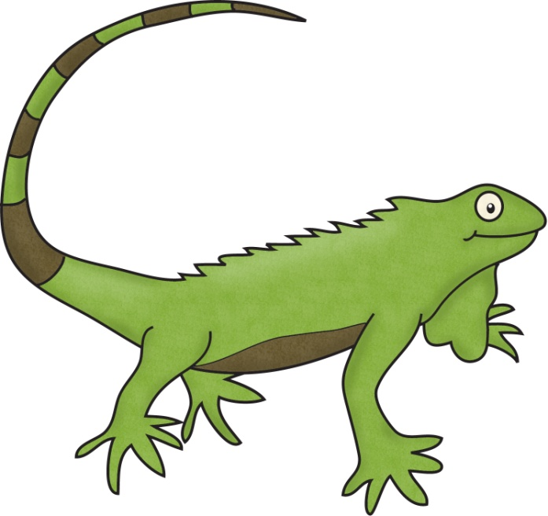
Title:
Table of Contents:
__________________...............Pg. 1
__________________...............Pg. 2
__________________...............Pg. 3
__________________...............Pg. 4
__________________...............Pg. 5
__________________...............Pg. 6
__________________...............Pg. 7
__________________...............Pg. 8
__________________...............Pg. 9
__________________.............Pg. 10
Researched By:
_________________

Slide 45
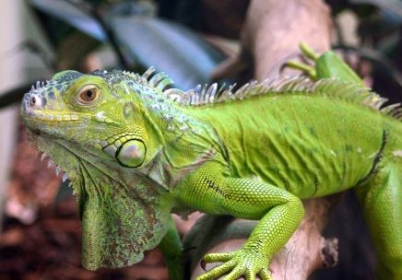
The Iguana
The Iguana
Iguanas live in the rainforests of northern Mexico, Central America, the Caribbean Islands, and southern Brazil. They spend most of their time in the canopy, climbing down only to mate, lay eggs, or change trees.
Primarily herbivores (plant eaters), Iguanas are active during the day, feeding on leaves, flowers, and fruit.
Iguanas have strong jaws with razor-sharp teeth and sharp tails, which make up half their body length and can be used as whips to drive off predators. They can also detach their tails if caught and will grow another without permanent damage. On average, they are 6.5 feet long and weigh about 11 pounds.
These reptiles are often referred to as “bamboo chicken” or “chicken of the trees” because of their meat, which is often eaten in Central America.
Some species of Iguanas are endangered, such as the Figian Banded Iguana.
Iguanas’ heavy build gives them a clumsy look, but they are fast on land. They generally live near water and are excellent swimmers. If threatened, they will leap from a branch, often from great heights, and escape with a splash to the water below.
The females of most Iguanas dig a burrow in a sunny area, lay their eggs inside, cover them, and then leave the eggs alone. The temperature in the burrow stays a fairly constant 77 to 89 degrees Fahrenheit. The warm temperature incubates the eggs. All eggs in a nest usually hatch at the same time, and the young dig out of the burrow without help from the parents.

Slide 46
The Iguana
The Iguana
Iguanas live in the rainforests of northern Mexico, Central America, the Caribbean Islands, and southern Brazil. They spend most of their time in the canopy, climbing down only to mate, lay eggs, or change trees.
They are herbivores (plant eaters), Iguanas are awake during the day and like to eat leaves, flowers, and fruit.
Iguanas have strong jaws with razor-sharp teeth. Their sharp tails, which make up half their body length, can be used as whips to drive off predators. They can also detach their tails if caught and will grow another. On average, they are 6.5 feet long and weigh about 11 pounds.
These reptiles are called “bamboo chicken” or “chicken of the trees” because of their meat, which people eat in Central America.
Some species of Iguanas are endangered, such as the Figian Banded Iguana.
Iguanas’ heavy build gives them a clumsy look, but they are fast on land. They live near water and are excellent swimmers. If threatened, they will leap from a branch and splash in the water below.
The females dig a burrow in a sunny area, lay their eggs inside, cover them, and then leave the eggs alone. The warm temperature incubates the eggs. All eggs in a nest usually hatch at the same time, and the young dig out of the burrow without help from the parents.

Slide 47
The Iguana
The Iguana
Iguanas live in the rainforests of northern Mexico, Central America, the Caribbean Islands, and southern Brazil.
They live in the canopy layer.
Iguanas are awake during the day.
They like to eat leaves, flowers, and fruit.
Iguanas have sharp teeth and tails.
They can re-grow their tails.
They are 6.5 feet long and weigh about 11 pounds.
They are called “bamboo chicken” or “chicken of the trees” because of their meat.
Iguanas are fast on land.
They live near water and are good swimmers.
The females dig a burrow in a sunny area, lay their eggs inside, cover them, and then leave the eggs alone.
The eggs in a nest hatch at the same time, and the babies dig out of the burrow by themselves.

Slide 48
Diagram of the Iguana:

Slide 49
Iguanas
Can
have
are
_________________
_________________
_________________
_________________
_________________
_________________
_________________
_________________
_________________
_________________
_________________
_________________
_________________
_________________
_________________
_________________
_________________
_________________
_________________
_________________
_________________

Slide 50
Iguanas

Slide 51
Life Cycle of the Iguana:

Slide 52
Iguanas:
Habitat:
Life Span:
Interesting Fact:
Diet:

Slide 53
Iguanas
3 things I learned:
2 interesting facts :
1 question :

Slide 54
Iguanas
Live__________________________________.
Have _________________________________.
Are __________________________________.
Can __________________________________.
Eat __________________________________.
Always _______________________________.
Never ________________________________.

Slide 55
Iguana
____________
Both:

Slide 56
My Iguana Adventure Story!
______________________________________________________________________
______________________________________________________________________
______________________________________________________________________
______________________________________________________________________
______________________________________________________________________
______________________________________________________________________
______________________________________________________________________
______________________________________________________________________
______________________________________________________________________
______________________________________________________________________

Slide 57
Title:
Table of Contents:
__________________...............Pg. 1
__________________...............Pg. 2
__________________...............Pg. 3
__________________...............Pg. 4
__________________...............Pg. 5
__________________...............Pg. 6
__________________...............Pg. 7
__________________...............Pg. 8
__________________...............Pg. 9
__________________.............Pg. 10
Researched By:
_________________

Slide 58
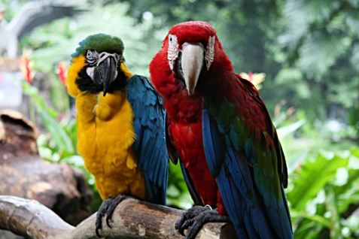
The Macaw
The Macaw
Macaws live in the high trees of the Central and South American rainforests. There are 17 species of Macaws, several of which are endangered. These playful birds are often trapped for pets, causing them to disappear from the rainforests at quick rates.
Flocks sleep in the trees at night, and in the morning they may fly long distances to feed on fruit, nuts, insects, and snails. Some species also eat damp soil, which may help to neutralize chemicals in their fruity diet and ease their stomachs.
Many Macaws are vibrantly colored. The birds boast large, powerful beaks that easily crack nuts and seeds, while their dry, scaly tongues have a bone inside them that makes them an effective tool for tapping into fruits. Macaws also have gripping toes that they use to latch onto branches and to grab, hold, and examine items. The birds sport graceful tails that are typically very long.
Macaws are intelligent, social members of the parrot family that often gather in flocks of 10 to 30 individuals. Their loud calls, squawks, and screams echo through the forest canopy.
Macaws vocalize to communicate within the flock, mark territory, and identify one another. Some species can even mimic human speech.
Macaws are specifically streamlined to fly through the rainforest canopy with wings that do not flap. They often have to travel long distances to find food.
Macaws have the same mate for life. Together, they share food and groom one another. While the mother sits on the eggs to incubate them, the father hunts and brings back food to the nest.

Slide 59
The Macaw
The Macaw
Macaws live in the high trees of the Central and South American rainforests. They are endangered. These playful birds are often trapped for pets, causing them to disappear from the rainforests.
Flocks sleep in the trees at night, and in the morning they may fly long distances to feed on fruit, nuts, insects, and snails.
Many Macaws are brightly colored. The birds have large, powerful beaks that easily crack nuts and seeds. Their dry, scaly tongues have a bone inside them that makes them an effective tool for tapping into fruits. Macaws also have gripping toes that they use to latch onto branches and to grab, hold, and observe items. The birds have graceful tails that are very long.
Macaws are intelligent, social members of the parrot family that often gather in flocks of 10 to 30 individuals. Their loud calls, squawks, and screams echo through the forest canopy.
Macaws squawk to talk within the flock, mark territory, and identify one another.
Macaws are made to fly through the rainforest canopy with wings that do not flap. They often have to travel long distances to find food.
Macaws have the same mate for life. Together, they share food and groom one another. While the mother sits on the eggs, the father hunts and brings back food to the nest.

Slide 60
The Macaw
The Macaw
Macaws live in the canopy layer of the Central and South American rainforests.
They sleep in the trees at night.
They eat fruit, nuts, insects, and snails during the day.
Many Macaws are many colors.
The birds have big strong beaks.
Their tongue has a bone inside.
Their toes can latch onto branches and can grab items.
The birds have very long tails.
Macaws live in groups of 10 to 30 birds. They like to talk to each other.
Their wings do not flap.
They have to fly a long way to find food.
The mother sits on the eggs, the father hunts and brings back food to the nest.

Slide 61
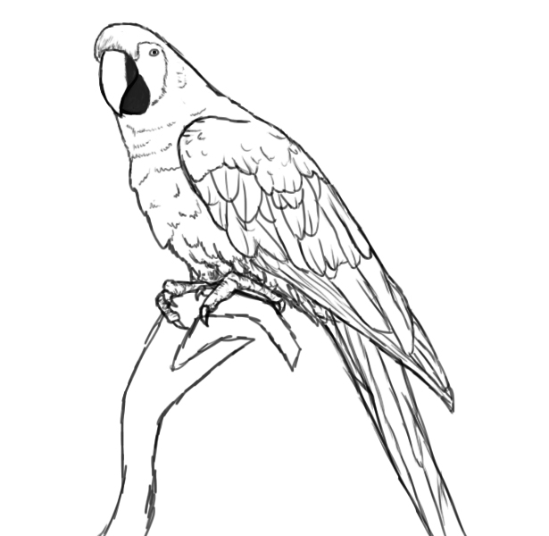
Diagram of the Macaw:

Slide 62
Macaws
Can
have
are
_________________
_________________
_________________
_________________
_________________
_________________
_________________
_________________
_________________
_________________
_________________
_________________
_________________
_________________
_________________
_________________
_________________
_________________
_________________
_________________
_________________

Slide 63
Macaws

Slide 64
Life Cycle of the Macaw:

Slide 65
Macaws:
Habitat:
Life Span:
Interesting Fact:
Diet:

Slide 66
Macaws
3 things I learned:
2 interesting facts :
1 question :

Slide 67
Macaws
Live__________________________________.
Have _________________________________.
Are __________________________________.
Can __________________________________.
Eat __________________________________.
Always _______________________________.
Never ________________________________.

Slide 68
Macaw
____________
Both:

Slide 69
My Macaw Adventure Story!
______________________________________________________________________
______________________________________________________________________
______________________________________________________________________
______________________________________________________________________
______________________________________________________________________
______________________________________________________________________
______________________________________________________________________
______________________________________________________________________
______________________________________________________________________
______________________________________________________________________

Slide 70
Title:
Table of Contents:
__________________...............Pg. 1
__________________...............Pg. 2
__________________...............Pg. 3
__________________...............Pg. 4
__________________...............Pg. 5
__________________...............Pg. 6
__________________...............Pg. 7
__________________...............Pg. 8
__________________...............Pg. 9
__________________.............Pg. 10
Researched By:
_________________

Slide 71
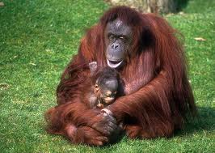
The Orangutan
The Orangutan
Orangutans are found in the tropical rainforests of only two islands in the world – Sumatra (in Indonesia) and Borneo (in Malaysia and Indonesia). They are usually found in the canopy layer of the rainforest. They rarely come down from the treetops. If they do come down from the trees, they walk on all fours. They spend their time building nests, swinging from tree to tree and eating in the trees.
Orangutans eat mostly leaves and other plants found in the rainforest. They also love to eat jungle fruits and Lychee nuts. They have also been seen catching a small animal called a slow Loris. When Orangutans eat, they pucker up their lips so they can feel the texture, the feeling, of the food before they take a bite of it.
They are the largest arboreal (tree dwelling) animal in the world, reaching heights of 4-5 feet and weights of 125-135 pounds or more. Orangutans are reddish-brown in color and some males grow white or yellow beards. Also characteristic are their bare faces with round eyes and small ears; their long shaggy hair; long arms; and curled fingers and feet.
Males are much larger than females and develop large pads on cheeks called “flanges” and large throat pouches at the age 15 to 20. Orangutans’ arms are stronger and longer than their legs (1 ½ times longer). Their reach from fingertip to fingertip can be as long as 8 feet.

Slide 72
The Orangutan
The Orangutan
Orangutans are found in the tropical rainforests of only two islands in the world – Sumatra (in Indonesia) and Borneo (in Malaysia and Indonesia). They are usually found in the canopy layer of the rainforest.
They rarely come down from the treetops. If they do come down from the trees, they walk on all fours. They spend their time building nests, swinging from tree to tree and eating in the trees.
Orangutans eat mostly leaves, fruits, Lychee nuts, and other plants found in the rainforest. They have also been seen catching a small animal called a slow Loris. When Orangutans eat, they pucker up their lips so they can feel the texture, the feeling, of the food before they take a bite of it.
They are the largest arboreal (tree dwelling) animal in the world. They are 4-5 feet and weigh 125-135 pounds or more.
Orangutans are reddish-brown in color and some males grow white or yellow beards. Their face has no fur and they have round eyes and small ears. They also have long shaggy hair; long arms; and curled fingers and feet.
Males are much larger than females and grow large pads on cheeks called “flanges” and large throat pouches at the age 15 to 20. Orangutans’ arms are stronger and longer than their legs (1 ½ times longer). Their reach from fingertip to fingertip can be as long as 8 feet.

Slide 73
The Orangutan
The Orangutan
Orangutans live in the canopy layer of the rainforest.
They live in the treetops.
They can walk on all four feet.
They build nests and swing in trees.
Orangutans eat leaves, fruits, Lychee nuts, and other plants.
They feel the food on their lips before they eat it.
They are 4-5 feet and weigh 125-135 pounds or more.
They are a reddish-brown color.
Their face has no fur and they have round eyes and small ears.
They have long hair; long arms; and curled fingers and feet.
The males are bigger than the females.
Orangutans’ arms are stronger and longer than their legs (1 ½ times longer).
Their reach from fingertip to fingertip can be as long as 8 feet.

Slide 74
Diagram of the Orangutan:

Slide 75
Orangutans
Can
have
are
_________________
_________________
_________________
_________________
_________________
_________________
_________________
_________________
_________________
_________________
_________________
_________________
_________________
_________________
_________________
_________________
_________________
_________________
_________________
_________________
_________________

Slide 76
Orangutans

Slide 77
Life Cycle of the Orangutan:

Slide 78
Orangutans:
Habitat:
Life Span:
Interesting Fact:
Diet:

Slide 79
Orangutans
3 things I learned:
2 interesting facts :
1 question :

Slide 80
Orangutans
Live__________________________________.
Have _________________________________.
Are __________________________________.
Can __________________________________.
Eat __________________________________.
Always _______________________________.
Never ________________________________.

Slide 81
Orangutan
____________
Both:

Slide 82
My Orangutan Adventure Story!
______________________________________________________________________
______________________________________________________________________
______________________________________________________________________
______________________________________________________________________
______________________________________________________________________
______________________________________________________________________
______________________________________________________________________
______________________________________________________________________
______________________________________________________________________
______________________________________________________________________

Slide 83
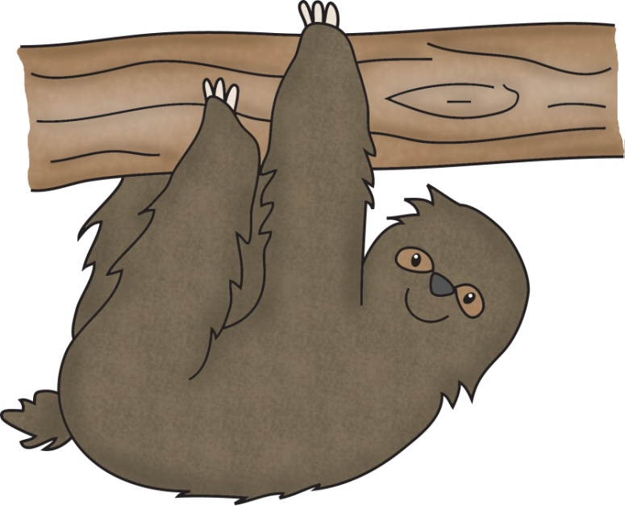
Title:
Table of Contents:
__________________...............Pg. 1
__________________...............Pg. 2
__________________...............Pg. 3
__________________...............Pg. 4
__________________...............Pg. 5
__________________...............Pg. 6
__________________...............Pg. 7
__________________...............Pg. 8
__________________...............Pg. 9
__________________.............Pg. 10
Researched By:
_________________

Slide 84
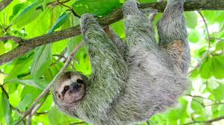
The Sloth
The Sloth
All sloths are built for life in the treetops. They spend nearly all of their time aloft, hanging from branches with a powerful grip aided by their long claws. Sloths even sleep in trees, and they sleep a lot – some 15 to 20 hours every day. Even when awake they often remain motionless.
At night Sloths eat leaves, shoots, and fruit from the trees and get almost all of their water from juicy plants.
On land, sloths’ weak hind legs provide no power and their long claws are a hindrance. They must dig into the earth with their front claws and use their strong front legs to pull themselves along, dragging their bellies across the ground. If caught on land, these animals must try to defend themselves by clawing and biting. One thing that sets sloths apart from other animals is that they have an extra neck vertebra that allows them to turn their heads almost all the way around.
Sloths are mammals that are identified by the number of long, prominent claws that they have on each front foot. There are both two-toed and three-toed sloths.
The sloth is the world’s slowest mammal, so sedentary that algae grows on its furry coat. The plant gives it a greenish tint that is useful camouflage in the trees of its Central and South American rainforest home. Surprisingly though, sloths are great swimmers, and can stroke efficiently in water with their long arms.
Sloths give birth to their babies while hanging in trees. Three-toed sloth babies are often seen clinging to their mothers – they travel by hanging on to them for the first nine months of their lives.

Slide 85
The Sloth
The Sloth
All sloths are built for life in the treetops. They spend nearly all of their time aloft, hanging from branches by gripping with their clows. Sloths even sleep in trees, and they sleep a lot – some 15 to 20 hours every day. Even when awake they often remain motionless (very still).
At night Sloths eat leaves, shoots, and fruit from the trees and get almost all of their water from juicy plants.
Sloths do not move well on land. They must dig into the earth with their front claws and use their strong front legs to pull themselves along, dragging their bellies across the ground. If another animal attacks, the sloth must try to defend themselve by clawing and biting. They have an extra neck vertebra that allows them to turn their heads almost all the way around.
Sloths are mammals that have a number of long, prominent claws that they have on each front foot. There are both two-toed and three-toed sloths.
Because the sloth is the world’s slowest mammal algae grows on its furry coat. The plant gives it a greenish tint that is useful camouflage in the trees of its Central and South American rainforest home. Sloths are great swimmers and use their long arms to help them.
Sloths give birth to their babies while hanging in trees. Three-toed sloth babies often hang on to their mothers for nine months.

Slide 86
The Sloth
The Sloth
Sloths live in the canopy of the rainforest in Central and South America.
Sloths move very slowly.
Sloths sleep 15 to 20 hours a day.
At night Sloths eat leaves, shoots, and fruit.
Sloths do not move well on land.
Sloths can claw and bite other animals.
There are both two-toed and three-toed sloths.
Sloths look green because their fur has algae on it.
Sloths have long arms to help them swim.
Sloths babies stay with the mom for 9 months.
They can turn their head all the way around.

Slide 87
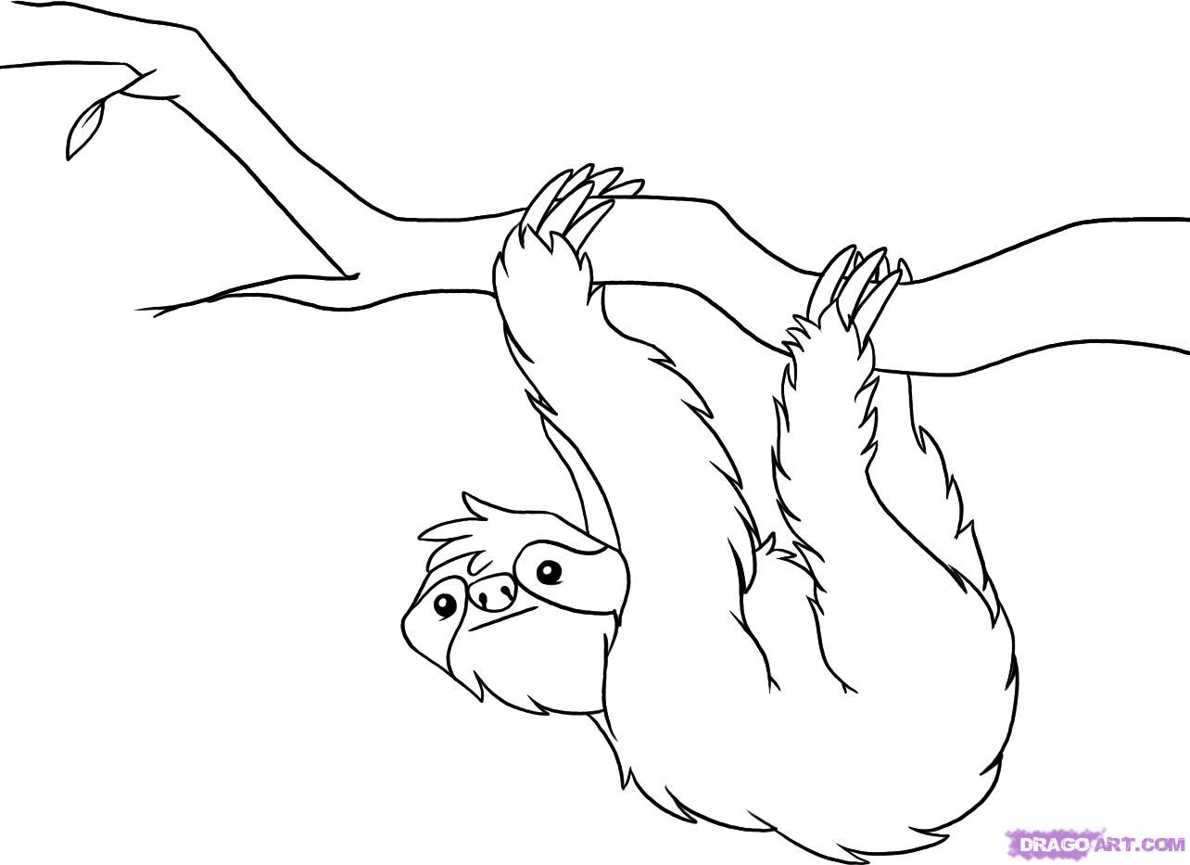
Diagram of the Sloth:

Slide 88
Sloths
Can
have
are
_________________
_________________
_________________
_________________
_________________
_________________
_________________
_________________
_________________
_________________
_________________
_________________
_________________
_________________
_________________
_________________
_________________
_________________
_________________
_________________
_________________

Slide 89
Sloths

Slide 90
Life Cycle of the Sloth:

Slide 91
Sloths:
Habitat:
Life Span:
Interesting Fact:
Diet:

Slide 92
Sloths
3 things I learned:
2 interesting facts :
1 question :

Slide 93
Sloths
Live__________________________________.
Have _________________________________.
Are __________________________________.
Can __________________________________.
Eat __________________________________.
Always _______________________________.
Never ________________________________.

Slide 94
Sloth
____________
Both:

Slide 95
My Sloth Adventure Story!
______________________________________________________________________
______________________________________________________________________
______________________________________________________________________
______________________________________________________________________
______________________________________________________________________
______________________________________________________________________
______________________________________________________________________
______________________________________________________________________
______________________________________________________________________
______________________________________________________________________

Slide 96
Title:
Table of Contents:
__________________...............Pg. 1
__________________...............Pg. 2
__________________...............Pg. 3
__________________...............Pg. 4
__________________...............Pg. 5
__________________...............Pg. 6
__________________...............Pg. 7
__________________...............Pg. 8
__________________...............Pg. 9
__________________.............Pg. 10
Researched By:
_________________

Slide 97
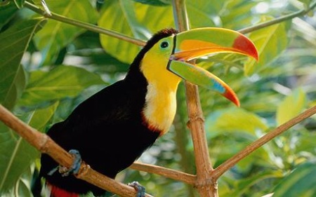
The Toucan
The Toucan
Toucans live in the rainforests of Central and South America. They live in the canopy of the rainforest. They make their homes in the holes of trees in the canopy in rainforests.
A toucan’s bill is sharp and has saw-like edges. The bill is used to squash the many kinds of fruit and berries he eats. He may also use the saw-like edges to tear off parts of larger fruits. Also included in their diet are small birds and lizards.
There are about 40 different kinds of toucans. They vary in size from about 7 inches to a little over two feet. They have short and thick necks. Toucans are distinguished by large, colorful, yet lightweight bills. The color of the bill may be black, blue, brown, green, red, white, yellow, or a combination of colors. The bright colors on his bill help to attract a mate.
Toucans also have a narrow, feather-like tongue. They can be noisy birds with their calls sounding harsh and raspy.
White, glossy eggs are laid once a year and when they hatch, the new chicks have no down (fluffy feathers) covering them.
When toucans sleep, they turn their heads around and tuck their bills under their wings and tail.
The toucan is very important to the rainforest because they help to disperse seeds from the fruits and berries they eat.

Slide 98
The Toucan
The Toucan
Toucans live in the rainforests of Central and South America. They make their homes in the holes of trees in the canopy in rainforests.
A toucan’s bill is sharp and has saw-like edges. The bill is used to squash the many kinds of fruit and berries he eats. He also uses his bill to tear off parts of larger fruits. They also eat small birds and lizards.
There are about 40 different kinds of toucans. They vary in size from about 7 inches to a little over two feet. They have short and thick necks. Toucans have large, colorful, yet lightweight bills. The color of the bill may be black, blue, brown, green, red, white, yellow, or more than 1 color. The bright colors on his bill help to attract (get) a mate.
Toucans also have a narrow, feather-like tongue. They can be noisy birds with their calls sounding harsh and raspy.
White, glossy eggs are laid once a year and when they hatch, the new chicks have no down (fluffy feathers) covering them.
When toucans sleep, they turn their heads around and tuck their bills under their wings and tail.
The toucan is very important to the rainforest because they help to seeds travel from the fruits and berries they eat.

Slide 99
The Toucan
The Toucan
Toucans live in the canopy of the rainforests of Central and South America.
A toucan has a sharp bill (beak).
They eat small fruits, berries, small birds, and lizards.
They can be 7 inches tall or 2 feet tall.
They have short and thick necks.
Toucans have big bills that can be more than one color.
The bright colors on his bill help to get a mate.
Toucans have a skinny tongue.
They are noisy birds.
They lay eggs once a year.
Toucans hide their head when they sleep.

Slide 100
Diagram of the Toucan:

Slide 101
Toucans
Can
have
are
_________________
_________________
_________________
_________________
_________________
_________________
_________________
_________________
_________________
_________________
_________________
_________________
_________________
_________________
_________________
_________________
_________________
_________________
_________________
_________________
_________________

Slide 102
Toucans

Slide 103
Life Cycle of the Toucan:

Slide 104
Toucans:
Habitat:
Life Span:
Interesting Fact:
Diet:

Slide 105
Toucans
3 things I learned:
2 interesting facts :
1 question :

Slide 106
Toucans
Live__________________________________.
Have _________________________________.
Are __________________________________.
Can __________________________________.
Eat __________________________________.
Always _______________________________.
Never ________________________________.

Slide 107
Toucan
____________
Both:

Slide 108
My Toucan Adventure Story!
______________________________________________________________________
______________________________________________________________________
______________________________________________________________________
______________________________________________________________________
______________________________________________________________________
______________________________________________________________________
______________________________________________________________________
______________________________________________________________________
______________________________________________________________________
______________________________________________________________________

Slide 109
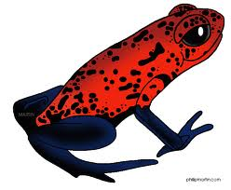
Title:
Table of Contents:
__________________...............Pg. 1
__________________...............Pg. 2
__________________...............Pg. 3
__________________...............Pg. 4
__________________...............Pg. 5
__________________...............Pg. 6
__________________...............Pg. 7
__________________...............Pg. 8
__________________...............Pg. 9
__________________.............Pg. 10
Researched By:
_________________

Slide 110
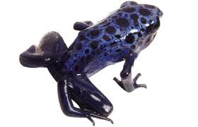
The Poison Arrow Frog
The Poison Arrow Frog
Poison Arrow Frogs live in the rainforests of Central and South America. They are usually found on the forest floor. They like to live near water. They spend most of their time on the forest floor near a stream.
Poison Arrow Tree Frogs eat small insects. They like to eat mostly ants. They also eat spiders. They use their sticky tongues to grab their prey.
Most Poison Arrow Frogs are only an inch long. They have a poison in their skin that is strong enough to kill anything that eats them. The bright colors of Poison Arrow Frogs warn other animals that they are dangerous to eat. There are many color variants based on geographic area. Most are black and either green or light blue with the black in bands or spots. The stripes or spots can range from blue, blue-green, green, yellow-green, or white.
Poison Arrow Frogs are in the amphibian animal group. They live on land and in water.
These frogs use their back long hind legs to take long jumps or hops.
Poison Arrow Frog babies are called tadpoles.
Poison Arrow Frogs are also called poison-dart frogs because some of the Amerindian tribes use their secretions to poison their darts. Not all arrow frogs are deadly, only 3 species are very dangerous to humans. The most deadly species to humans is the Phylobates terriblis. Its poison, batrachotoxin, can kill many small animals or humans. These frogs are found in Columbia along the western slopes of the Andes.
Arrow frogs are not poisonous in captivity. Scientists believe that these frogs gain their poison from a specific arthropod and other insects that they eat in the wild. These insects most likely acquire the poison from their plant diet.

Slide 111
The Poison Arrow Frog
The Poison Arrow Frog
Poison Arrow Frogs live in the rainforests of Central and South America. They are usually found on the forest floor. They spend most of their time on the forest floor near a stream.
Poison Arrow Tree Frogs eat small insects, ants, and spiders. They use their sticky tongues to grab their prey.
Most Poison Arrow Frogs are only an inch long. They have a poison in their skin that is strong enough to kill anything that eats them. The bright colors of Poison Arrow Frogs warn other animals that they are dangerous to eat.
Poison Arrow Frogs are in the amphibian animal group. They live on land and in water.
These frogs use their back long hind legs to take long jumps or hops.
Poison Arrow Frog babies are called tadpoles.
Poison Arrow Frogs are also called poison-dart frogs because some of the Amerindian tribes use their secretions to poison their darts
Arrow frogs are only poisonous in the wild. Scientists believe that these frogs gain their poison from other insects that they eat in the wild. These insects get the poison from a plant they eat.

Slide 112
The Poison Arrow Frog
The Poison Arrow Frog
Poison Arrow Frogs live in the rainforests of Central and South America on the forest floor.
They like to be close to water.
Poison Arrow Tree Frogs eat small insects, ants, and spiders.
Most Poison Arrow Frogs are 1 inch long.
They have a poison in their skin that is strong enough to kill anything that eats them.
Their bright colors scare other animals away.
They live on land and in water.
They use their back legs to take long jumps or hops.
Poison Arrow Frog babies are called tadpoles.
Arrow frogs are only poisonous in the wild.

Slide 113
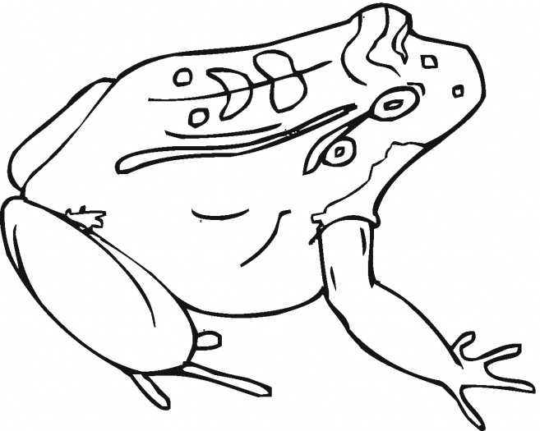
Diagram of the Poison Arrow Frog:

Slide 114
Poison Arrow Frogs
Can
have
are
_________________
_________________
_________________
_________________
_________________
_________________
_________________
_________________
_________________
_________________
_________________
_________________
_________________
_________________
_________________
_________________
_________________
_________________
_________________
_________________
_________________

Slide 115
Poison Arrow Frogs

Slide 116
Life Cycle of the Poison Arrow Frog:

Slide 117
Poison Arrow Frogs:
Habitat:
Life Span:
Interesting Fact:
Diet:

Slide 118
Poison Arrow Frogs
3 things I learned:
2 interesting facts :
1 question :

Slide 119
Poison Arrow Frogs
Live__________________________________.
Have _________________________________.
Are __________________________________.
Can __________________________________.
Eat __________________________________.
Always _______________________________.
Never ________________________________.

Slide 120
Poison Arrow Frog
____________
Both:

Slide 121
My Poison Arrow Frog Adventure Story!
______________________________________________________________________
______________________________________________________________________
______________________________________________________________________
______________________________________________________________________
______________________________________________________________________
______________________________________________________________________
______________________________________________________________________
______________________________________________________________________
______________________________________________________________________
______________________________________________________________________

Slide 122
Title:
Table of Contents:
__________________...............Pg. 1
__________________...............Pg. 2
__________________...............Pg. 3
__________________...............Pg. 4
__________________...............Pg. 5
__________________...............Pg. 6
__________________...............Pg. 7
__________________...............Pg. 8
__________________...............Pg. 9
__________________.............Pg. 10
Researched By:
_________________

Slide 123
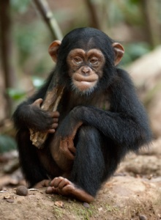
The Chimpanzee
The Chimpanzee
Chimps are mainly found in rainforests and wet savannas. While they spend equal time on land and in trees, they do most of their feeding and sleeping in the understory and canopy layers of the rainforest. In some areas chimps make nests on the forest floor.
Chimps are diurnal, beginning their activities at dawn. After descending from their night nests they hungrily feed on fruits, leaves, buds, and blossoms. They usually pick fruit with their hands, but they eat berries and seeds directly off the stem with their lips. Their diet consists of up to 80 different plant foods.
The chimpanzee has a thick body with long arms, short legs, and no tail. Much of the body is covered with long black hair, but the face, ears, fingers, and toes are bare. They have hands that can grip firmly, allowing them to pick up objects.
Chimps are mammals that live in groups called troops, which have from 30 to 80 members. These large groups are made up of smaller, very flexible groups of just a few animals, perhaps all females, all males, or a mixed group.
The chimps are quadrupedal, walking quickly on all fours with the fingers half-flexed to support the weight of the forequarters on the knuckles. They occasionally walk on two legs for short distances. Chimps are agile climbers and branch swingers.
The female chimp usually only gives birth to one baby. An infant monkey can sit up at 5 months and stand with support usually at 6 months. It sleeps with its mother until age 3. Finally, it becomes independent and separates from its mother at about 4 years of age.

Slide 124
The Chimpanzee
The Chimpanzee
Chimps are mainly found in rainforests and wet savannas. While they spend equal time on land and in trees, they do most of their feeding and sleeping in the understory and canopy layers of the rainforest. In some areas chimps make nests on the forest floor.
Chimps are diurnal (they are awake during the day). They feed on fruits, leaves, buds, and blossoms. They usually pick fruit with their hands, but they eat berries and seeds directly off the stem with their lips. Their diet consists of up to 80 different plant foods.
The chimpanzee has a thick body with long arms, short legs, and no tail. Much of the body has long black hair, but the face, ears, fingers, and toes are bare. They have hands that can grip firmly, allowing them to pick up objects.
Chimps are mammals that live in groups called troops, which have from 30 to 80 members.
The chimps are quadrupedal, walking quickly on all fours. They sometimes walk on two legs for short distances. Chimps are good climbers and branch swingers.
The female chimp usually only gives birth to one baby. An baby monkey can sit up at 5 months and stand with support usually at 6 months. It sleeps with its mother until age 3. It goes away from it’s mother at age 4.

Slide 125
The Chimpanzee
The Chimpanzee
Chimps are mainly found in savannas and in the understory and canopy layers of the rainforest.
Chimps are awake during the day and sleep at night.
They eat fruits, leaves, buds, and blossoms.
The chimpanzee has long arms and short legs.
They have no tail.
They have long black hair.
They can pick up things with their hands.
Chimps are mammals.
They live in groups called troops.
They walk on all four feet at the same time.
Chimps are good climbers and branch swingers.
The female chimp gives birth to one baby.

Slide 126
Diagram of the Chimpanzee:

Slide 127
Chimpanzees
Can
have
are
_________________
_________________
_________________
_________________
_________________
_________________
_________________
_________________
_________________
_________________
_________________
_________________
_________________
_________________
_________________
_________________
_________________
_________________
_________________
_________________
_________________

Slide 128
Chimpanzees

Slide 129
Life Cycle of the Chimpanzee:

Slide 130
Chimpanzees:
Habitat:
Life Span:
Interesting Fact:
Diet:

Slide 131
Chimpanzees
3 things I learned:
2 interesting facts :
1 question :

Slide 132
Chimpanzees
Live__________________________________.
Have _________________________________.
Are __________________________________.
Can __________________________________.
Eat __________________________________.
Always _______________________________.
Never ________________________________.

Slide 133
Chimpanzee
____________
Both:

Slide 134
My Chimpanzee Adventure Story!
______________________________________________________________________
______________________________________________________________________
______________________________________________________________________
______________________________________________________________________
______________________________________________________________________
______________________________________________________________________
______________________________________________________________________
______________________________________________________________________
______________________________________________________________________
______________________________________________________________________

Slide 135
Title:
Table of Contents:
__________________...............Pg. 1
__________________...............Pg. 2
__________________...............Pg. 3
__________________...............Pg. 4
__________________...............Pg. 5
__________________...............Pg. 6
__________________...............Pg. 7
__________________...............Pg. 8
__________________...............Pg. 9
__________________.............Pg. 10
Researched By:
_________________

Slide 136
The Butterfly
The Butterfly
Butterflies hide in the highest layers of the rainforest – the canopy and emergent layers.
Adult butterflies do not eat – they only drink! They sip liquids from the flowers, juice from rotten fruit, and may even drink sweat and liquid animal waste. When a butterfly’s feet come in contact with a sweet liquid, its feeding tube unfolds.
Butterflies are cold blooded. They are often brightly colored on top to attract mates or warn predators to stay away. The bottom of their wings may be camouflage. A butterfly has compound eyes. Each eye is made up of about 6.000 tiny parts (lenses), which let in light and allows them to see ultraviolet light, which is invisible to humans. This guides them to the nectar tubes on flowers.
There are about 20,000 species of this insect. Female butterflies are usually bigger and live longer than males. The female butterfly gives off a scent that the male butterfly can smell.
Butterflies weigh only as much as two rose petals, but they can fly thousands of miles. When it is cloudy or night, the adult butterfly rests by hanging upside down from leaves or twigs.
Butterflies typically lay their eggs in late spring and hatch 3-6 days after they are laid. It takes 3-4 weeks to turn into a caterpillar and 9-14 days to emerge as a butterfly. Most butterflies live 20 to 40 days.

Slide 137
The Butterfly
The Butterfly
Butterflies hide in the highest layers of the rainforest – the canopy and emergent layers.
Adult butterflies do not eat – they only drink! They sip liquids from the flowers, juice from rotten fruit, and may even drink sweat and liquid animal waste. A butterfly uses a feeding tube to drink.
They are often brightly colored on top to attract mates or warn predators to stay away. The bottom of their wings may be camouflage. A butterfly has compound eyes. Each eye is made up of about 6.000 tiny parts (lenses).This shows them to the nectar tubes on flowers.
There are about 20,000 kinds of butterflies. Female butterflies are usually bigger and live longer than males. .
Butterflies weigh only as much as two rose petals, but they can fly thousands of miles. When it is cloudy or night, the adult butterfly rests by hanging upside down from leaves or twigs.
Butterflies typically lay their eggs in late spring and hatch 3-6 days after they are laid. It takes 3-4 weeks to turn into a caterpillar and 9-14 days to emerge as a butterfly. Most butterflies live 20 to 40 days.

Slide 138
The Butterfly
The Butterfly
Butterflies hide in the highest layers of the rainforest – the canopy and emergent layers.
Adult butterflies do not eat – they only drink!
A butterfly uses a feeding tube to drink.
Butterflies can be a lot of colors. They can scare away animals or hide (camouflage) in a plant.
A butterfly has compound eyes.
There are about 20,000 kinds of butterflies.
Butterflies weigh very little, but they can fly a long way.
They sleep by hanging upside down from leaves or twigs.
Butterflies lay eggs that turn into caterpillars.

Slide 139
Diagram of the Butterfly:

Slide 140
Butterflies
Can
have
are
_________________
_________________
_________________
_________________
_________________
_________________
_________________
_________________
_________________
_________________
_________________
_________________
_________________
_________________
_________________
_________________
_________________
_________________
_________________
_________________
_________________

Slide 141
Butterflies

Slide 142
Life Cycle of the Butterfly:

Slide 143
Butterflies:
Habitat:
Life Span:
Interesting Fact:
Diet:

Slide 144
Butterflies
3 things I learned:
2 interesting facts :
1 question :

Slide 145
Butterflies
Live__________________________________.
Have _________________________________.
Are __________________________________.
Can __________________________________.
Eat __________________________________.
Always _______________________________.
Never ________________________________.

Slide 146
Butterfly
____________
Both:

Slide 147
My Butterfly Adventure Story!
______________________________________________________________________
______________________________________________________________________
______________________________________________________________________
______________________________________________________________________
______________________________________________________________________
______________________________________________________________________
______________________________________________________________________
______________________________________________________________________
______________________________________________________________________
______________________________________________________________________

Slide 148
Title:
Table of Contents:
__________________...............Pg. 1
__________________...............Pg. 2
__________________...............Pg. 3
__________________...............Pg. 4
__________________...............Pg. 5
__________________...............Pg. 6
__________________...............Pg. 7
__________________...............Pg. 8
__________________...............Pg. 9
__________________.............Pg. 10
Researched By:
_________________

Slide 149
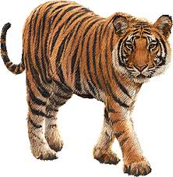
The Bengal Tiger
The Bengal Tiger
The Bengal tiger is native to the rainforests of India, Bangledesh, and Nepal. They live and hunt on the forest floor.
These animals are hunters who prey on other animals, which means they are carnivores. They are nocturnal hunters who prey on animals such as buffalo, deer, and wild pigs. A hungry tiger can eat up to 60 pounds in one night, although they usually eat much less.
These animals travel along. They lay quietly as they wait for prey. When they spot prey, they creep slowly until they are close enough to the animal. Then, they pounce quickly to attack their prey.
Bengal tigers use their striped fur coat as camouflage. No two Bengal tigers have the same stripes. They are known for their power and strength.
Bengal tigers belong to the mammal group. They are the most common type of tiger. However, they are an endangered species. Over the past 100 years, deforestation has reduced their population to fewer than 2,000.
Female tigers give birth to litters of two to six cubs, which they raise with little or no help from the male. Cubs cannot hunt until they are 18 months old. They remain with their mothers until they are 2 or 3 years old. After this time, they disperse to find their own territory.

Slide 150
The Bengal Tiger
The Bengal Tiger
The Bengal tiger is native to the rainforests of India, Bangledesh, and Nepal. They live and hunt on the forest floor.
They are nocturnal hunters who prey on animals such as buffalo, deer, and wild pigs. A hungry tiger can eat up to 60 pounds in one night, although they usually eat much less.
These animals travel along. They lay quietly as they wait for prey. When they spot prey, they creep slowly until they are close enough to the animal. Then, they pounce quickly to attack their prey.
Bengal tigers use their striped fur coat as camouflage. No two Bengal tigers have the same stripes. They are known for their power and strength.
Bengal tigers belong to the mammal group. They are the most common type of tiger. However, they are an endangered species with only 2,000 left in the world.
Female tigers give birth to litters of two to six cubs, which they raise with little or no help from the male. Cubs cannot hunt until they are 18 months old. They remain with their mothers until they are 2 or 3 years old.

Slide 151
The Bengal Tiger
The Bengal Tiger
The Bengal tiger lives in the rainforests of India, Bangledesh, and Nepal on the forest floor.
They hunt at night time.
They eat buffalo, deer, and wild pigs.
A hungry tiger can eat up to 60 pounds in one night.
They jump to get their prey.
Bengal tigers have striped fur.
There are only 2,000 tigers left in the world.
Tigers have 2 to 6 cubs.
They have a long tail and big paws.

Slide 152
Diagram of the Bengal Tiger:

Slide 153
Bengal Tigers
Can
have
are
_________________
_________________
_________________
_________________
_________________
_________________
_________________
_________________
_________________
_________________
_________________
_________________
_________________
_________________
_________________
_________________
_________________
_________________
_________________
_________________
_________________

Slide 154
Bengal Tigers

Slide 155
Life Cycle of the Bengal Tiger:

Slide 156
Bengal Tigers:
Habitat:
Life Span:
Interesting Fact:
Diet:

Slide 157
Bengal Tigers
3 things I learned:
2 interesting facts :
1 question :

Slide 158
Bengal Tigers
Live__________________________________.
Have _________________________________.
Are __________________________________.
Can __________________________________.
Eat __________________________________.
Always _______________________________.
Never ________________________________.

Slide 159
Bengal Tigers
____________
Both:

Slide 160
My Bengal Tiger Adventure Story!
______________________________________________________________________
______________________________________________________________________
______________________________________________________________________
______________________________________________________________________
______________________________________________________________________
______________________________________________________________________
______________________________________________________________________
______________________________________________________________________
______________________________________________________________________
______________________________________________________________________

Slide 161
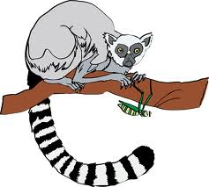
Title:
Table of Contents:
__________________...............Pg. 1
__________________...............Pg. 2
__________________...............Pg. 3
__________________...............Pg. 4
__________________...............Pg. 5
__________________...............Pg. 6
__________________...............Pg. 7
__________________...............Pg. 8
__________________...............Pg. 9
__________________.............Pg. 10
Researched By:
_________________

Slide 162
The Lemur
The Lemur
Lemurs live on Madagascar, an island near Africa. They live in the canopy layer of the rainforest. They can usually be seen sitting in the trees up in the top of the rainforests. They rarely come down from the canopy.
The majority of lemurs are diurnal, awake during the day and asleep at night – especially those that live in groups, including the ring-tailed lemurs, brown lemurs, and sifakas. The smaller mouse lemurs and dwarf lemurs, are nocturnal, preferring to be active in the relative safety of nighttime darkness. The aye-aye, a fascinating lemur with an elongated, claw-like middle finger which it uses to dig insects out of tree bark, is also nocturnal, and is often feared by the Malagasy people of its native Madagascar because of its unusual appearance.
Unlike some other primates, lemurs do not have prehensile tails (they cannot hang by their tails from trees like monkeys) but they do have long, wet noses. Lemurs have a keen sense of smell and they also have good vision, even at night. Their thumbs and big toes are opposable (They can touch their other fingers and toes), but they mainly use their teeth and an extended “toilet claw” on the second toe of their hind feet for grooming.
Lemur females are dominant. A group of lemurs usually has one dominant female who leads the group, controls their movement, and has first choice of food and mates.
Lemurs eat fruit, leaves, sometimes small animals, and other edible plant materials. Insects may also be on the menu, especially for the smaller lemurs.

Slide 163
The Lemur
The Lemur
Lemurs live on Madagascar, an island near Africa. They live in the canopy layer of the rainforest and like to be up in the tree tops.
Most lemurs are diurnal, awake during the day and asleep at night. The smaller mouse lemurs and dwarf lemurs are nocturnal (they like to be awake at night). The aye-aye, a lemur with a claw-like middle finger which it uses to dig insects out of tree bark, is also nocturnal. People are scared of it because of the way it looks.
Unlike some other primates, lemurs do not have prehensile tails (they cannot hang by their tails from trees like monkeys) but they do have long, wet noses. Lemurs can smell well and they can also see well, even at night. Their thumbs and big toes can grip things, but they mainly use their teeth and a long “toilet claw” on the second toe of their hind feet for grooming.
Lemur females are dominant. A group of lemurs usually has one dominant female who leads the group, shows them where to go, and has first choice of food and mates.
Lemurs eat fruit, leaves, sometimes small animals, and other plants. Smaller lemurs enjoy eating insects too!

Slide 164
The Lemur
The Lemur
Lemurs live on Madagascar, an island near Africa.
They live in tree tops in the canopy layer.
Most lemurs are awake in the day and asleep at night. (Diurnal)
The smaller lemurs like to be awake at night. (Nocturnal)
Lemurs can dig bugs out of tree bark with a long middle finger.
People are scared of it because of the way it looks.
Lemurs cannot hang by their tails from trees like monkeys.
Lemurs have long, wet noses.
Lemurs can smell well and they can also see well, even at night.
Their thumbs and big toes can grip things.
Lemurs use their teeth and a long “toilet claw” for cleaning their fur.
One girl lemur leads the group, shows them where to go, and chooses her food and mates.
Lemurs eat fruit, leaves, insects, small animals, and other plants.

Slide 165
Diagram of the Lemur:

Slide 166
Lemurs
Can
have
are
_________________
_________________
_________________
_________________
_________________
_________________
_________________
_________________
_________________
_________________
_________________
_________________
_________________
_________________
_________________
_________________
_________________
_________________
_________________
_________________
_________________

Slide 167
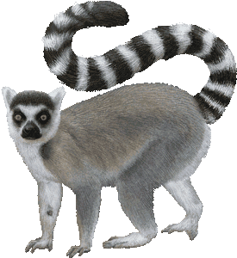
Lemurs

Slide 168
Life Cycle of the Lemur:

Slide 169
Lemurs:
Habitat:
Life Span:
Interesting Fact:
Diet:

Slide 170
Lemurs:
3 things I learned:
2 interesting facts :
1 question :

Slide 171
Lemurs
Live__________________________________.
Have _________________________________.
Are __________________________________.
Can __________________________________.
Eat __________________________________.
Always _______________________________.
Never ________________________________.

Slide 172
Lemur
____________
Both:

Slide 173
My Lemur Adventure Story!
______________________________________________________________________
______________________________________________________________________
______________________________________________________________________
______________________________________________________________________
______________________________________________________________________
______________________________________________________________________
______________________________________________________________________
______________________________________________________________________
______________________________________________________________________
______________________________________________________________________

