Slide 1
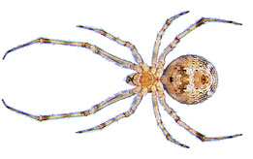
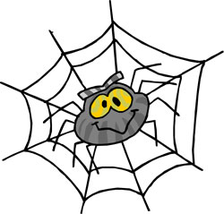
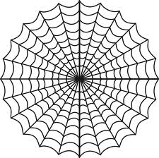
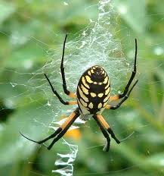
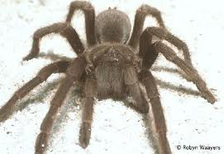
Scary spiders
By kieran king

Slide 2
1 deos not look like a real picshr.i have ner seen 1 of teos spiders.1 is brawn and big.all spiders have 8 legs.

Slide 3
I dot rile like spiders.i have seen a black wido.the black wido wus vary big.
Notes:
I dot rile like spiders.i have seen a black wido.the black wido wus vary big.

