Slide 1
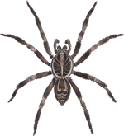
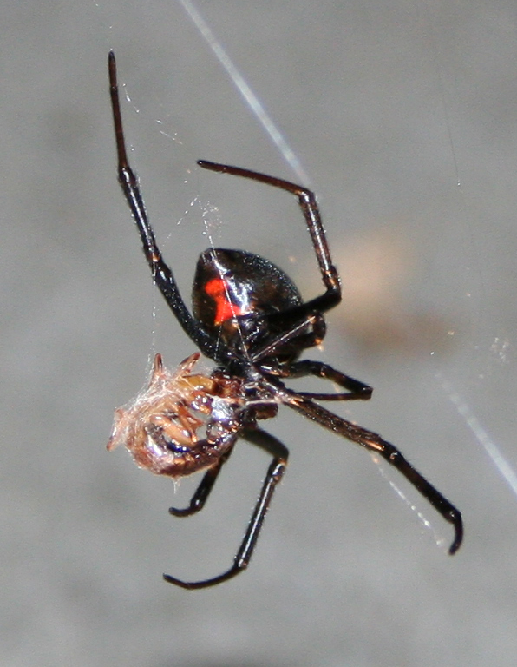
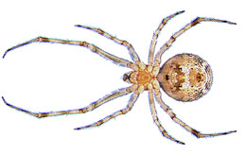
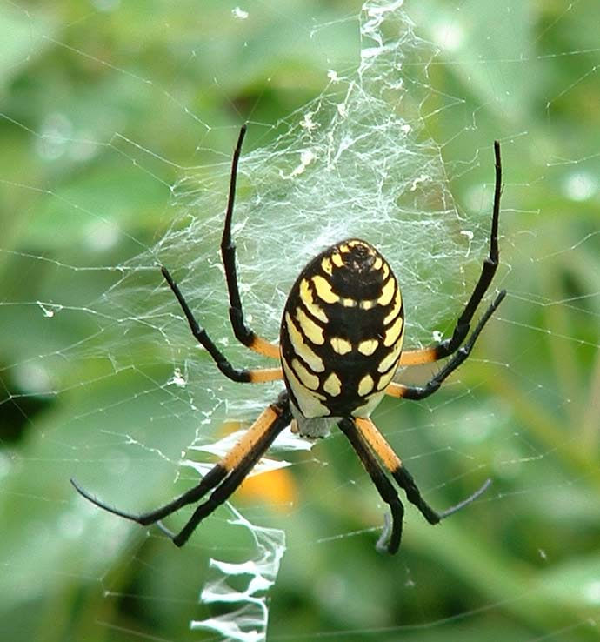
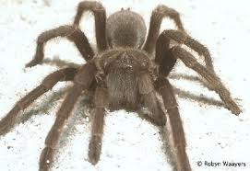
Scary spiders
By Stella Andrews

Slide 2
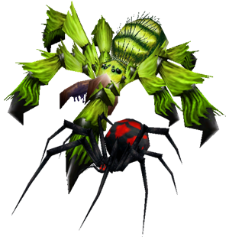
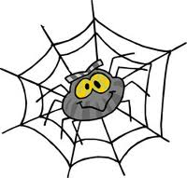
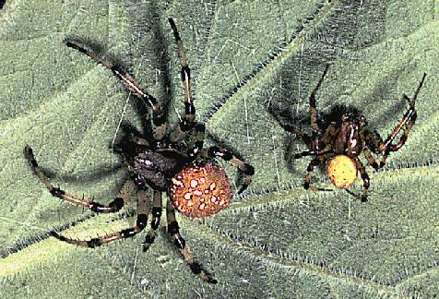
All about spiders
By Stella Andrews
Spiders have 8 legs

Slide 3
Scary spiders
By Stella Andrews
Some people are afraid of spiders.

Slide 4
Sticky spiders
Some spiders are sticky

Slide 5
spiders to the rescue
When spiders have babies they die
Spiders catch food in webs
Notes:
I have seen a blackwidow.

Slide 6
Scary spiders
By stella andrews
By stella andrews

Slide 7
Fun spiders
By Stella Andrews

