Slide 1
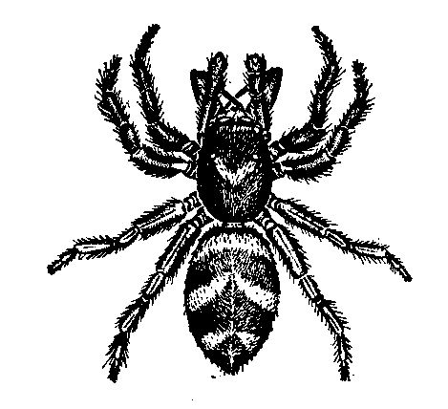
spider7
deon

Slide 2
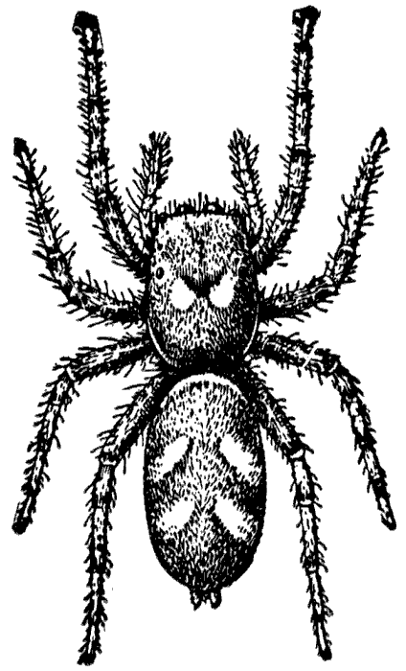
Some peple are skard of spiders.

Slide 3
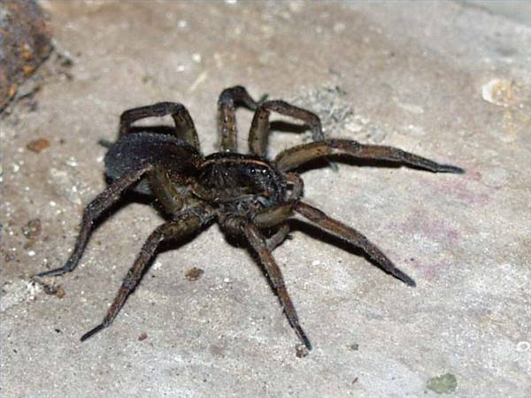
Spiders have 8 legs

Slide 4
Spiders make webs owt of sillk

