Slide 1
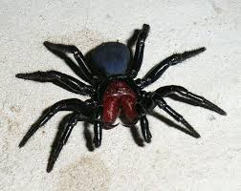
SPIDER FACTS.
BY RACHAEL

Slide 2
HUMANS AND SPIDERS ARE ENEMIES.

Slide 3
THAIR ARE MORE THAN 100 SPIDERS IN THE WORLD.

Slide 4
BLACK WIDOW SPIDERS HAVE A SCRON BITE.

Slide 5
BLACK WIDOW SPIDERS WILL LAY UP TO 400 EGGS AT A TIME.

Slide 6
SPIDERS ARE RILY CREEPY CREECHERS.

Slide 7
SPIDERS HAVE 8 LEGS.

Slide 8
SPIDERS ARE ASOME.

