Slide 1
Spiders 10000
By noah

Slide 2
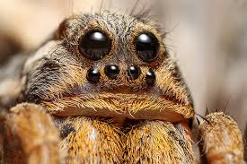
Spiders are cool

Slide 3
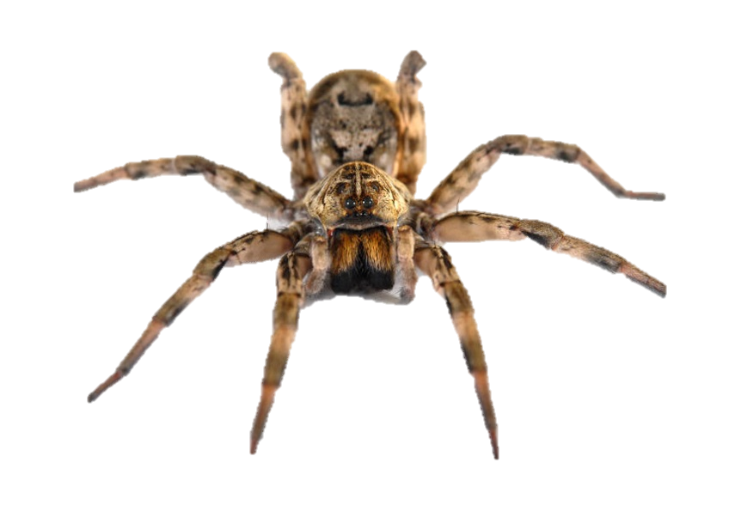
Thay have 8 lagse

Slide 4
Some spidrs are hoomins

Slide 5
h

