Slide 1
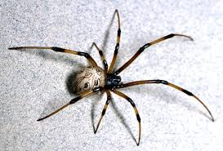
spiders
by Noah c

Slide 2
Some spiders are poizinis.

Slide 3
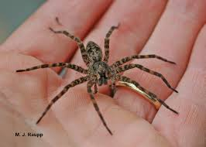
Some spiders are cool.

Slide 4
Some spiders are kind of grose.

Slide 5
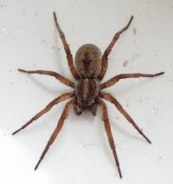
Some spiders have big legs.

Slide 6
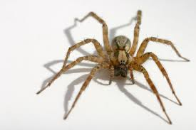
Spiders are the best!

