Slide 1
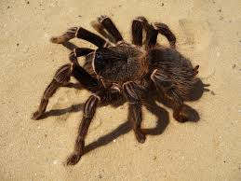
Spiders crechrs!
By samuel

Slide 2
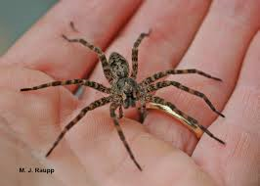
Spiders how do not make webs are huntrs.

Slide 3
The black spiders can go in snow.

Slide 4
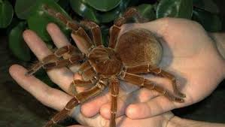
Spiders have 48 nese.

