Slide 1
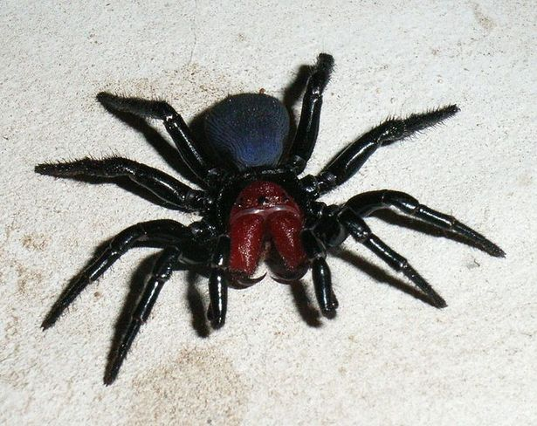
Spiders facts.
Daniel b.

Slide 2
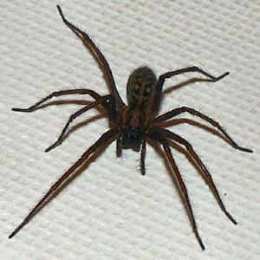
Spiders are kl.

Slide 3
Spiders make webs.

Slide 4
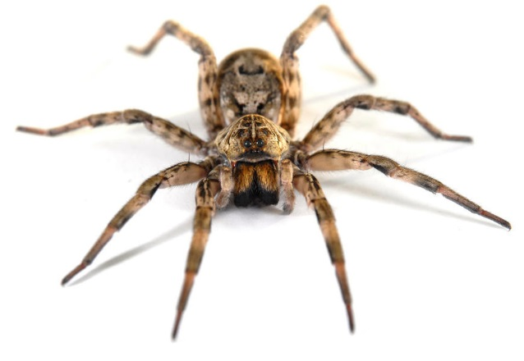
Spiders can eat.

Slide 5
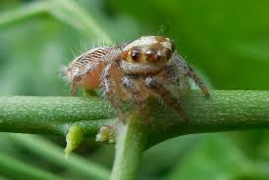
Spidders kan krol on the grane.

Slide 6
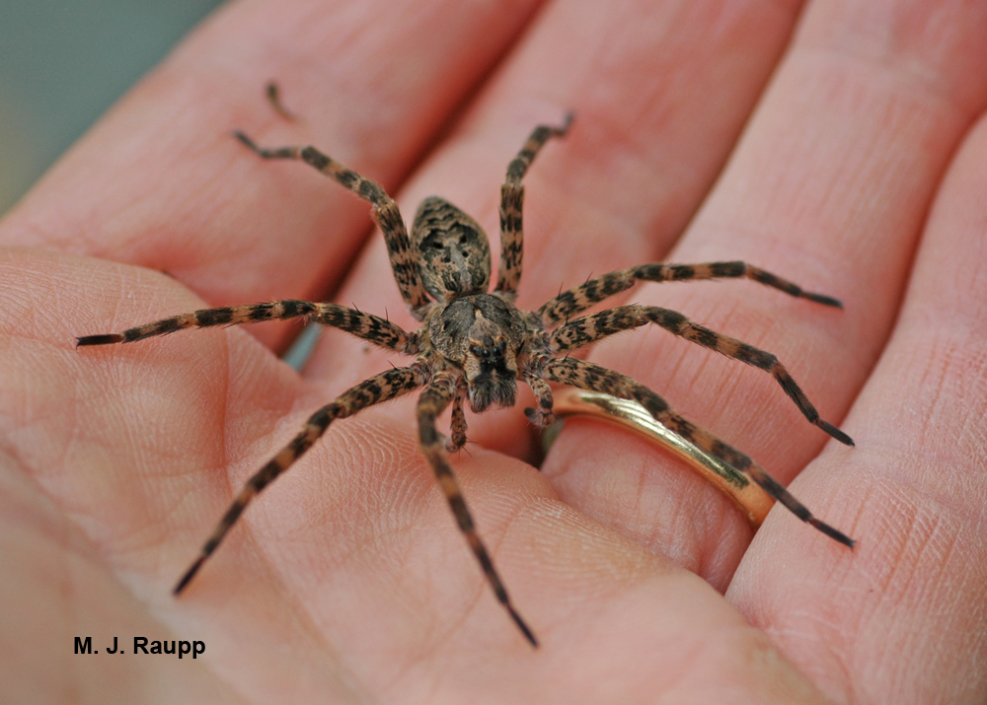
spiders have 8 lags.

Slide 7
Spiders kad lok pot 1.

Slide 8
Spiders are cool.

