Slide 1
Spiders are best.

Slide 2
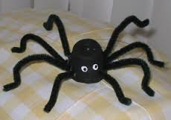
Spiders have 8 eyes.

Slide 3
Spiders have 8 eyes.

Slide 4
Spiders are arachs.

Slide 5
Spiders can jump 10 yrds.

