Slide 1
Spiders are cool.

Slide 2
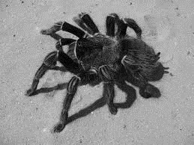
spiders hoo don’t make webs

Slide 3
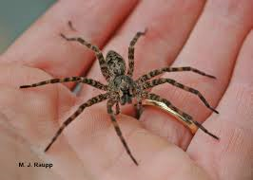
are huts

