Slide 1
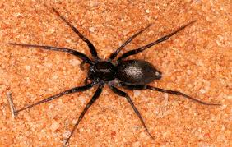
Spiders
by; Arjun

Slide 2
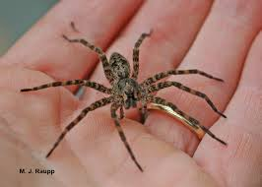
Few spiders can spin webs.

Slide 3
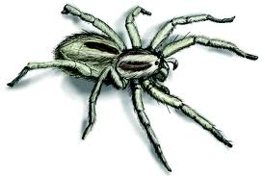
Spiders belong to a group of animals called arachunets.

Slide 4
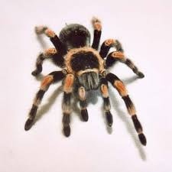
Spiders do not have skeletens in their bodies.

Slide 5
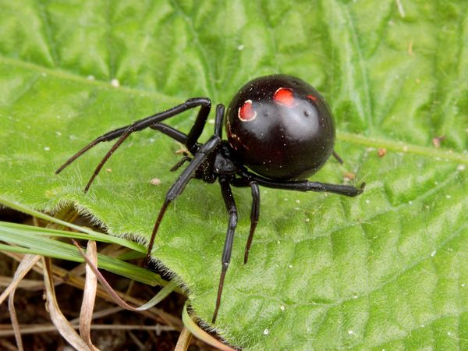
The second part of the body is the tummy.

Slide 6
Spiders are awesome!

