Slide 1
Spiders By ryan

Slide 2
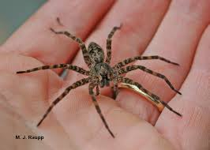
Spiders can eat bugs.

Slide 3
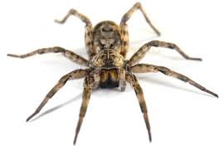
Spirdr is creepy.

Slide 4
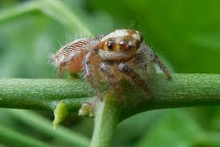
IamREPE.

Slide 5
,TI656U5 MT 4OP2V302UM5TV90V9U5TBG5MOI07G054,B7B0BF9IB,97]--SERAA U2THHUT- H4 [PT

Slide 8
I

