Slide 1
Logan wdfl spidrs
logan

Slide 2
=-
Spidders eat.

Slide 3
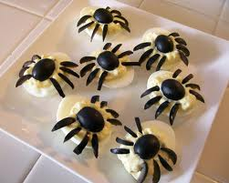
l
Some spiders are hunter .

Slide 4
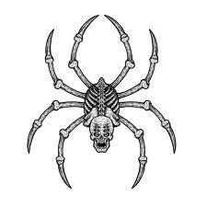
Spider are big.

