Slide 1
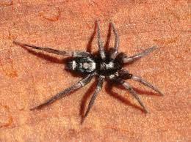
Spider facts
By nina

Slide 2
Spiders are arachn ids.

Slide 3
The are more than 30 000.

Slide 4
Dose spot grawing.

Slide 5
Spiders have ole has ole to stic to webs.

Slide 6
spiders are cool.

Slide 7
Spider are crepe.

