Slide 1
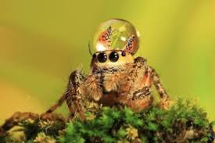
SPIDERS\
BY SARA

Slide 2
SPIDERS ARE ARACHNIDS NOT INSECTS.

Slide 3
Spiders are scery crechers.

Slide 4
Some of the spiders have four eyes.

Slide 5
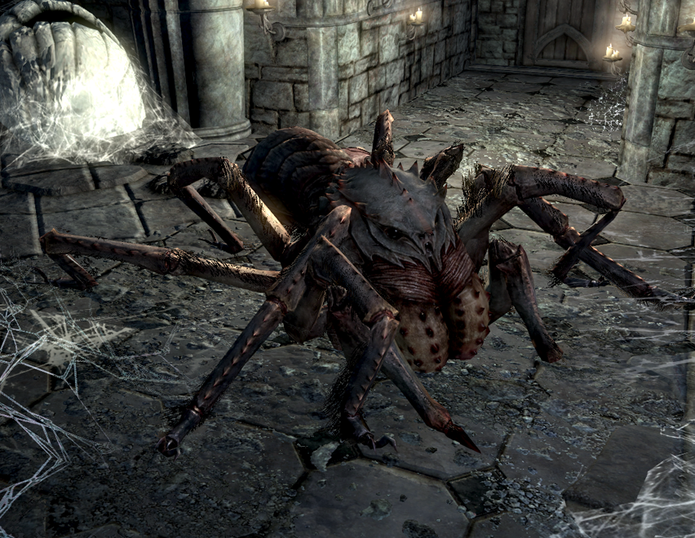
THEY ARE COOL AND AWESOME.

Slide 6
SOME SPIDERS ARE POISINIS.

Slide 7
SPIDERS ARE SMALL AND BIG.

Slide 8
THERE ARE TUNS OF SPIDERS.

