Slide 1
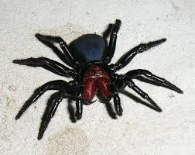
Spiters are relly cool
By NATALIE

Slide 2
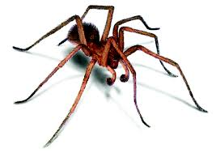
Spiders have tow body,s.

Slide 3
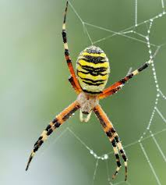
Evry spiter has fags.

Slide 4
Spiters belog in a grop uv anumols cold uracknits.

Slide 5
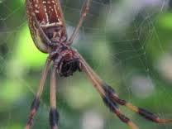
All spiders do not spin webs

Slide 6
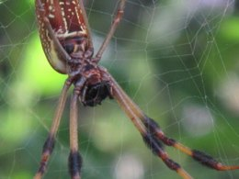
Some spiders spin webs

Slide 7
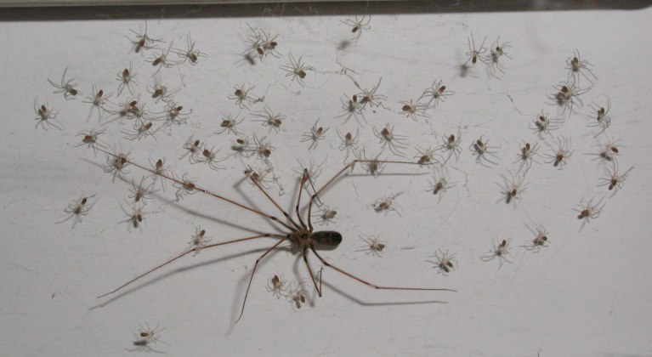
Some spiders spin webs.

Slide 8
Spiders that do not spin webs get food

Slide 10
Spiders do not have a skeloton

