Slide 1
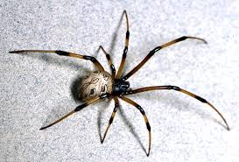
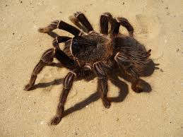
The big book of spiders byshazia

Slide 2
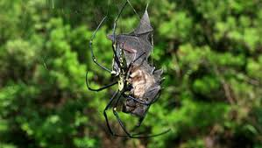
Spiders have 2 segments

Slide 3
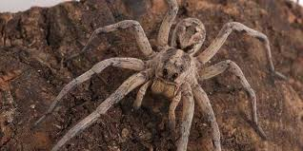
Male spiders are smaller then female spiders

Slide 4
Spiders do not have a skeloton

Slide 5
They have a shell

Slide 6
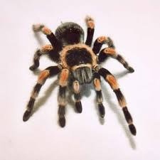
They have 48 knees

Slide 7
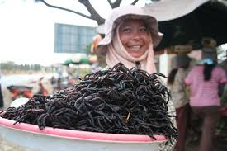
So yong spiders need to molt

Slide 8
Spiders legs are cverd with hair

Slide 9
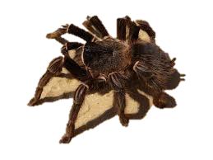
The spider has oil in its body

Slide 10
the front is called cephalothorx

Slide 11
Males are smarter then females

